Slide 1


Information for Fellows
2020-2021

Slide 2
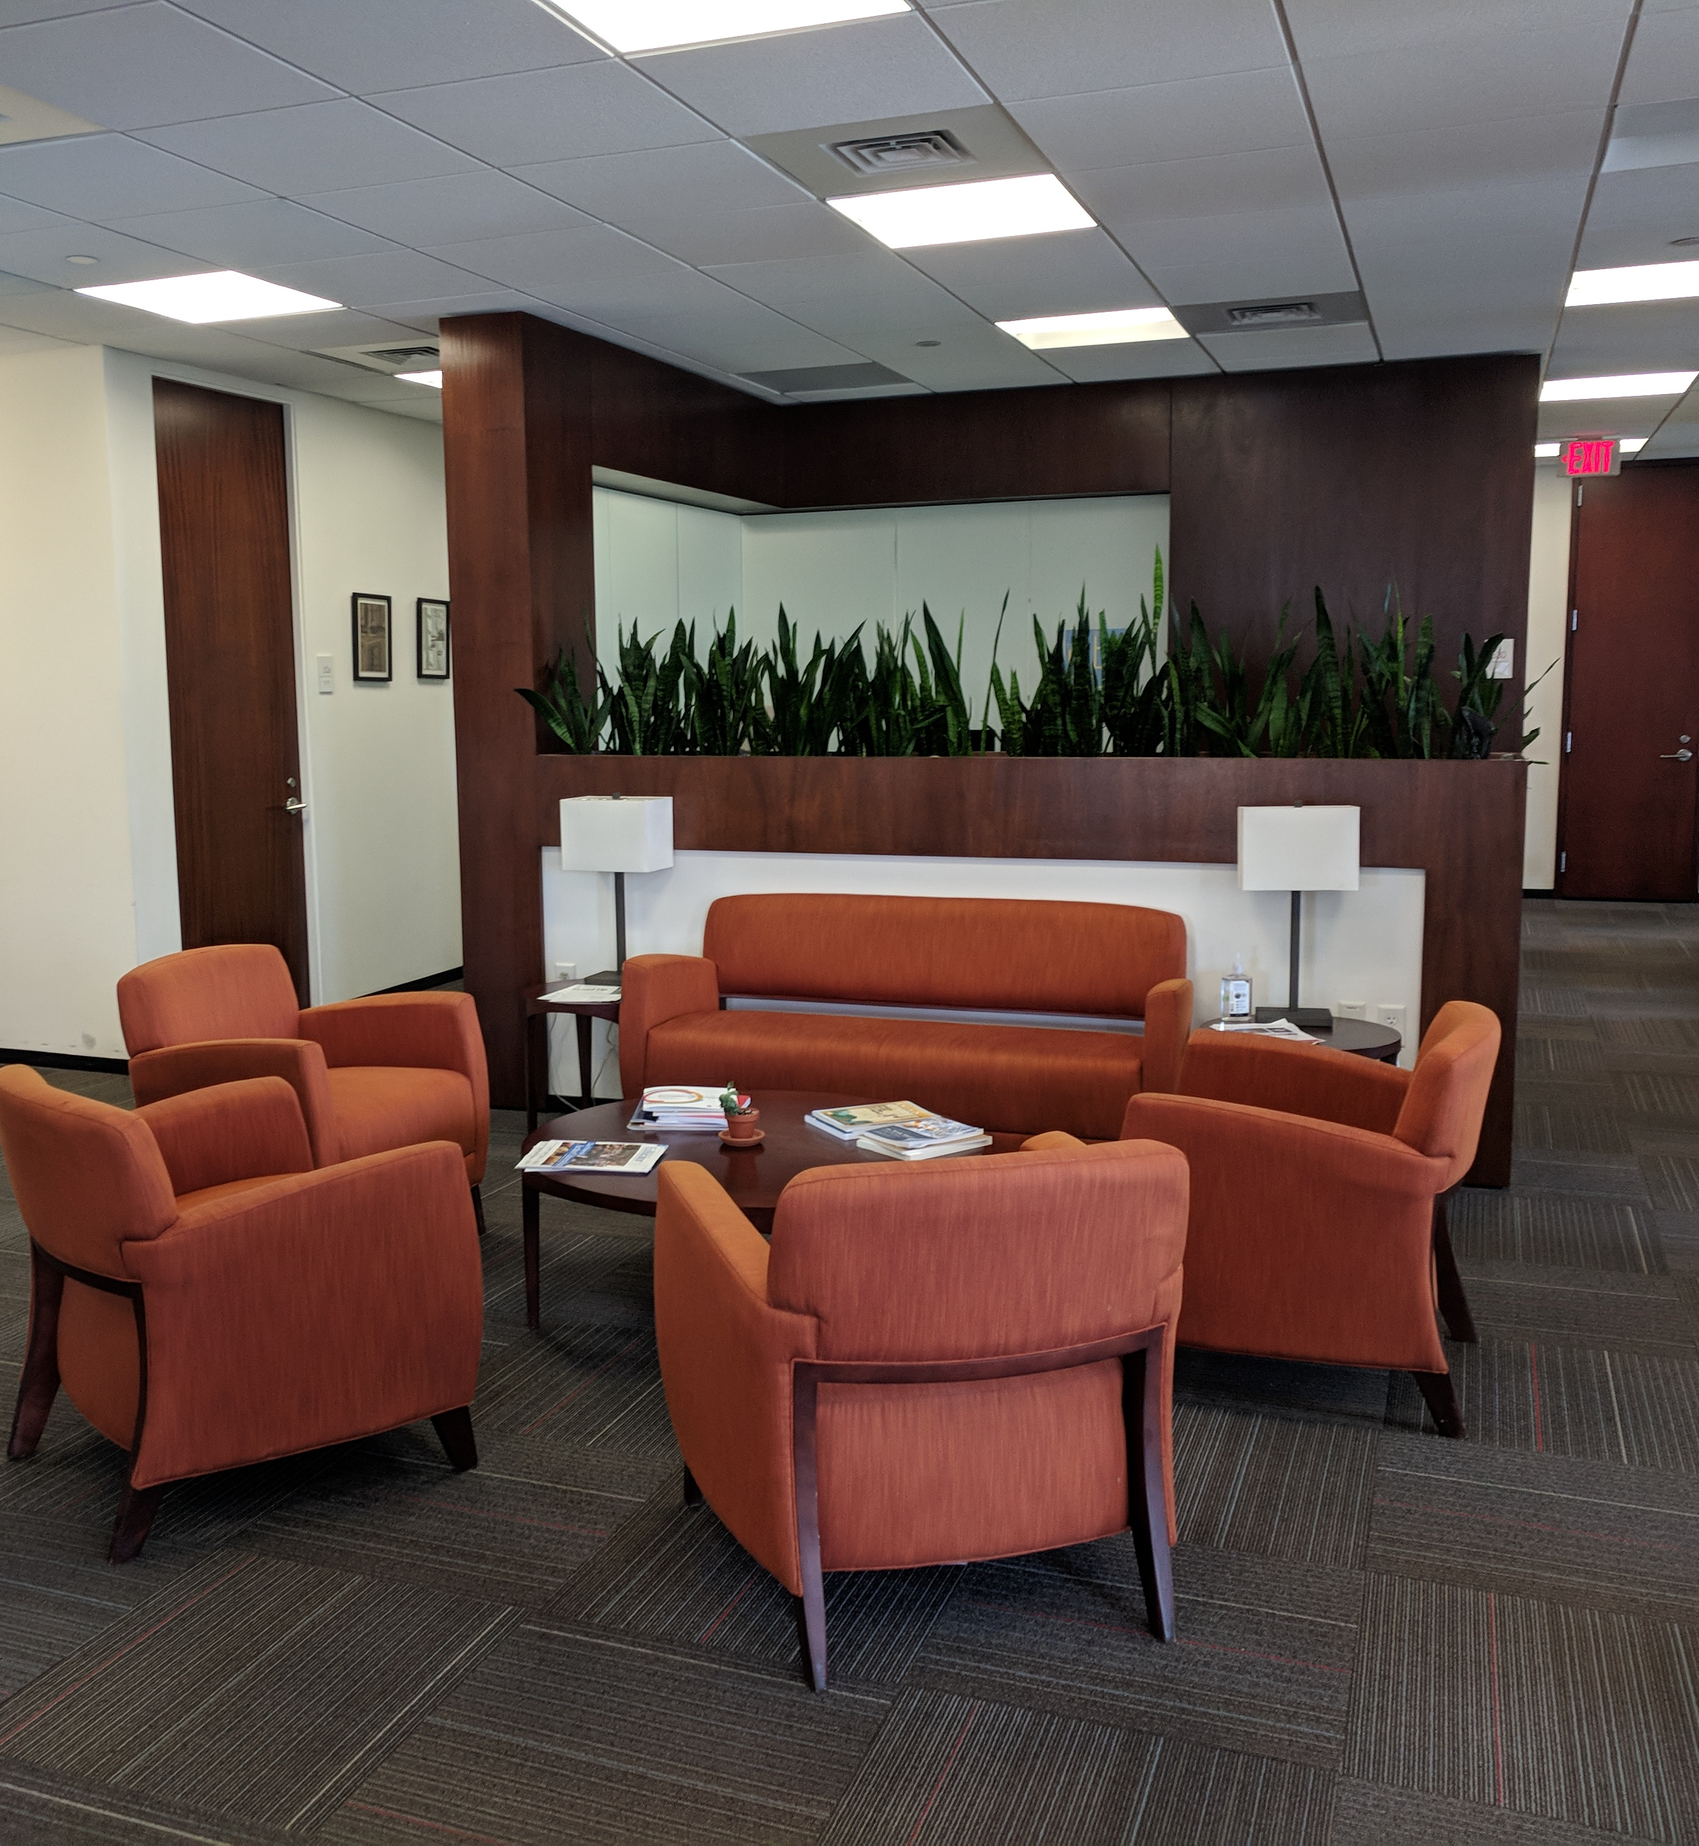
Contents
  Connecting with Each Other
  Orientation to the Center
  Information on Harvard Resources

Slide 3

Connecting with Each Other

Slide 4

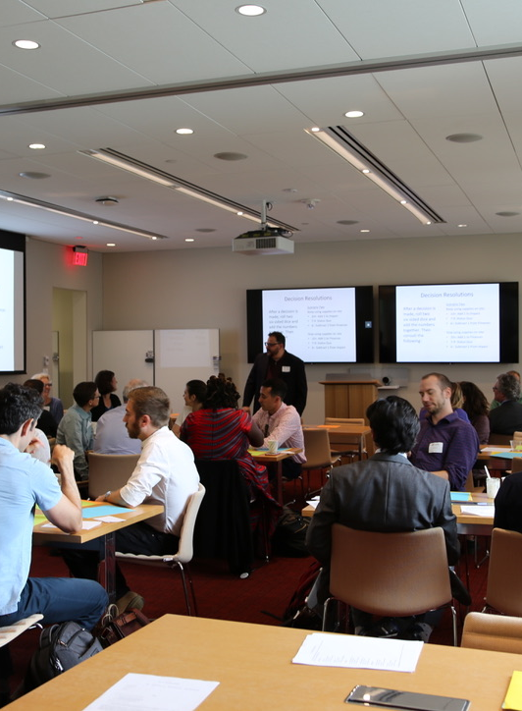
Seminars
Creating a Cohort Experience in a Virtual World:
Events Planned by Social Chairs
Icebreaker.video
"Walk and talk" events with random match
Fellow-driven Reading Groups
Fellow-driven Ethics Mondays
Office hours?

Slide 5
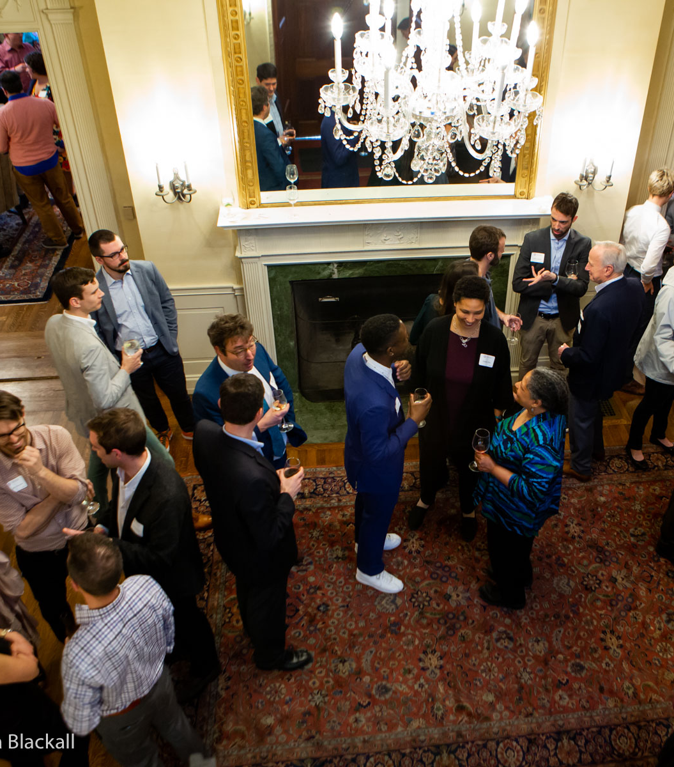
Orientation to the
Center

Slide 6
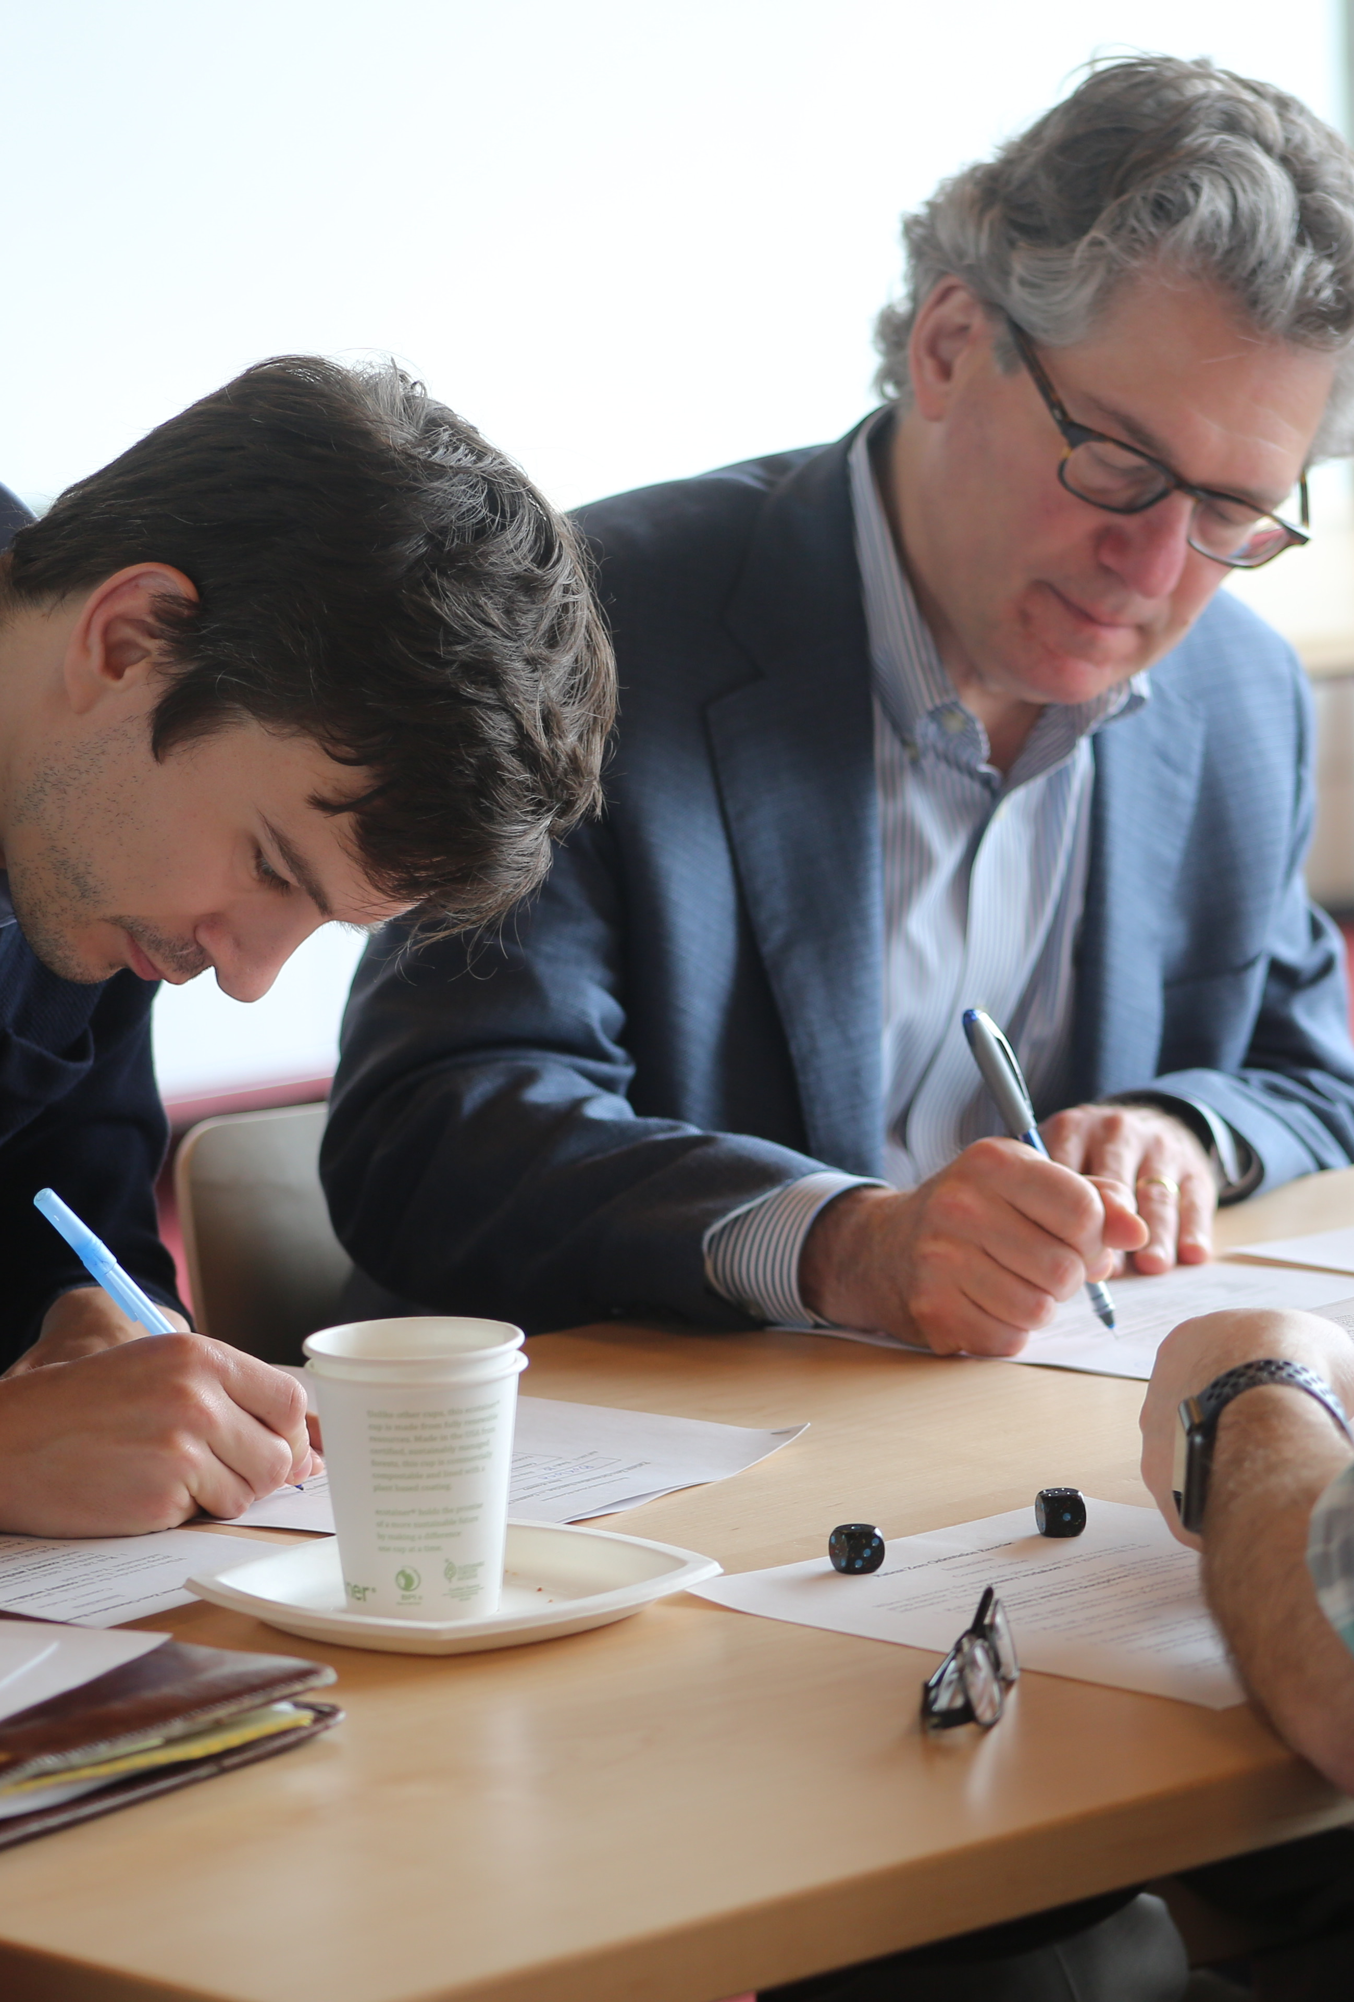
Mission
The Edmond J. Safra Center for Ethics seeks to strengthen teaching and research about pressing ethical issues; to foster sound norms of ethical reasoning and civic discussion; and to share the work of our community in the public interest.
https://ethics.harvard.edu/

Slide 7
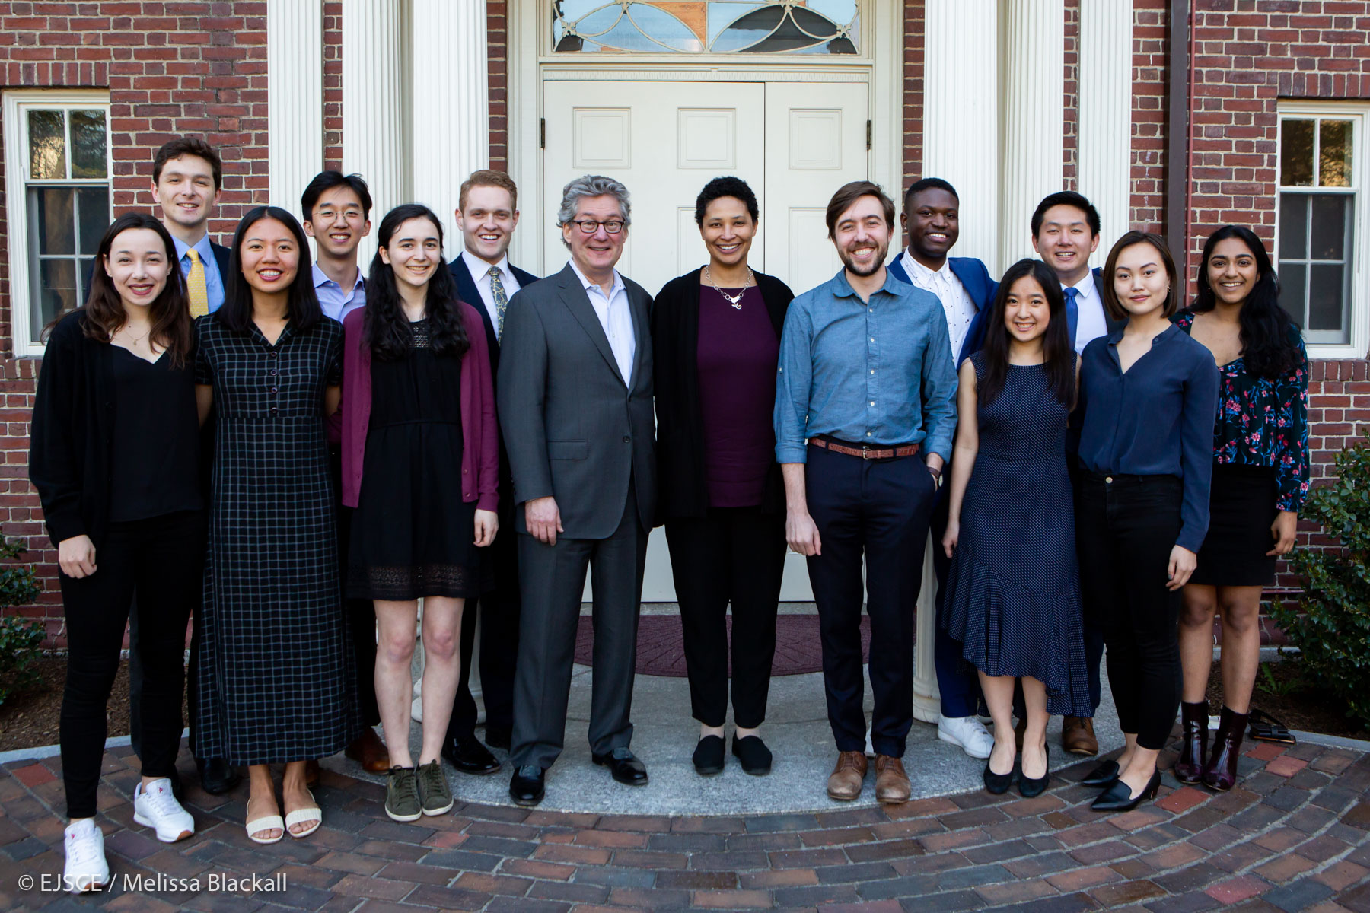
Fellowships Offered
Faculty / Fellows-in-Residence
Tel Aviv University Exchange Fellows
Graduate Fellows
Ethics Pedagogy Fellows
Undergraduate Fellows
Visiting Fellows
2019's graduating senior Undergraduate Fellows

Slide 8
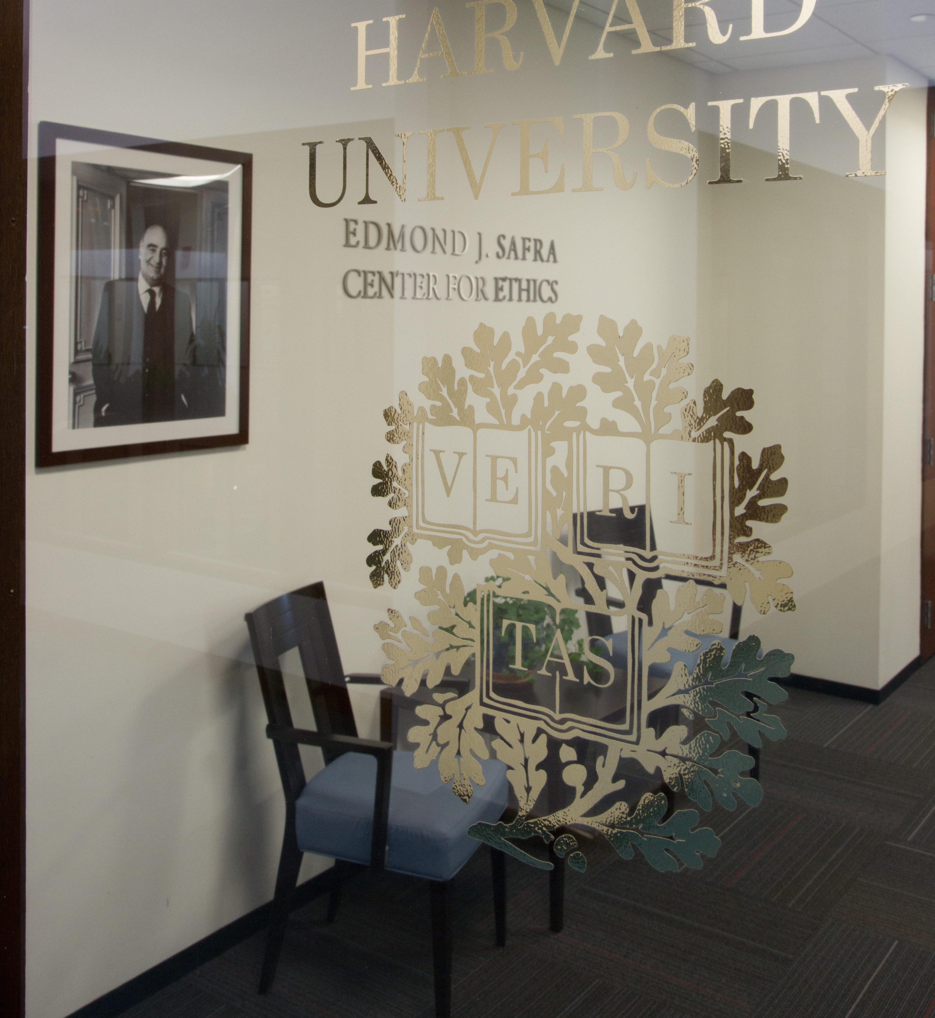
Naming Convention for Public Use
  Edmond J. Safra Center
  Center for Ethics
  EJ Safra Center
  EJS Center
  NEVER just "Safra Center"
  Fine to mention Center affiliation on publications but not required

Slide 9
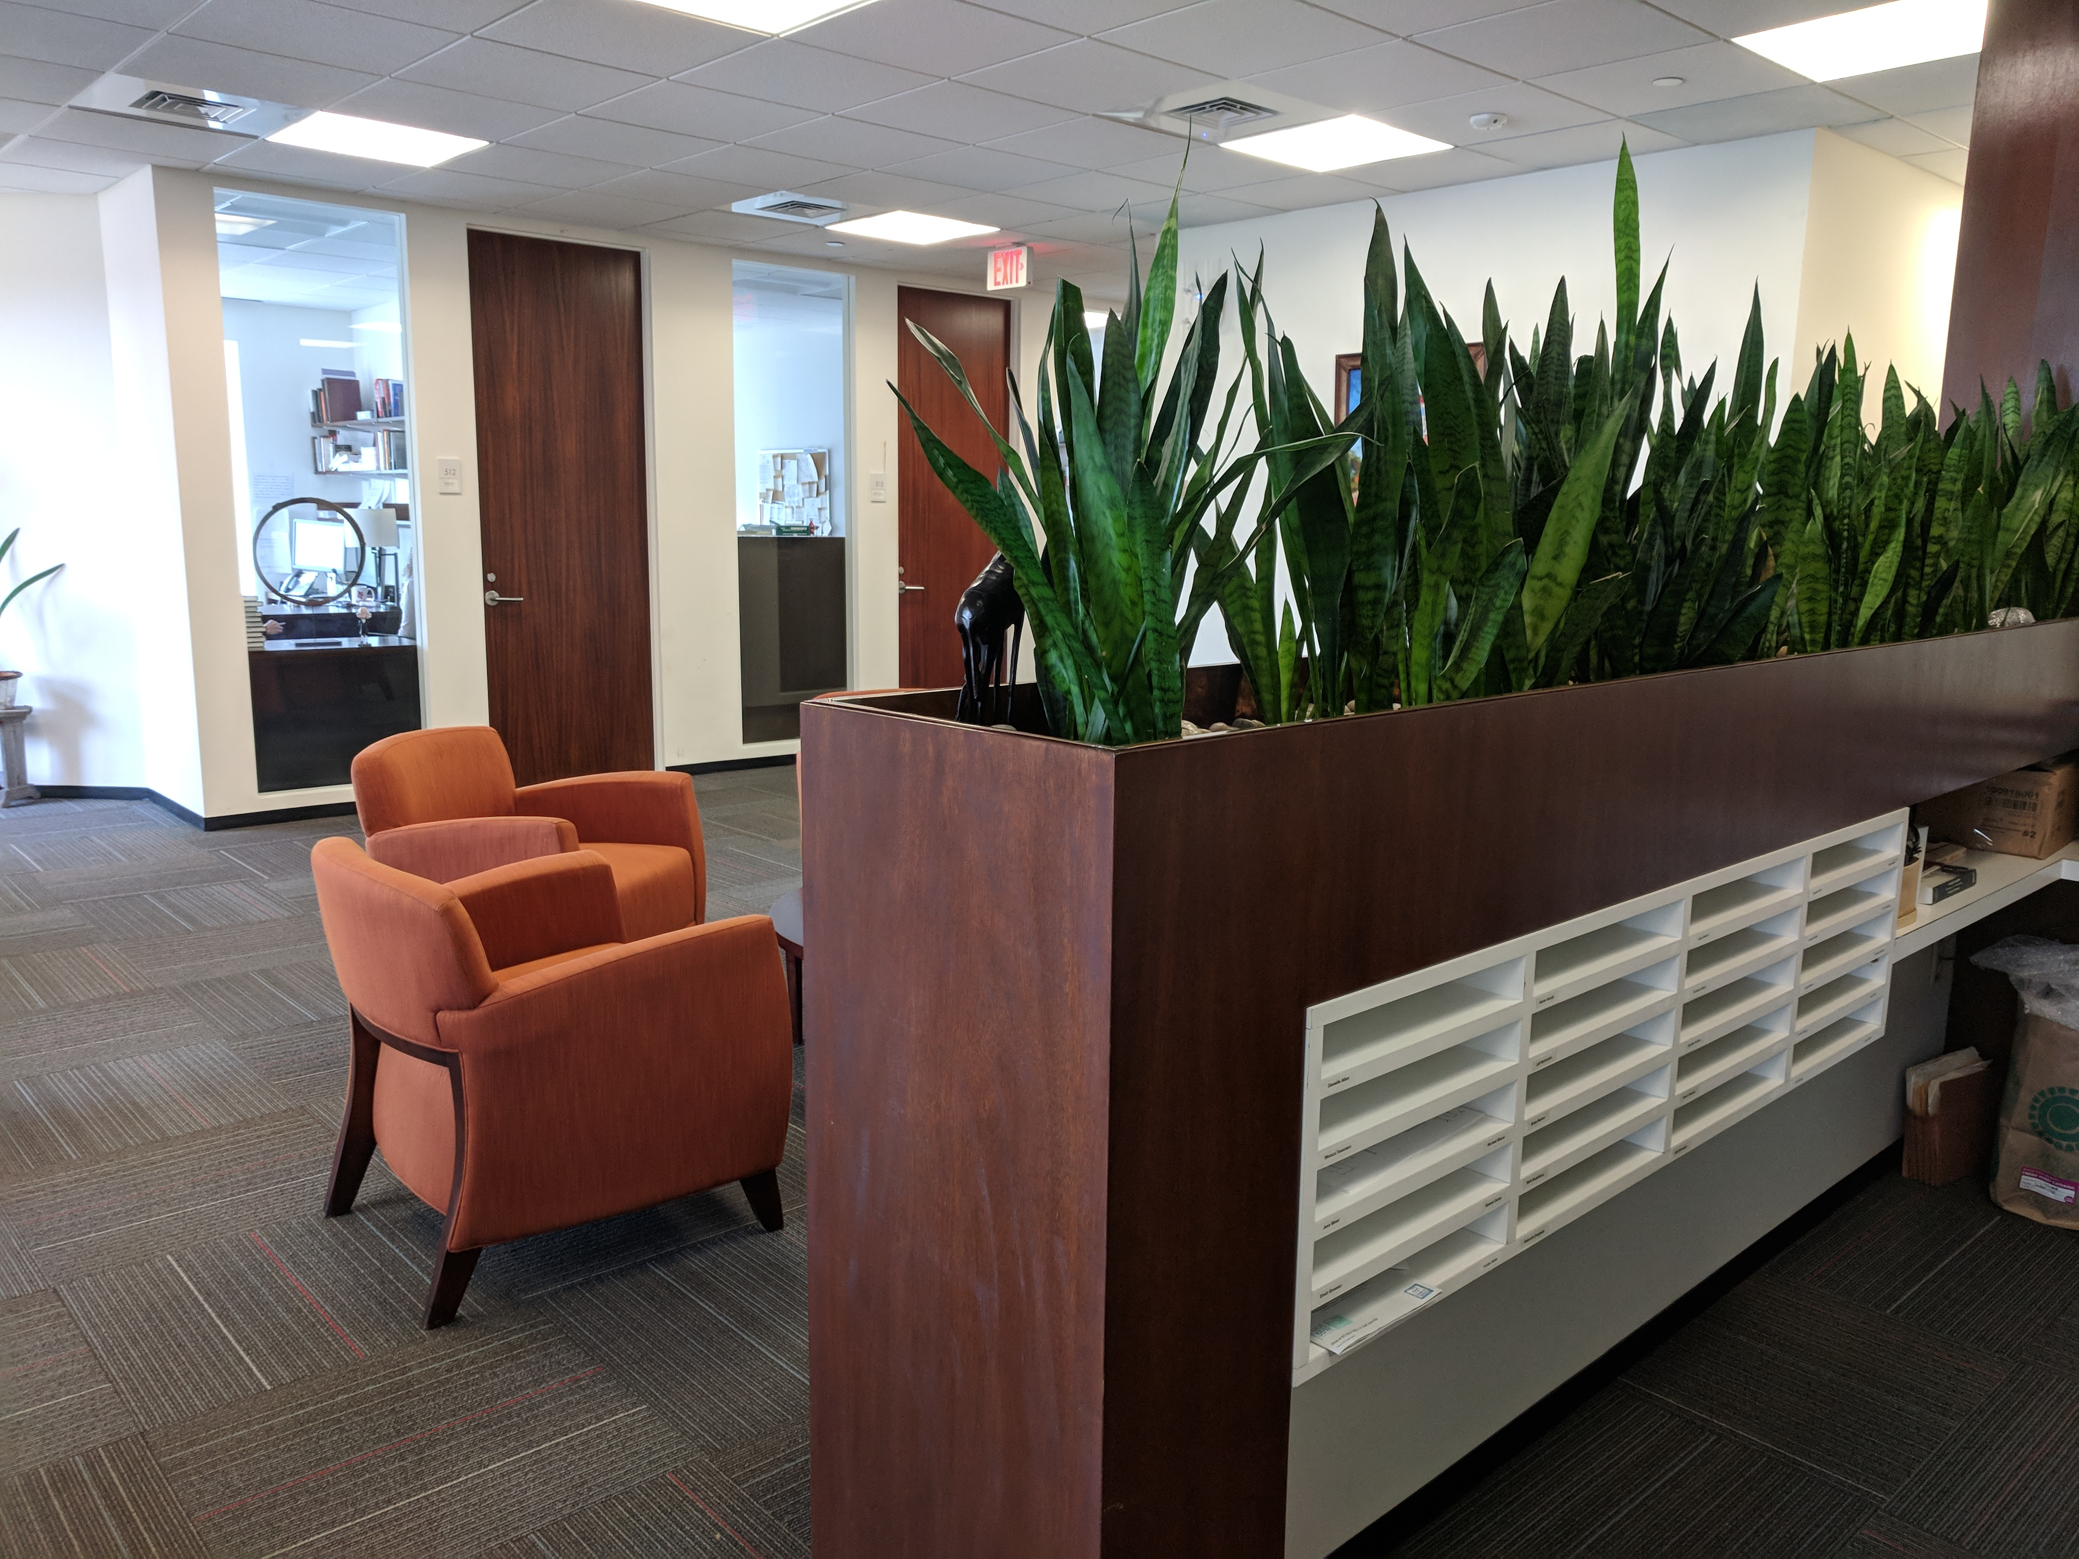
Finding Information
Our website: ethics.harvard.edu
Follow Us:
  Twitter: @harvardethics
  Facebook: @harvardethics
Public Events: https://ethics.harvard.edu/calendar/upcoming

Slide 10
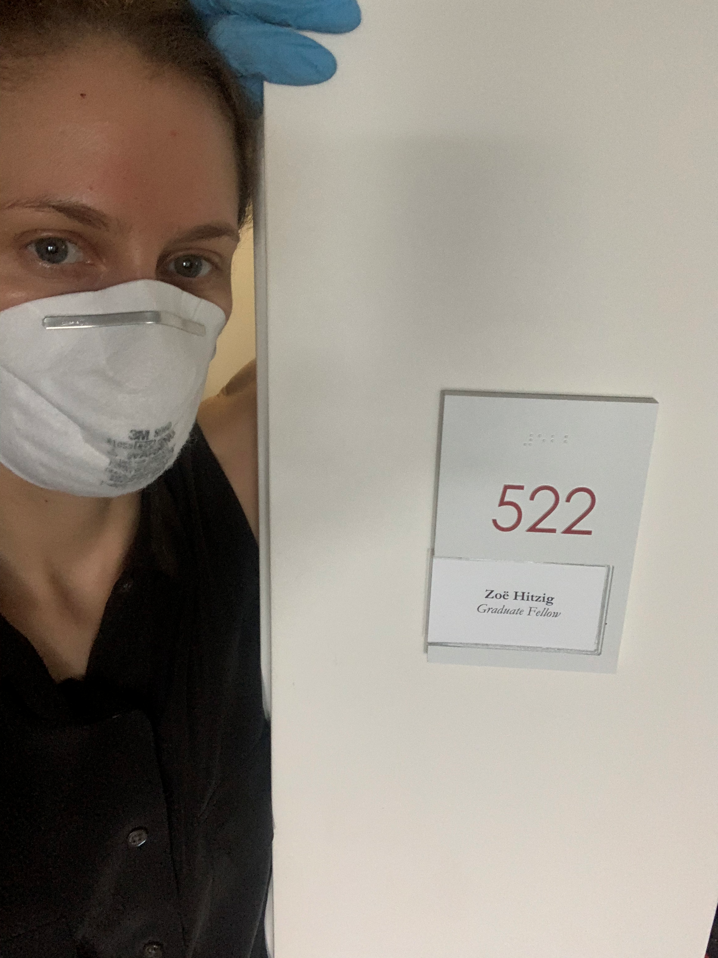
Online Information for Current Fellows
Visit the special section of the Center's website, just for Fellows, at
https://ethics.harvard.edu/ information-fellows

Slide 11
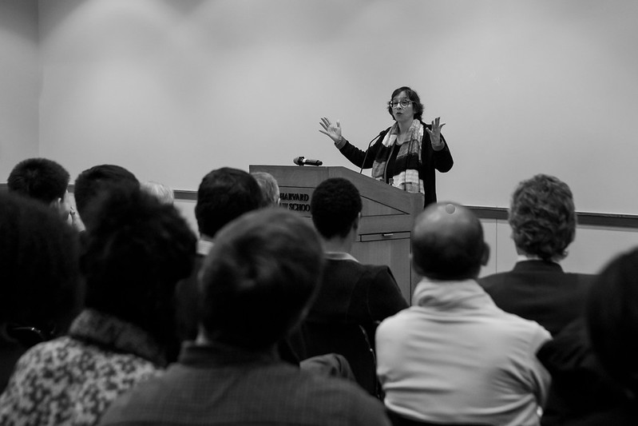
Upcoming Center-Sponsored Public Events
September 18 - Ethics in Your World Book Series with Danielle Allen and Rohini Somanathan, 12 pm: Register here.
October 9 - Ethics in Your World Book Series with Mathias Risse, 12 pm: Find more information here.
October 22-23 - Political Theory Graduate Student Conference: TENTATIVE
December 3 – Public Lecture with S. Matthew Liao: Find more information here.
More Added Regularly. Read the Newsletter!

Slide 12

Sharing Your Accomplishments: We Want to Know!
Publications, talks, awards, etc? Let Maggie know.
Something else to share with the community? Ask Maggie to include in the Newsletter.
Have an idea or suggestion for an event or improvement? Talk to Emily.

Slide 13
Making the Most of Your Fellowship Year
Primary obligation: your own research and writing
Other obligations: seminars, lectures, dinners (if possible)
Most valuable opportunity: conversations and connections with others

Slide 14
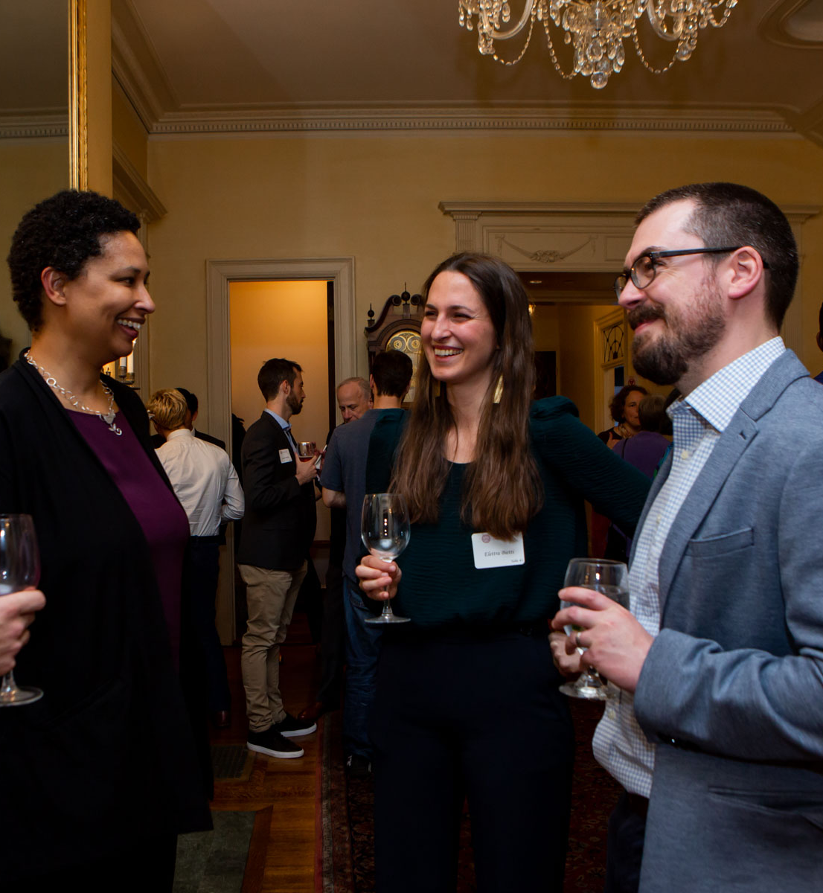
Center Faculty
Getting to know Faculty affiliated with the Center is a valuable opportunity.
Read up on the people on our website and tell us who you want to meet! We can help!
Fellows-in-Residence: Faculty Mentors

Slide 15
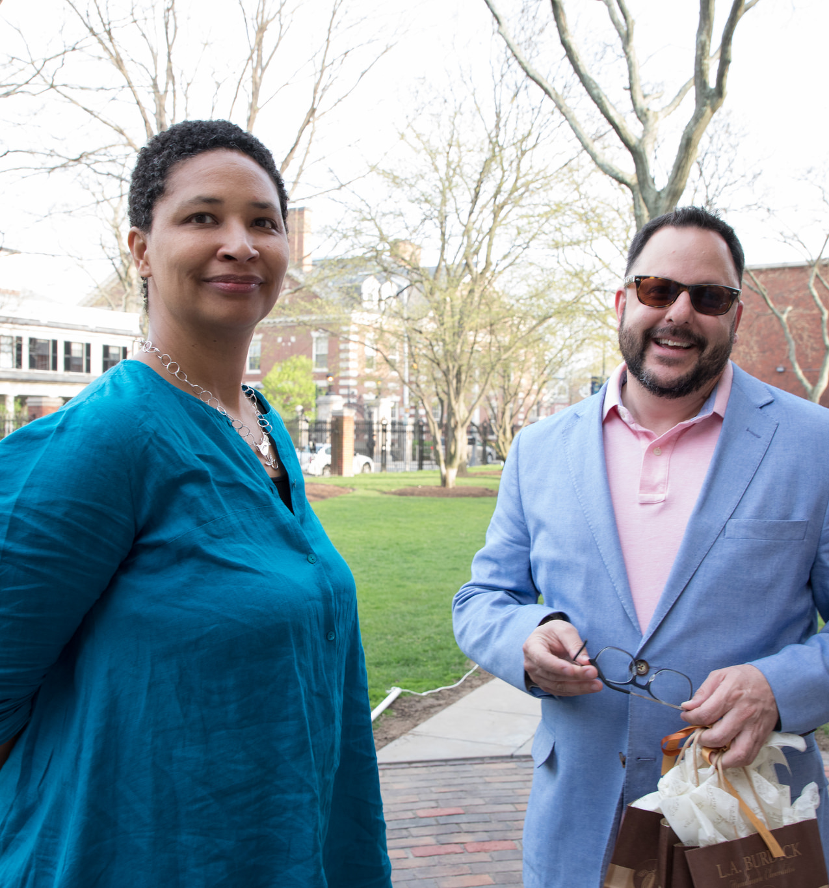
Seminars
FIR/Faculty Seminars: Tuesdays at Noon
Grad Fellow Seminars: Tuesdays at 12:45 pm
Grad Fellows are expected to attend FIR seminars
Inviting others to your seminar is fine (unless program directors say otherwise), but please let us know who to expect

Slide 16
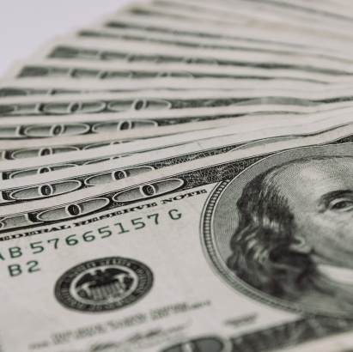
Research Funds and Financial Matters

Slide 17
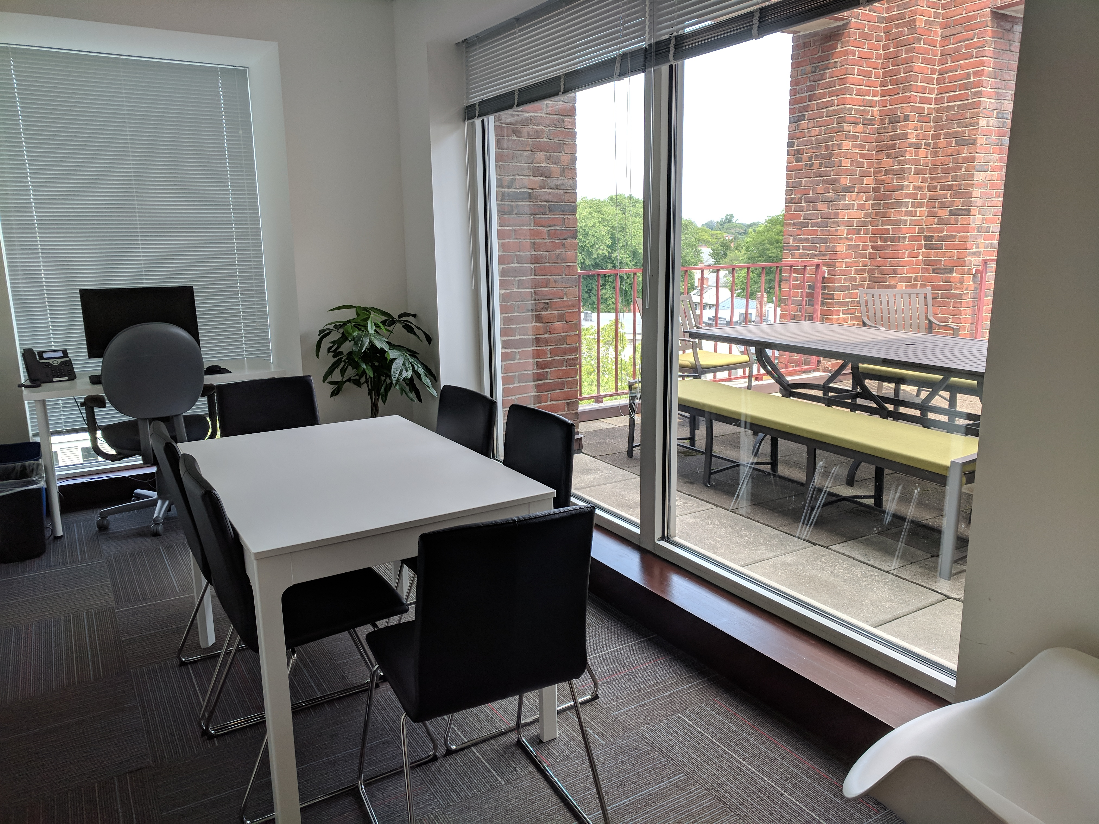
Research Funds
This year we are handling research funds differently due to our remote circumstances.
Fellow-in-Residence and Grad Fellow research funds will be paid in a lump sum directly to you in early fall
Research funds should be used for expenses related to your research such as books, professional memberships, conference fees, etc.

Slide 18
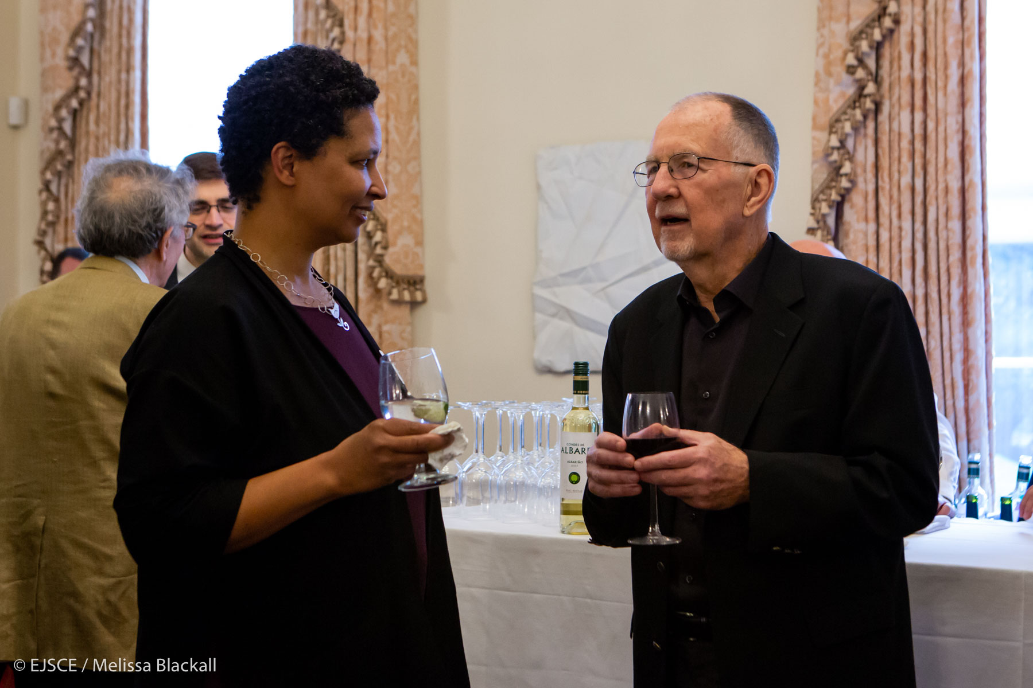
Stipends
Stipends are either paid to you directly or sent to your home institution. A member of the Finance Team will be in touch with you directly if we need any additional information in order to process your stipend.
Graduate Fellow stipends are paid at the end of each month

Slide 19
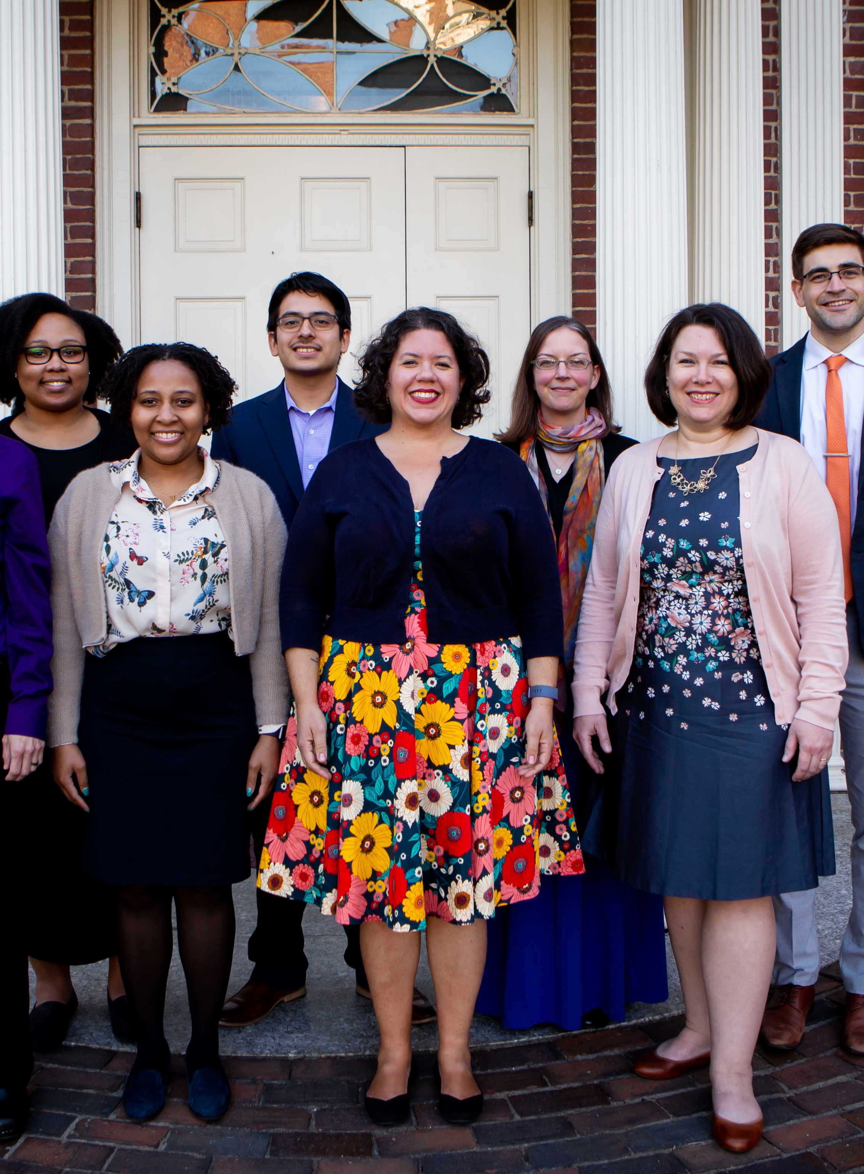
Directing Your Questions

Slide 20
Directing
Your
Questions
Seminars and Events for Fellows: Emily Bromley, ebromley@fas.harvard.edu
HR Issues + Financial Matters: Stephanie Dant, stephanie@ethics.harvard.edu
Danielle Allen's Calendar: Cherise Fields, cherisefields@fas.harvard.edu
Communications, Promoting Your Work: Maggie Gates, mgates@fas.harvard.edu
Fellows Happy Hour and Social Activities: Anna Lewis, annalewis@g.harvard.edu
All Other Issues: Emily Bromley

Slide 21
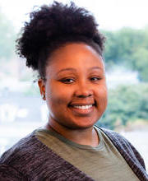
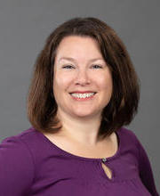
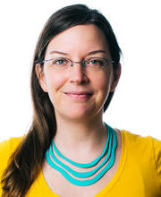
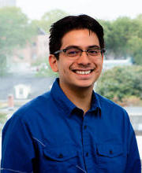
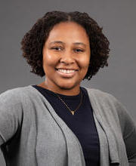
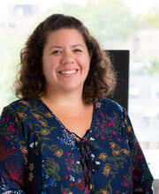
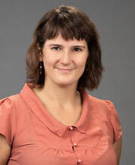

Vickie Aldin Emily Bromley Stephanie Dant Emiliano Duran
Cherise Fields Maggie Gates Anna Lewis Alex Ostrowski Schilling

Slide 22
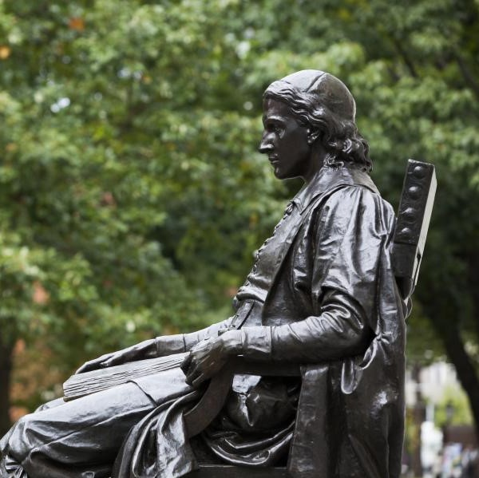
Harvard Resources

Slide 23

Harvard Credentials
HUID:
A Harvard ID number (HUID) has been assigned to you. Ask Emily if you don’t have it. Until we are on campus you will NOT be receiving a physical Harvard ID card, so be sure to keep track of your Harvard ID number for your records.
Harvard Key:
Obtain your Harvard Key at https://key.harvard.edu/ This connects you electronically to resources at Harvard. Your “onboard e-mail” is the e-mail account we have used to correspond with you.

Slide 24
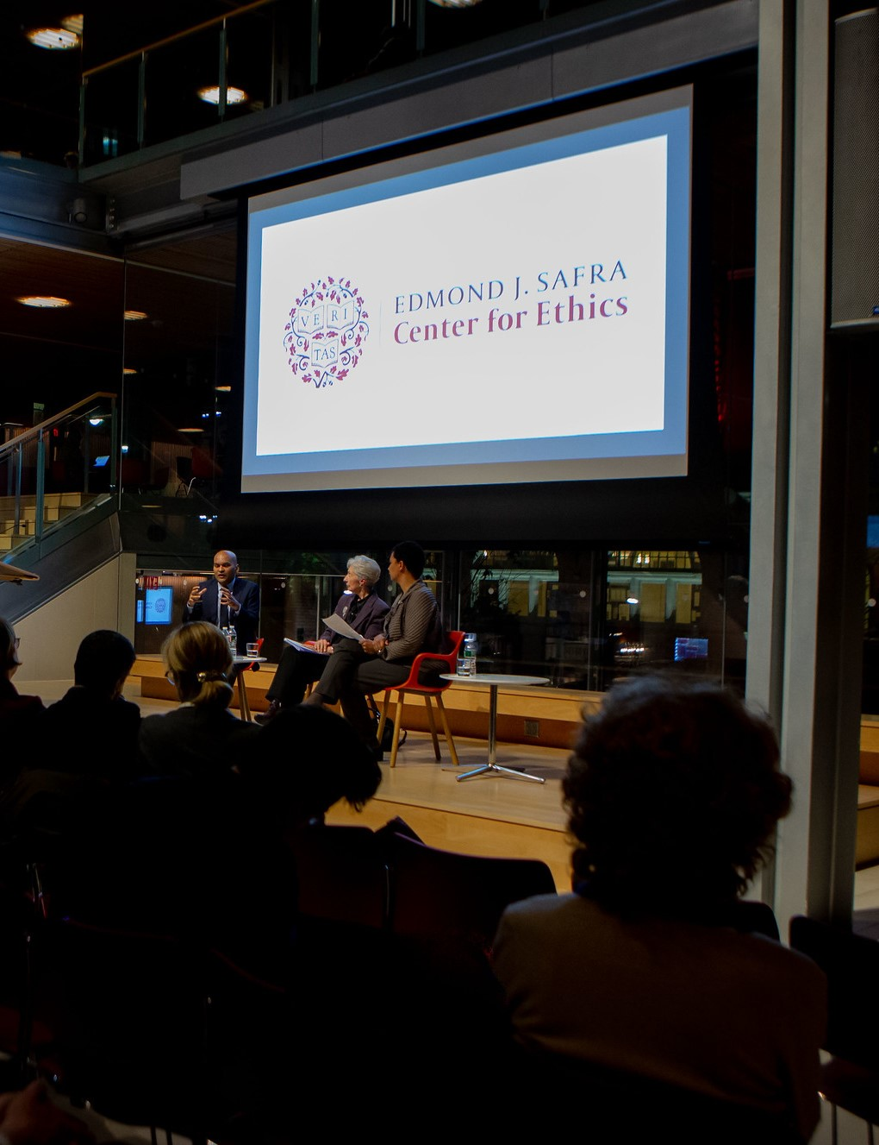
Harvard Credentials, cont.
Harvard Email:
Sign up at https://key.harvard.edu.
Harvard email address is necessary to access many University resources and receive announcements.
It is fine to forward that address to your primary email address.
MessageMe:
Activate the "MessageMe“ phone app for emergency university notices. You can also sign up for Message Me notifications at https://messageme.harvard.edu

Slide 25
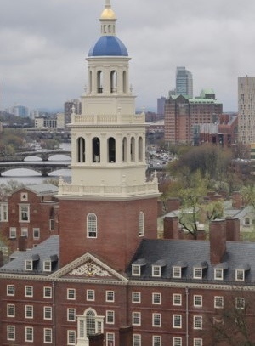
Tech Support
To Contact the Harvard University IT Group (HUIT): email ithelp@harvard.edu or call (617) 495-7777
Resources for Working Remotely can be found at: https://huit.harvard.edu/remote

Slide 26

Coronavirus Information
Information about Harvard’s response to COVID-19, including travel guidance and updates, can be found at https://www.harvard.edu/coronavirus
As of September 2, 10 positive cases were discovered in the past 7 days, out of 7,762 tests administered.
Testing Dashboard: https://www.harvard.edu/coronavirus/harvard-university-wide-covid-19-testing-dashboard

Slide 27
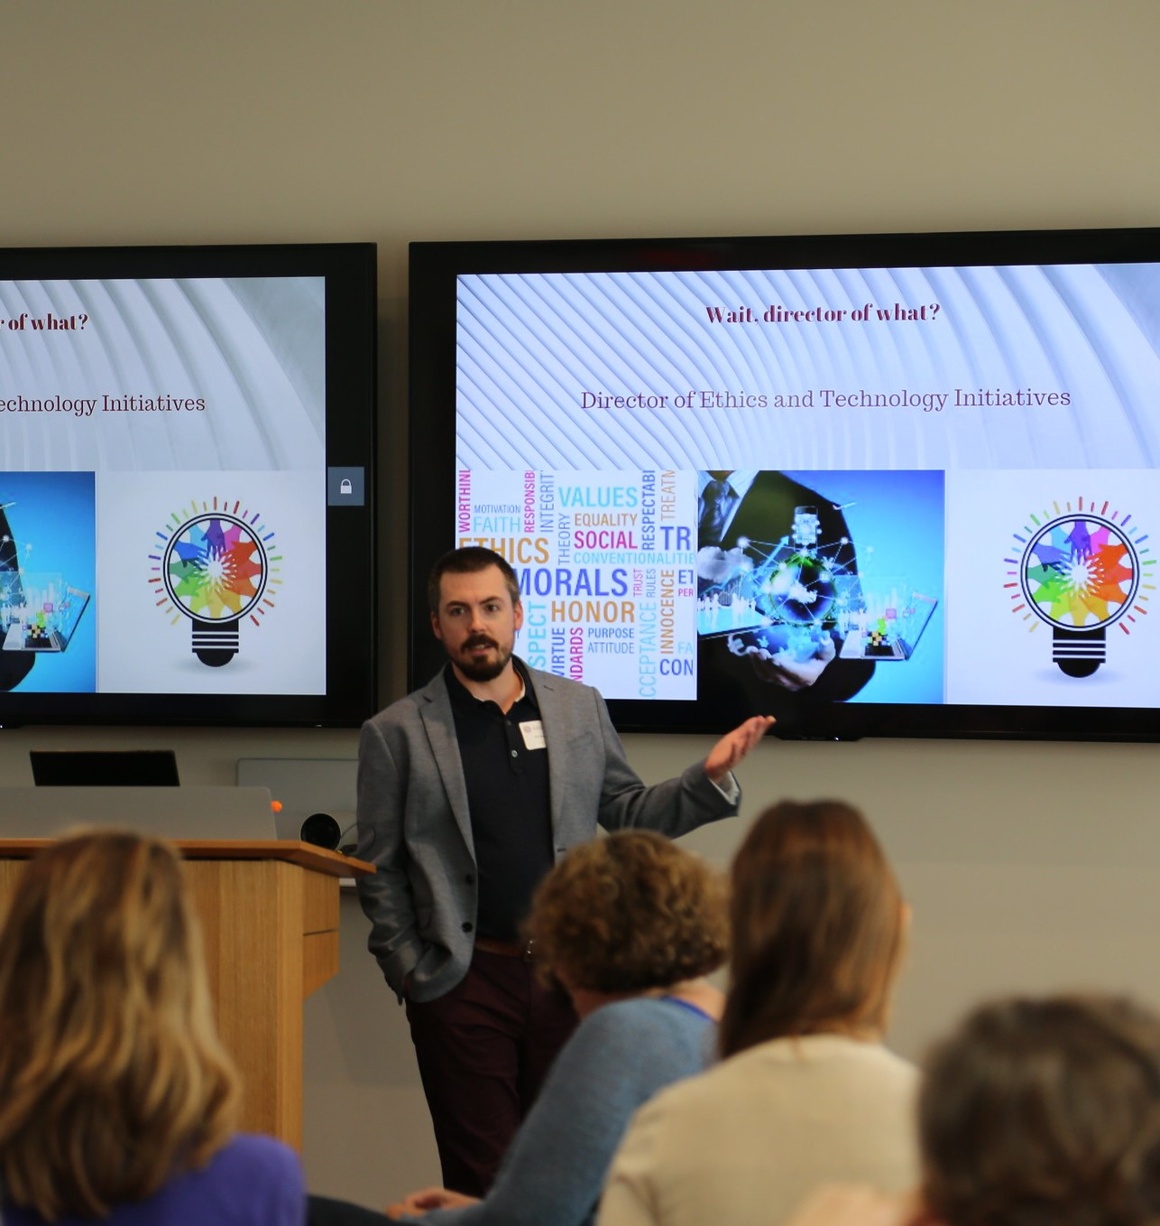
Tech Resources
Slack: harvard-ethics.slack.com
Office: https://mso.harvard.edu/
GSuite: http://g.harvard.edu/
Zoom: https://harvard.zoom.us/
  Personal Zoom rooms for all
  Fellows “Lounge Room” always available
  on Zoom for your use (Meeting ID: 272 658 0518, passcode 221423)

Slide 28
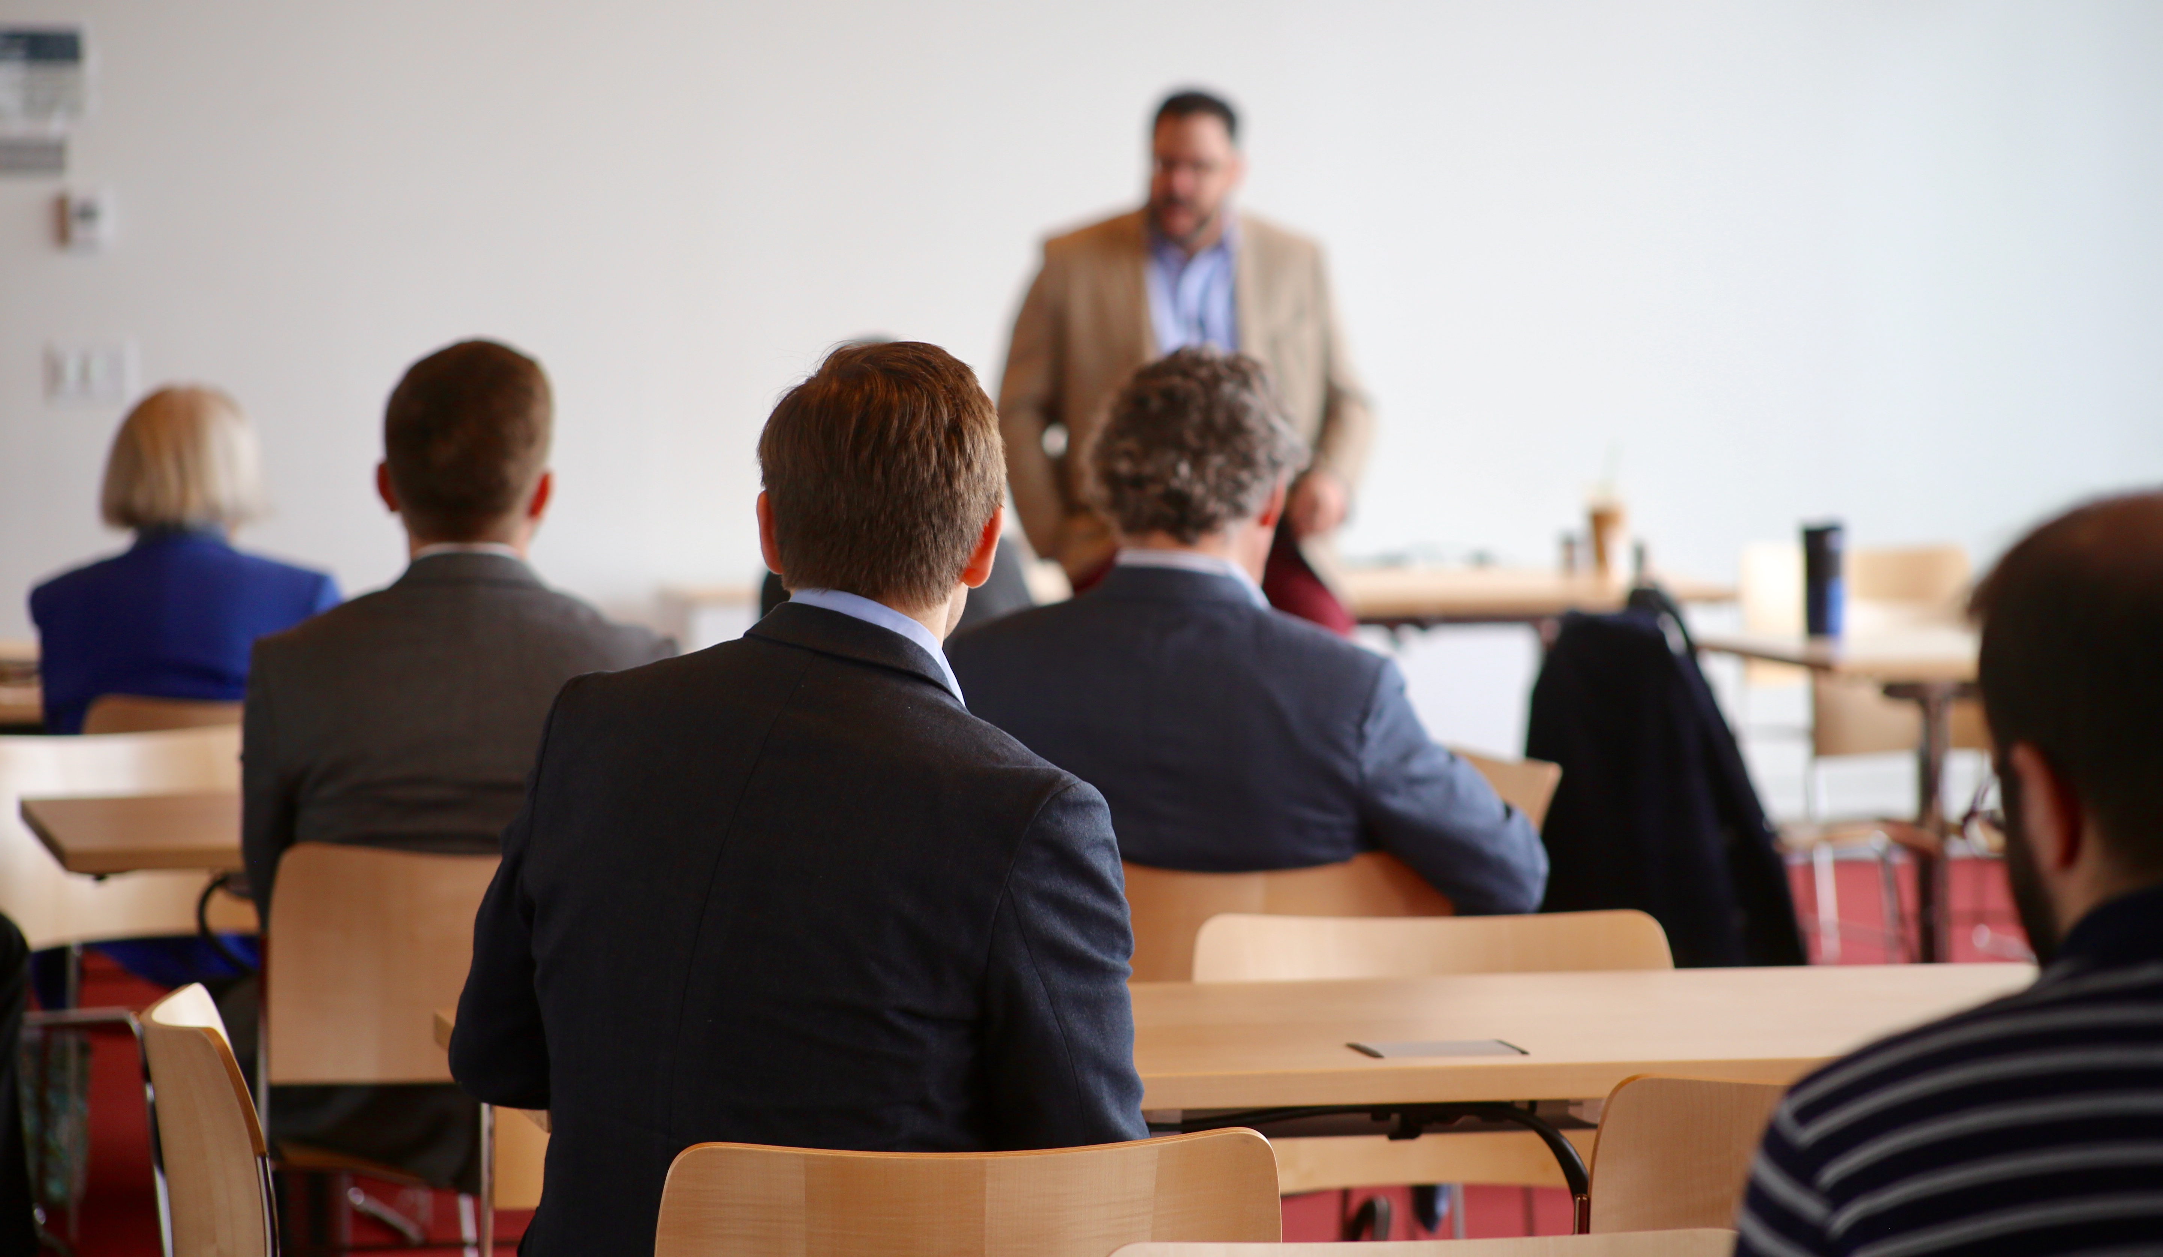
Find Out About
Upcoming Events
Virtual Academic and Social Activities: https://www.harvard.edu/coronavirus/socialize-remotely
Harvard Gazette Events: https://news.harvard. edu/gazette/harvard-events/
Contact Departments of interest to you and ask to be added to mailing lists

Slide 29

Perks
Athletic Facilities - CURRENTLY CLOSED
Harvard Museums - CURRENTLY CLOSED
Outings & Innings for discounts (check out the "Hidden Gems" page)
Center for Wellness classes and virtual resources

Slide 30
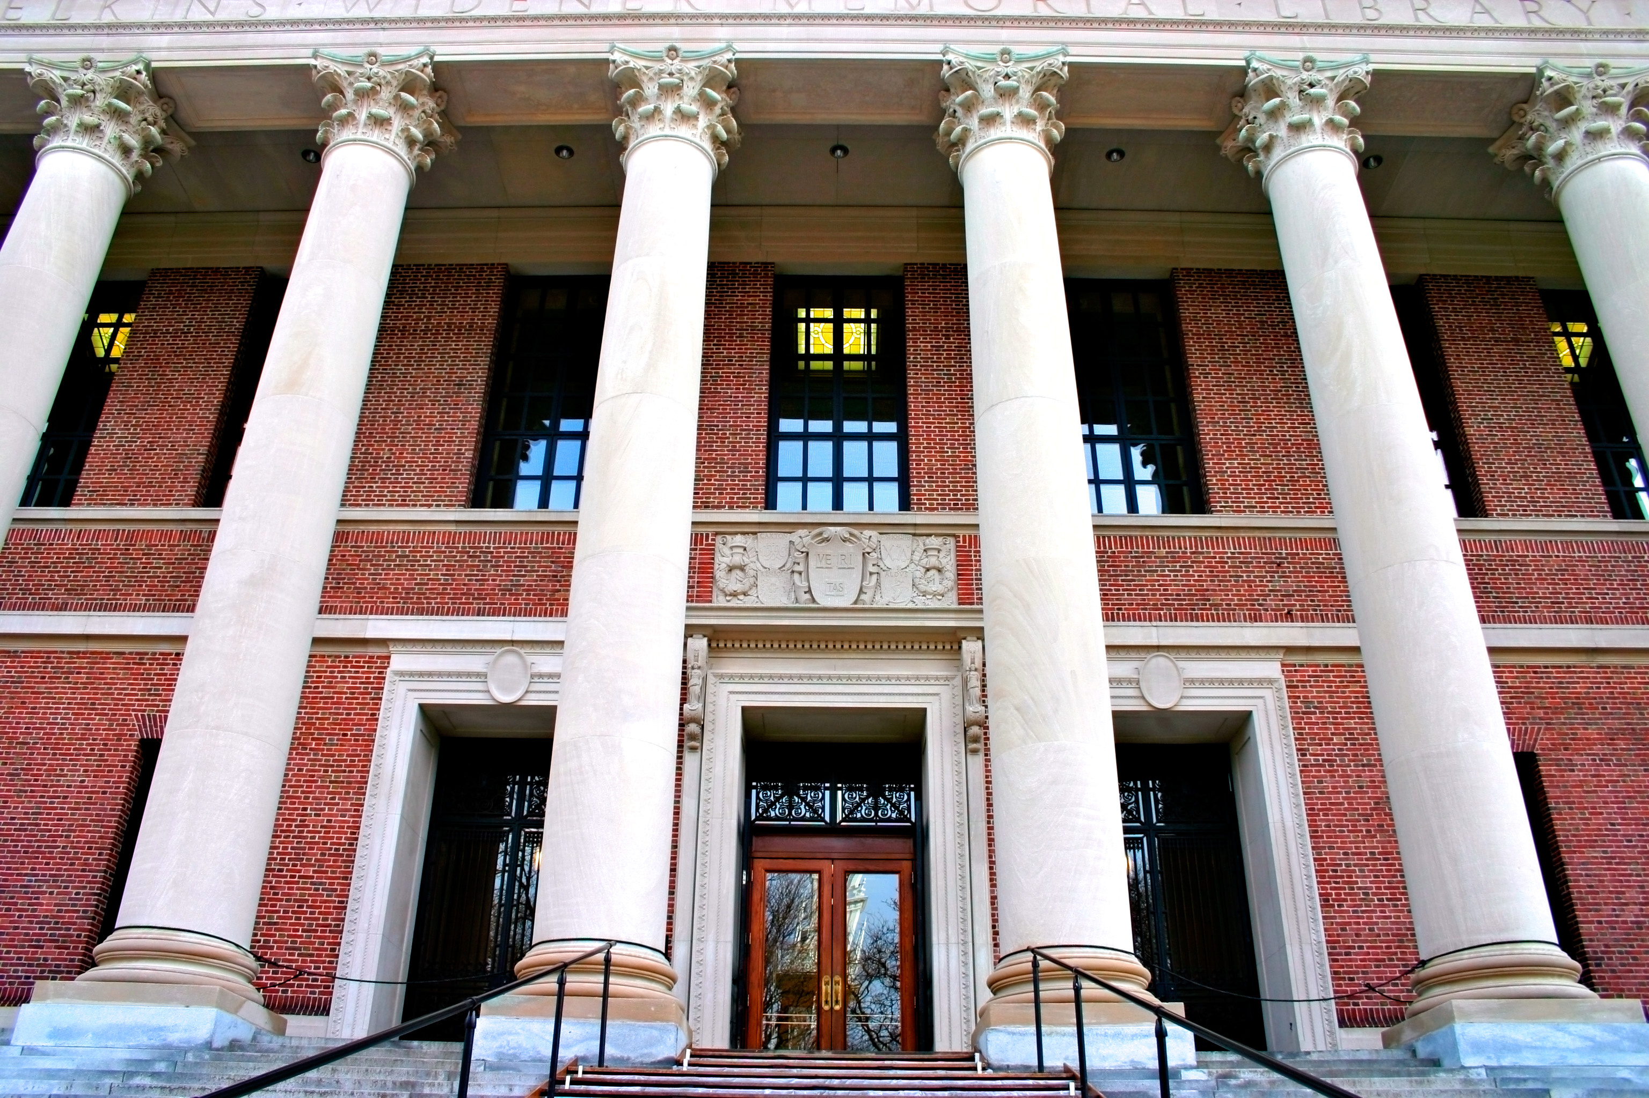
Library Orientation: Friday 9/4 at noon
(via Zoom)
Library services and tools info here
Widener Virtual Tour available here

Slide 31
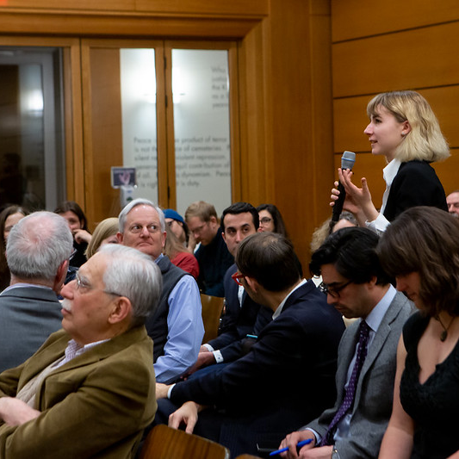
Questions?

Slide 32
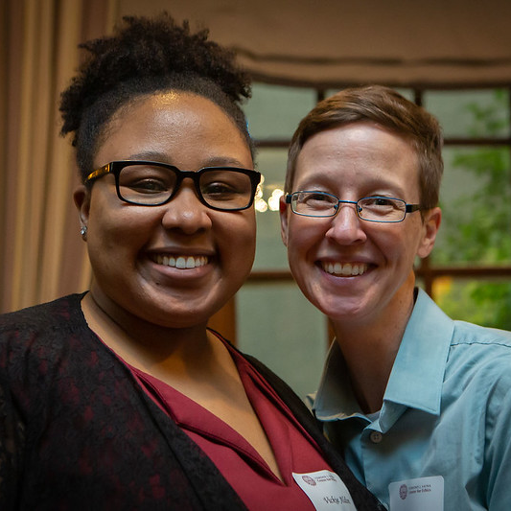
THANK YOU

