Slide 1


Welcome
New Fellows!
2022-2023

Slide 2
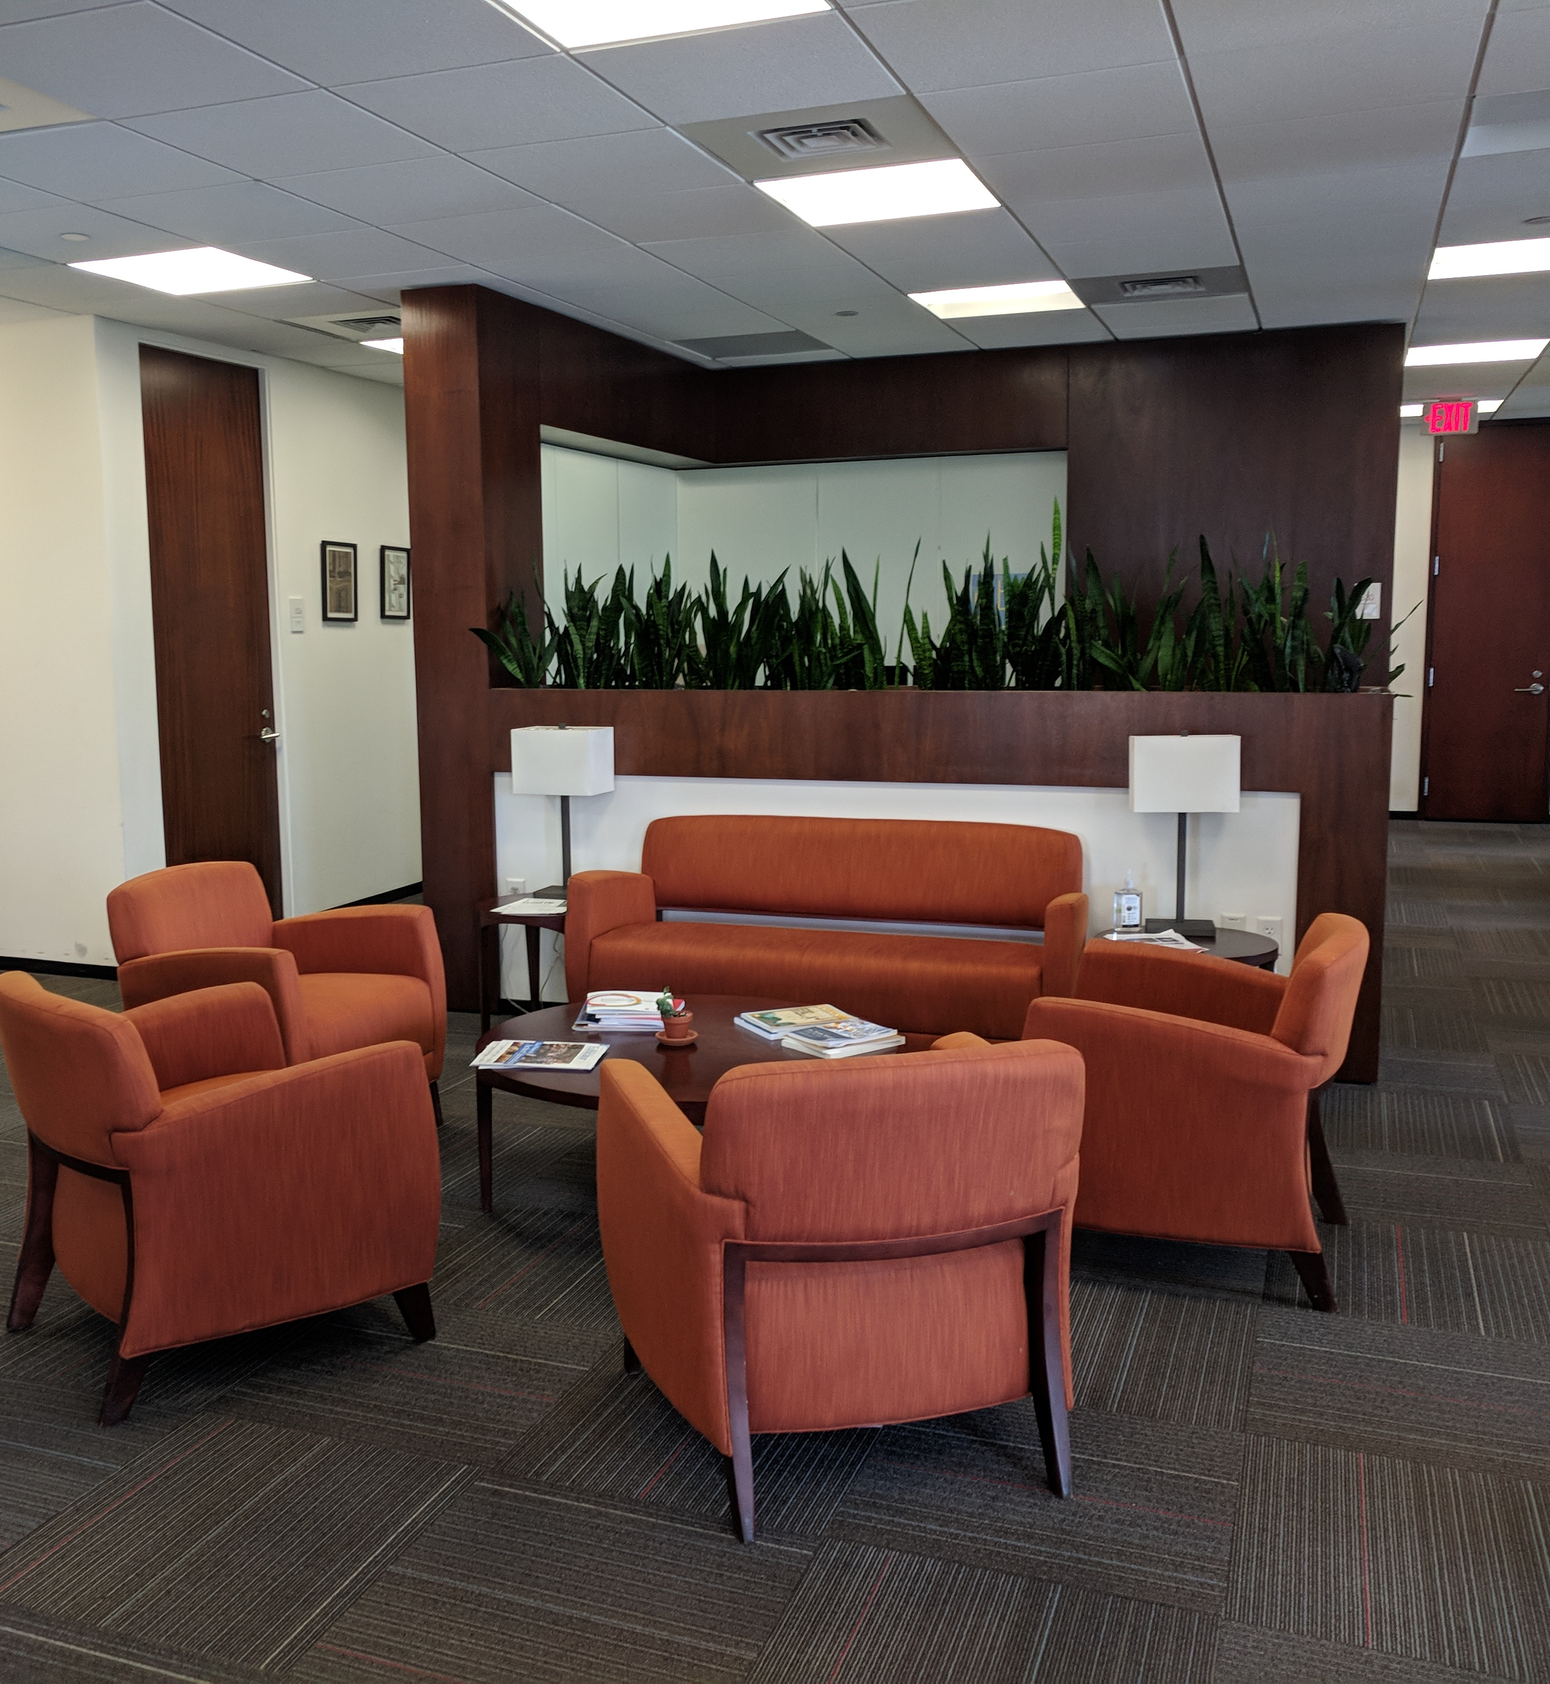
Orientation
  Connecting with Each Other and Using the Office
  Orientation to the Center
  Information on Harvard Resources
  COVID-19 Information

Slide 3

Connecting with Each Other & Using the Office

Slide 4

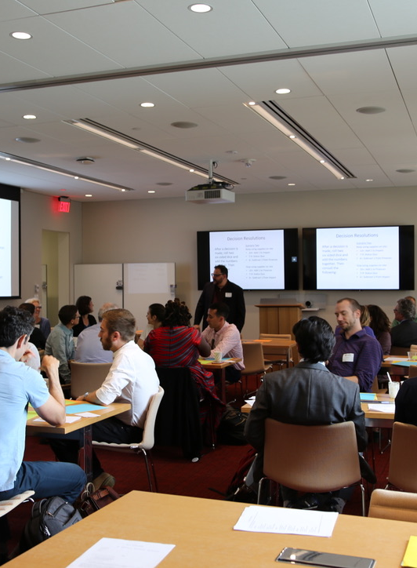
Seminars
The cohort experience is a crucial part of the Fellowship. You can support it by:
Serving as a social chair and planning events
Attending as many Center-organized academic and social events as possible
Starting and running a reading or discussion group
Developing other events

Slide 5
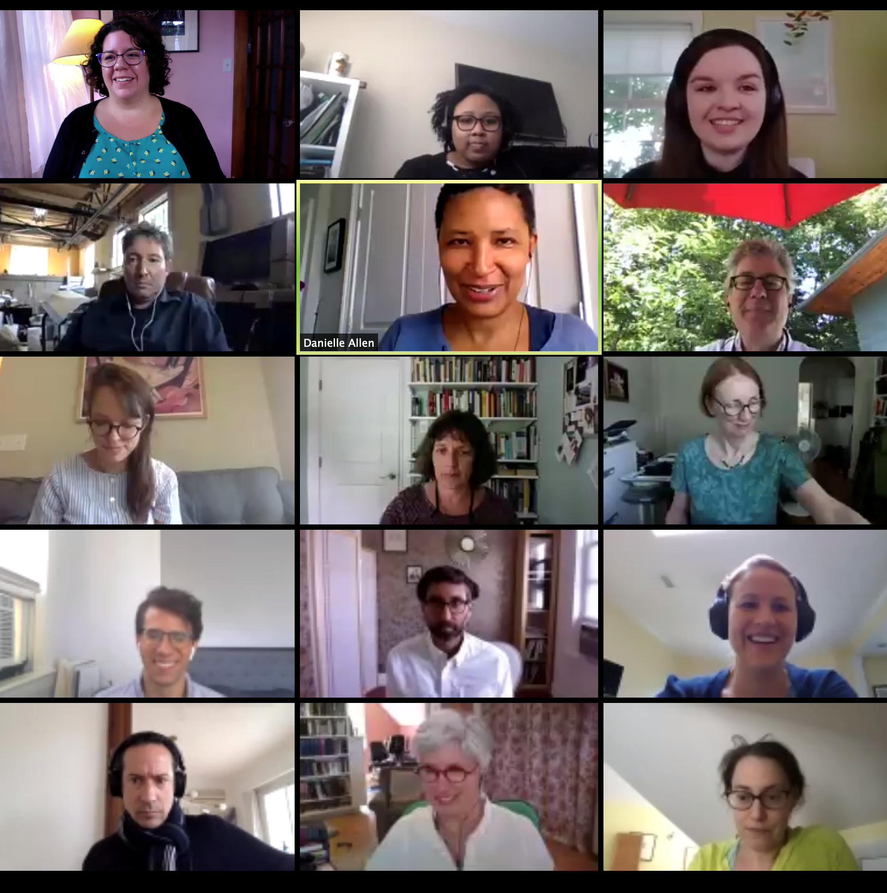
Fellows Zoom Lounge
Zoom “Lounge” for fellows:
  https://harvard.zoom.us/my/
  ejsafrafellows
  Passcode = 221423, Host Key = 788334
  Use this:
  to chat with other fellows online
  for reading groups or meetings
  for Fellows-in-Residence seminars
  Individual Zoom accounts available through Harvard

Slide 6
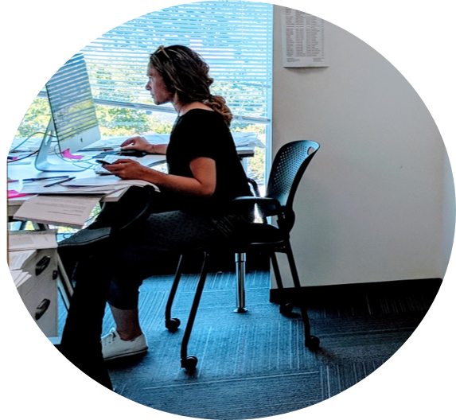
Making Good Use of Office Space
Offices assigned based on preferences in intake form
Work with officemate to determine how you will share the space
“Hoteling" spaces available for meetings, private Zoom calls, etc.—reserve one any time
Single office unoccupied for a day or more? Let others know!
Fellow offices not yet in space booking system, Officely, but can add if helpful to you

Slide 7

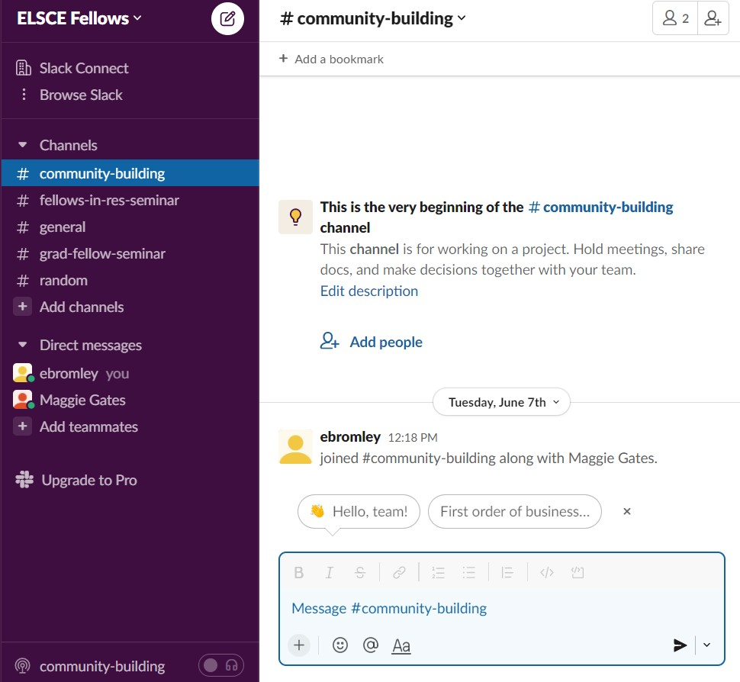
Slack
The Center uses the Free version of Slack for messaging—so old messages aren't saved past 90 days.
Separate workspace for Fellows (some staff may join)
Some channels already established, e.g. "community-building" and "fellows-in-res-seminar"
Make more as you like
Use Slack to stay connected to each other!

Slide 8

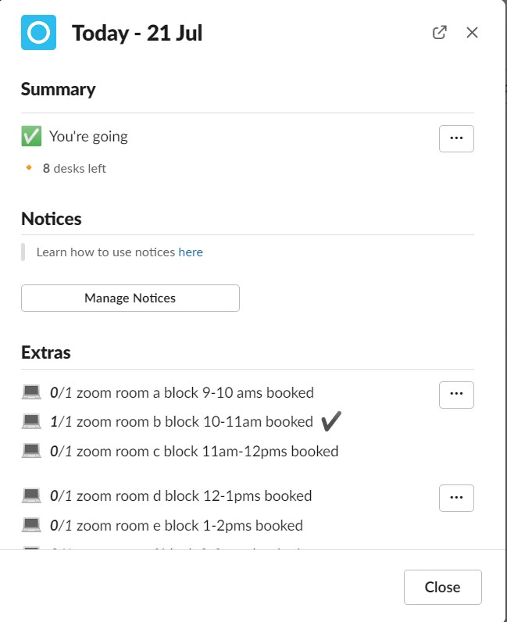
Officely
Space booking system completely within Slack
Use main staff workspace Officely Channel to book
Zoom room, collaboration, and hoteling spaces available
Zoom Only room bookable by the hour under “Extras”
Use separate channel for fellow offices?

Slide 9
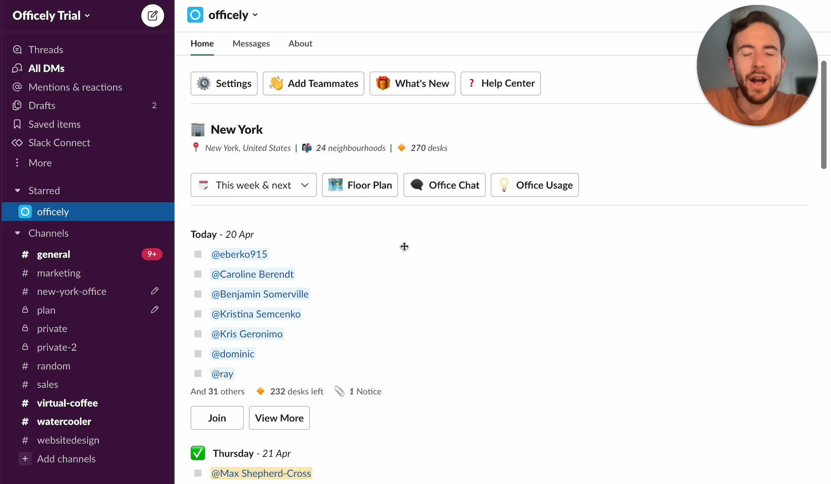

Slide 10
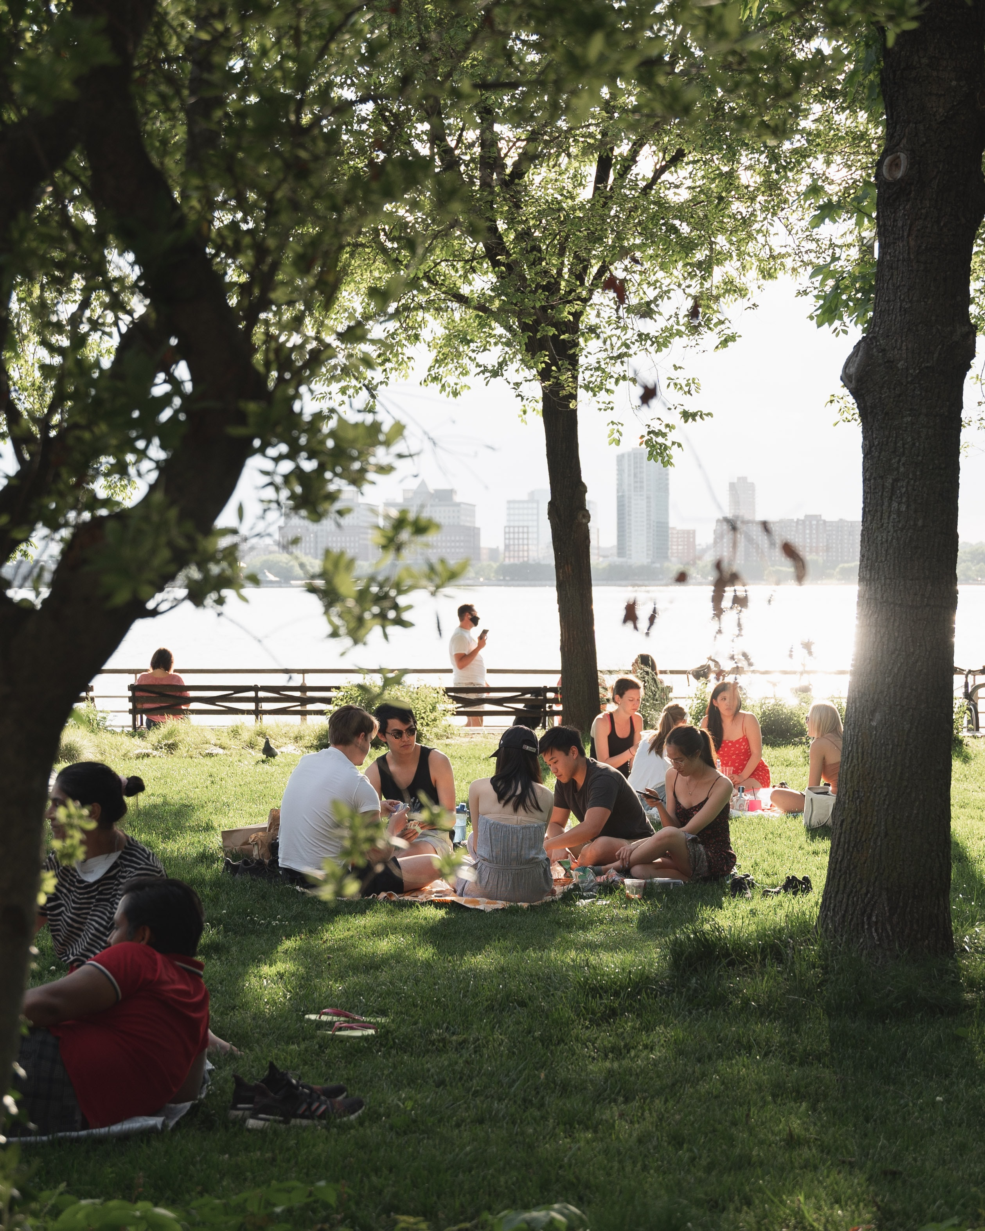
Family- and Pet-Friendly Picnic
Interested in a potluck?
Planning for 1-4 pm on September 18
Cambridge Common, near the playground
Rain date September 25

Slide 11
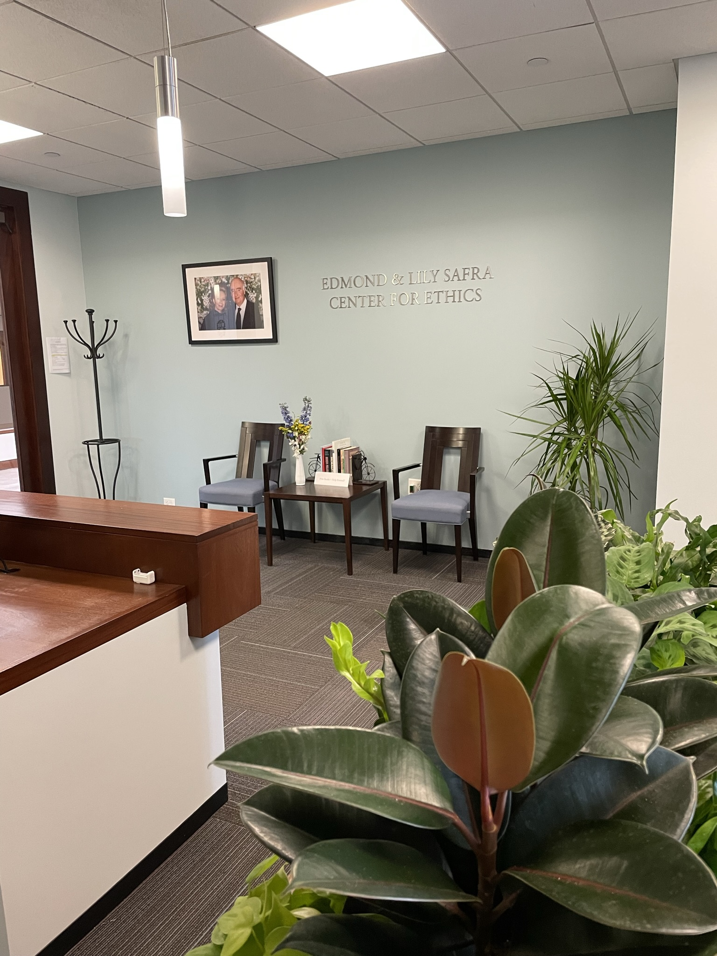
Anchor Day
First Wednesday of the month
All staff will be in the office
Most hoteling spaces likely to be occupied

Slide 12
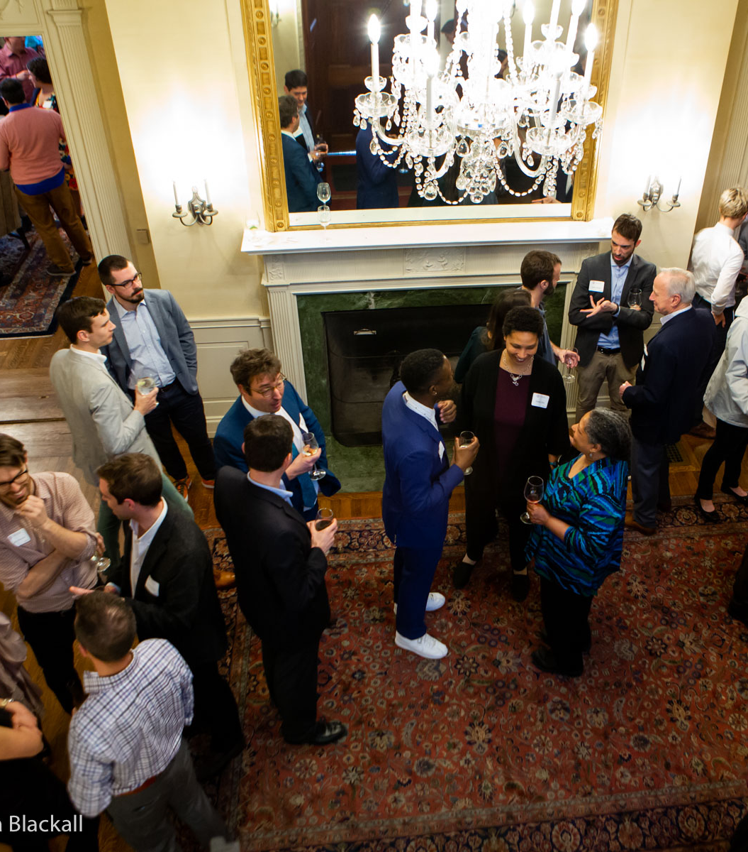
Orientation to the
Center

Slide 13
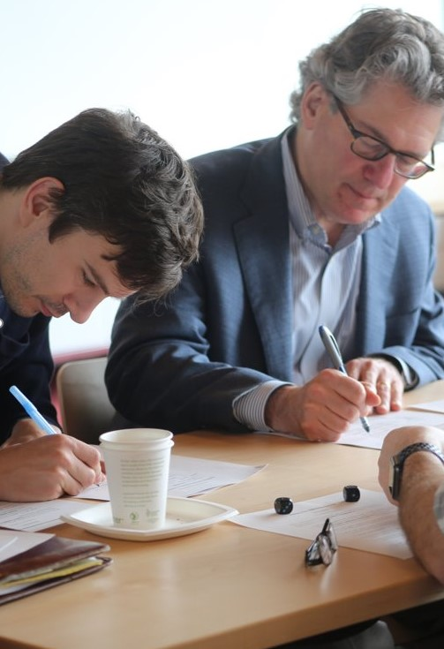
Mission
The Edmond & Lily Safra Center for Ethics seeks to strengthen teaching and research about pressing ethical issues; to foster sound norms of ethical reasoning and civic discussion; and to share the work of our community in the public interest.
https://ethics.harvard.edu/

Slide 14
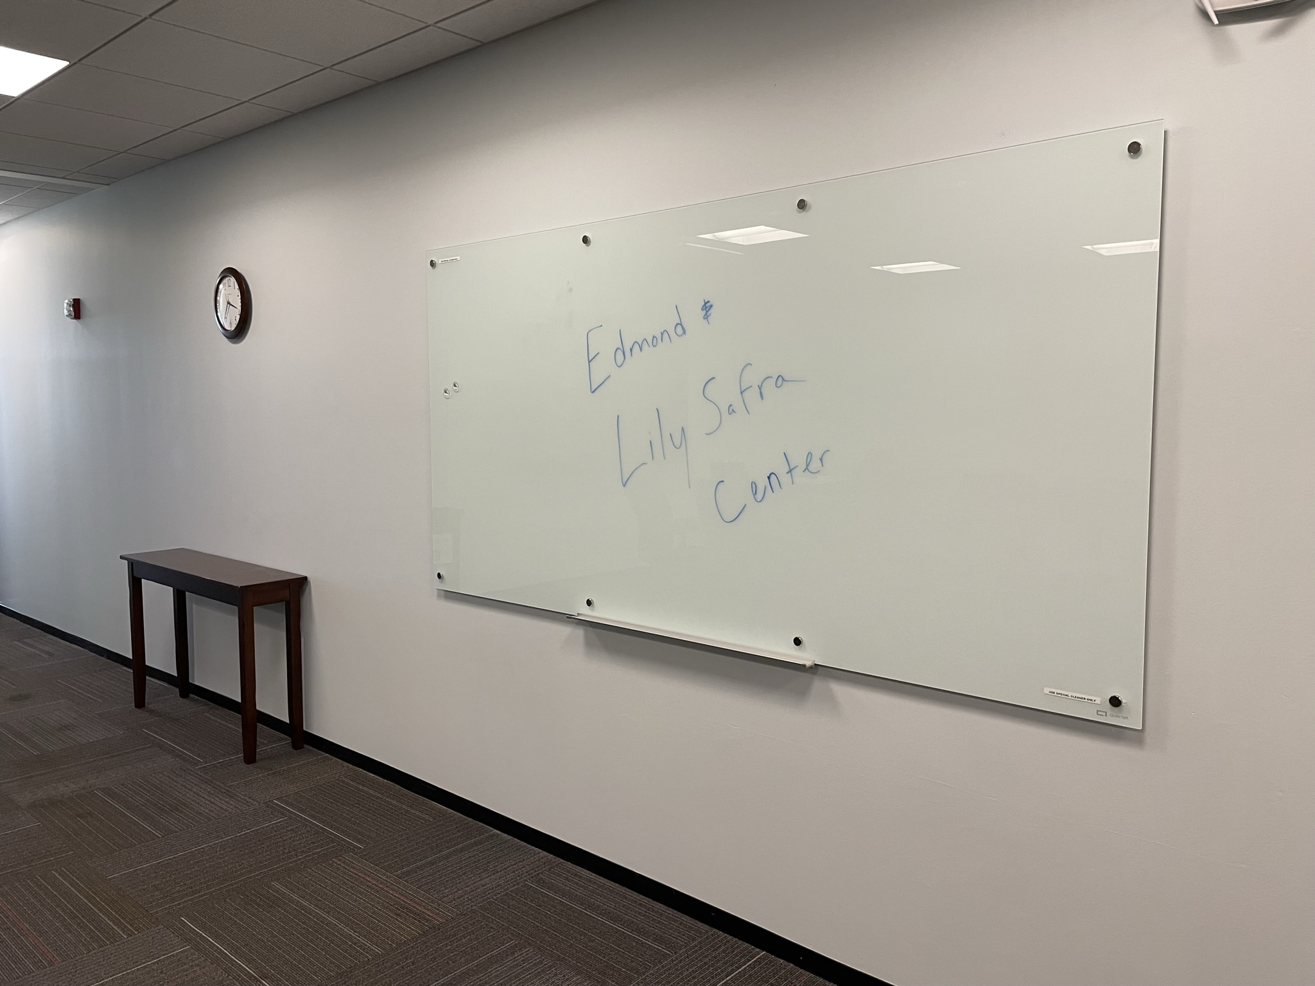
New Name!
As of July 1, we are the Edmond & Lily Safra Center for Ethics!

Slide 15
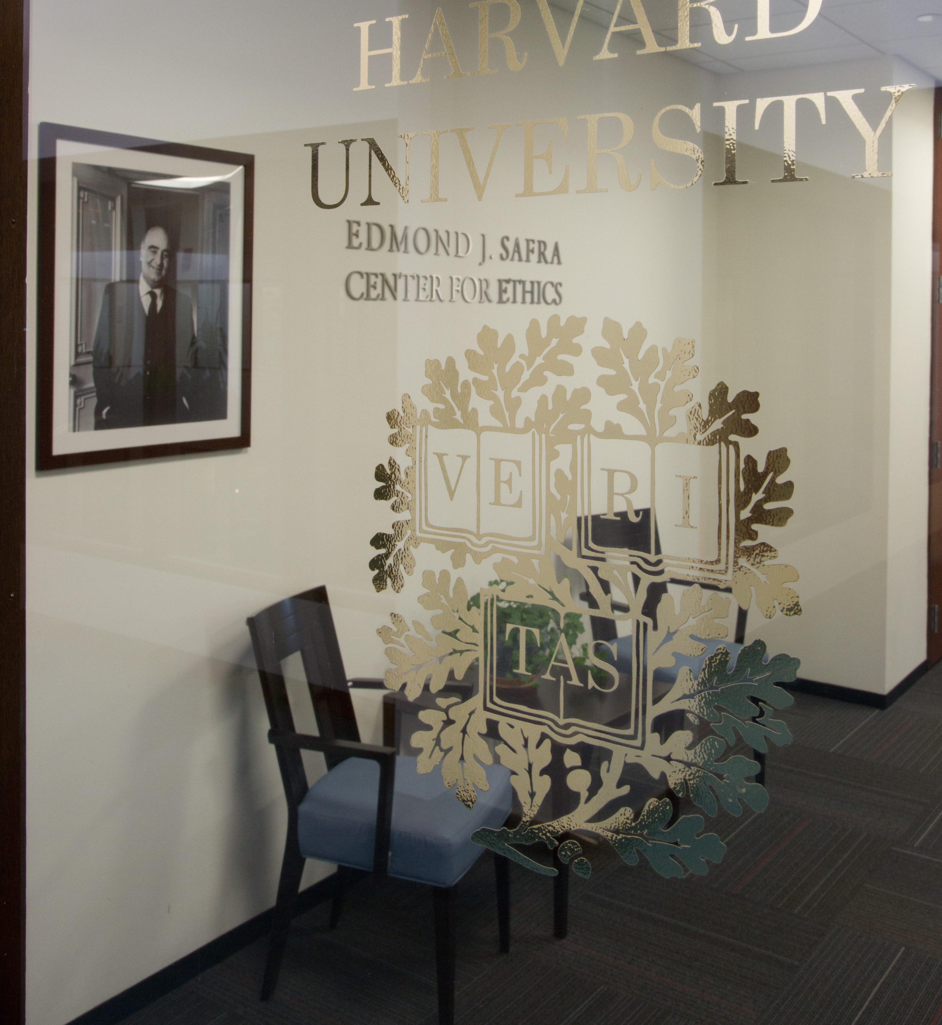
Naming Convention for Public Use
  Acceptable:
      Edmond & Lily Safra Center
      Center for Ethics
      E&L Safra Center
  NEVER just "Safra Center"
  It’s fine to mention your Center affiliation on publications but not required

Slide 16
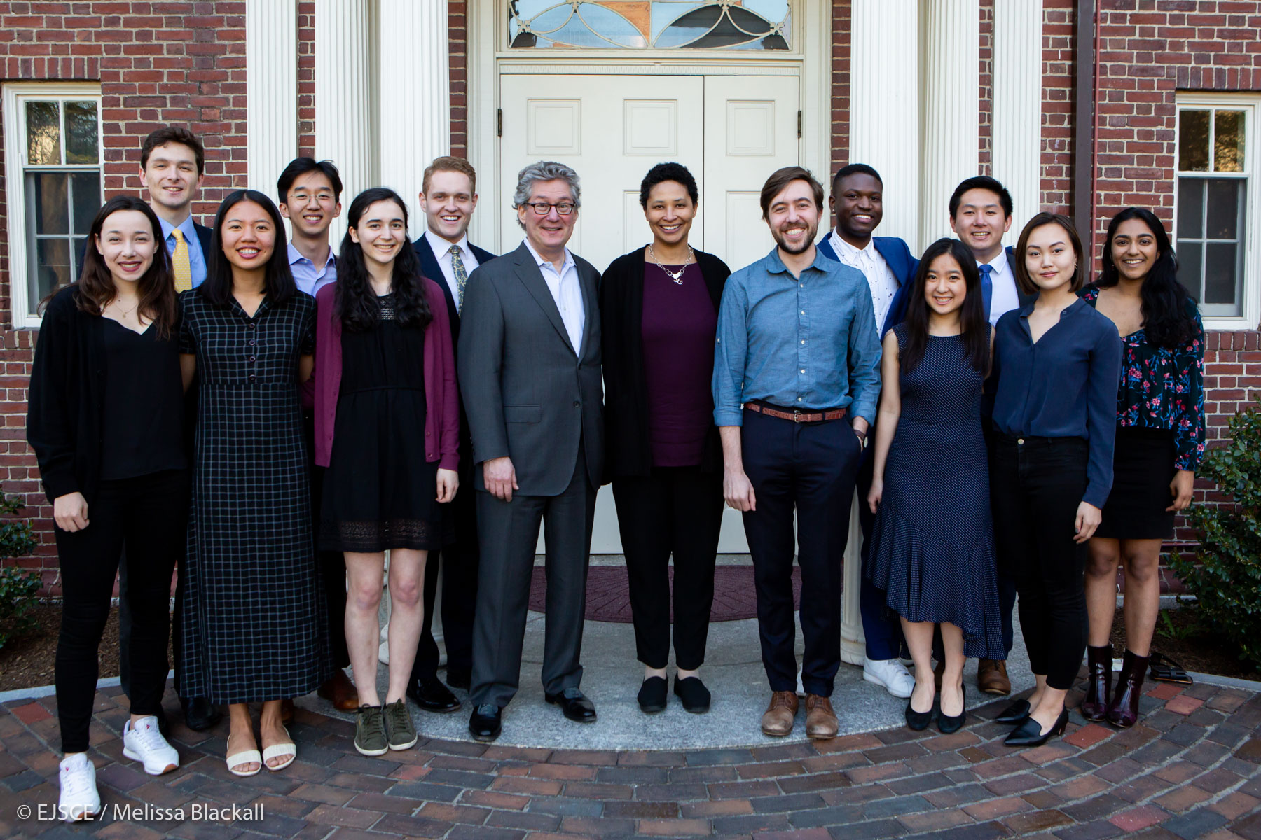
Fellowships Offered
Fellows-in-Residence
Tel Aviv University Exchange Fellows
Visiting Fellows
Graduate Fellows
Ethics Pedagogy Fellows
Undergraduate Fellows
Civil Disagreement Fellows
2019's graduating senior Undergraduate Fellows

Slide 17
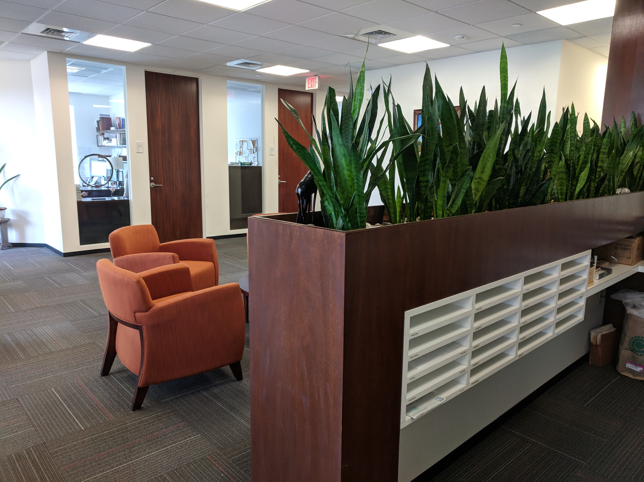
Finding Information
Our website: ethics.harvard.edu
Follow Us:
    Twitter: @harvardethics
    Facebook: @harvardethics
    Instagram: @harvardethics
Public Events: https://ethics.harvard.edu/calendar/upcoming

Slide 18
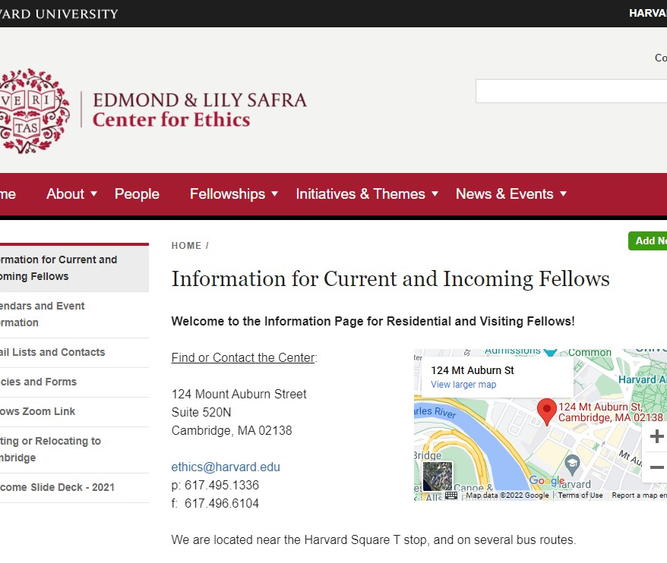
Online Information for Current Fellows
Visit the special section of the Center's website, just for Fellows, at
https://ethics.harvard.edu/information-fellows

Slide 19
BREAK

Slide 20
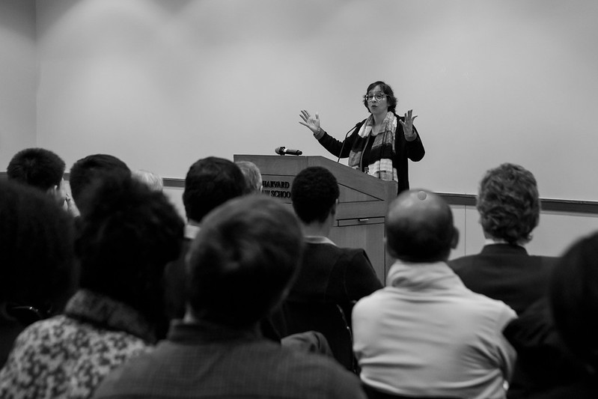
Upcoming Center-Sponsored Public Events
September 8 – Ethics Bonanza and Opening Dinner
September 23 – Ethics in Your World Book Talk with Bo Seo, 12 pm (virtual)
October 14 – Good Government Workshop Day 1, 10 am (virtual or hybrid)
October 20 – Public Lecture with Prof. Melvin Rogers, 5 pm
November 17 or December 1 –Civil Disagreement Series on Reproductive Rights, 4 pm (virtual)
More Added Regularly. Read the Newsletter!

Slide 21
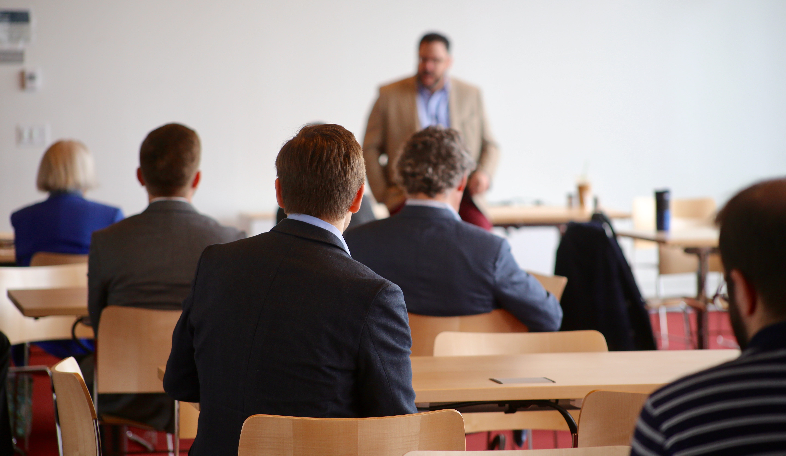
Upcoming Events around Harvard
Virtual Academic and Social Activities:
https://www.harvard.edu/coronavirus/socialize-remotely
Harvard Gazette Events:
https://news.harvard. edu/gazette/harvard-events/
Contact Departments of interest to you and ask to be added to mailing lists

Slide 22
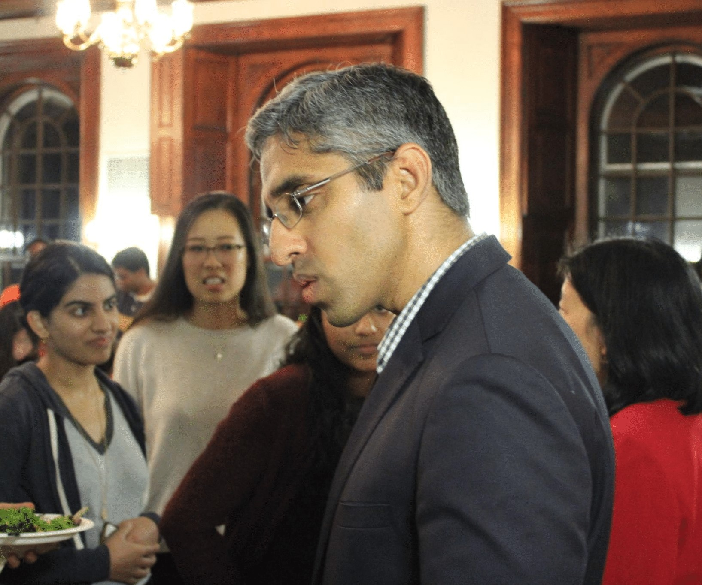
Ideas for Events During the Year?
Do you have a workshop, talk, or other event in mind for this academic year? Please let Emily know!
If you can share details with Emily and the Programming Team by mid-September, we will consider it as we decide what other events the Center will host this year.
Even if we cannot sponsor your event, you may be able to get some support in holding it. Fellowship research funds can be used to host an event.
Decisions and Desserts event with Vivek Murthy and Alice Chen, September 28, 2018

Slide 23

Sharing Your Accomplishments: We Want to Know!
Publications, talks, awards, etc? Let Maggie know.
Something else to share with the community? Ask Maggie to include in the Newsletter.
Have an idea or suggestion for an event or improvement? Talk to Emily.

Slide 24
Making the Most of Your Fellowship Year
Primary obligation: your own research and writing
Other obligations: seminars, lectures, dinners (when possible)
Most valuable opportunity: conversations and connections with others

Slide 25
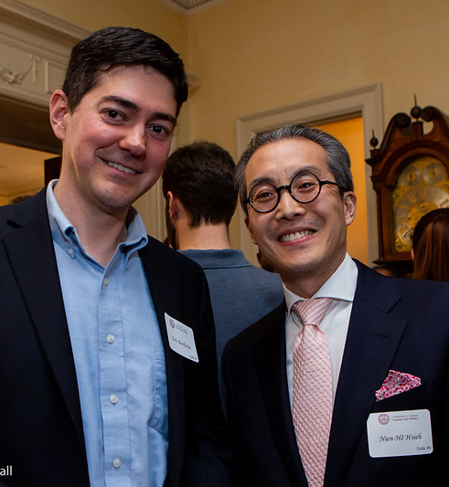
Center Faculty
Getting to know Faculty affiliated with the Center is a valuable opportunity.
Read up on the people on our website and tell us who you want to meet! We can help!
Fellows-in-Residence: Faculty Mentors

Slide 26
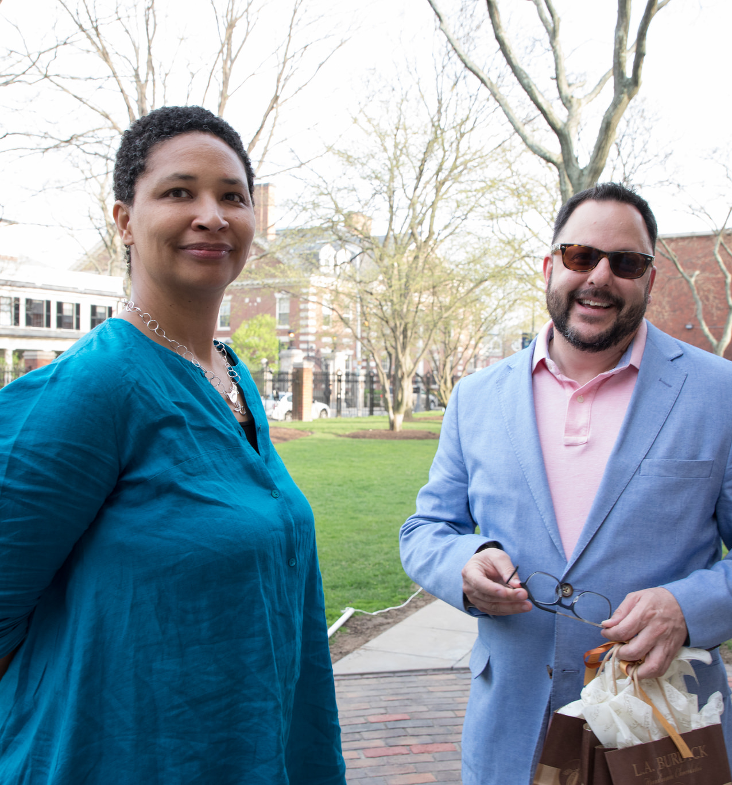
Seminars
Fellows-in-Residence/Faculty Seminars (with lunch): Alternate Tuesdays at Noon
Grad Fellow Seminars (with lunch): Alternate Tuesdays at Noon
Grad Fellows are expected to attend Fellow-in-Residence seminars
Inviting others to your seminar is fine (unless program directors say otherwise), but please let us know who to expect for catering purposes!

Slide 27
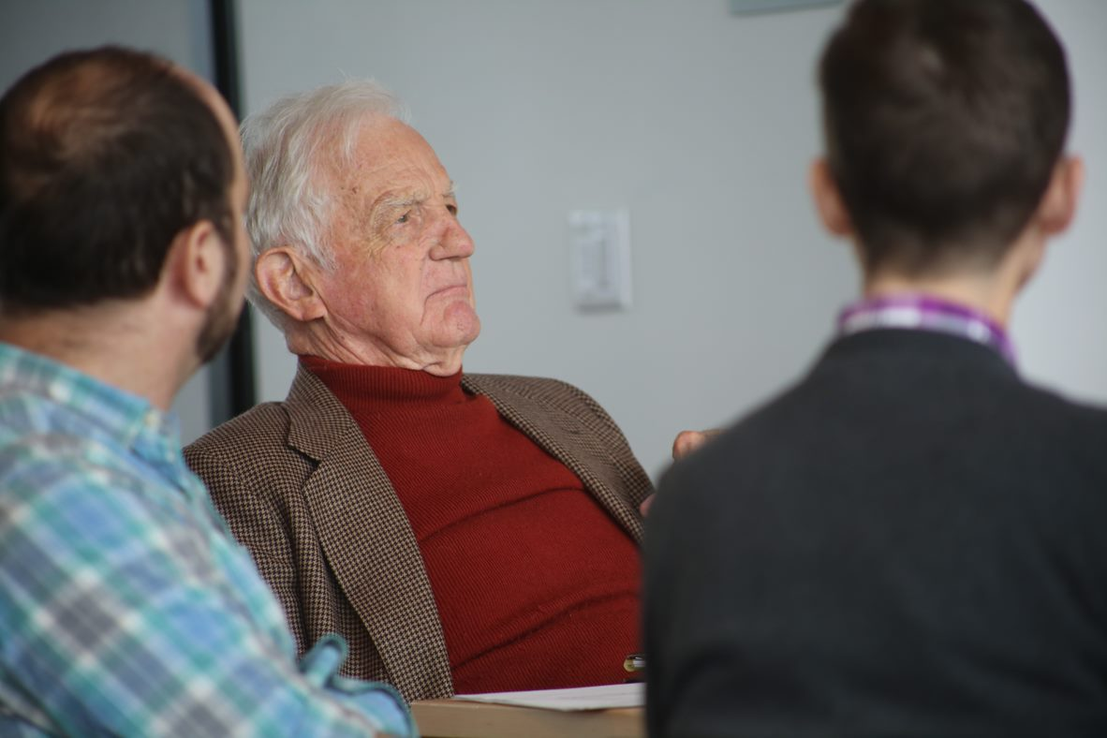
Seminar scheduling survey results will be shared soon
Planning meeting September 20 at noon
Graduate Fellows need not attend
By September 13, need a 1-page summary of your work or what you’re likely to present at a seminar.
Speak about your work for 1-2 minutes max
Fellow-in-Residence Seminar Planning Meeting

Slide 28

Research Funds and Financial Matters

Slide 29
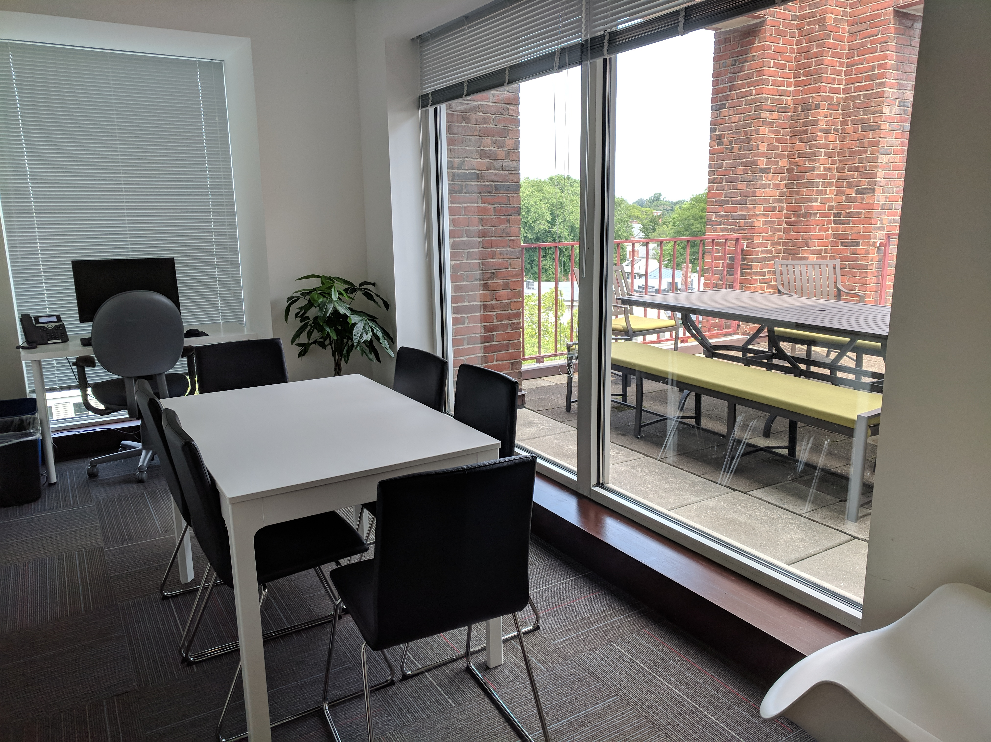
Research Funds
Fellow-in-Residence and Grad Fellow research funds will be paid in a lump sum directly to you in early fall
Research funds should be used for expenses related to your research such as books, professional memberships, conference fees, etc.

Slide 30
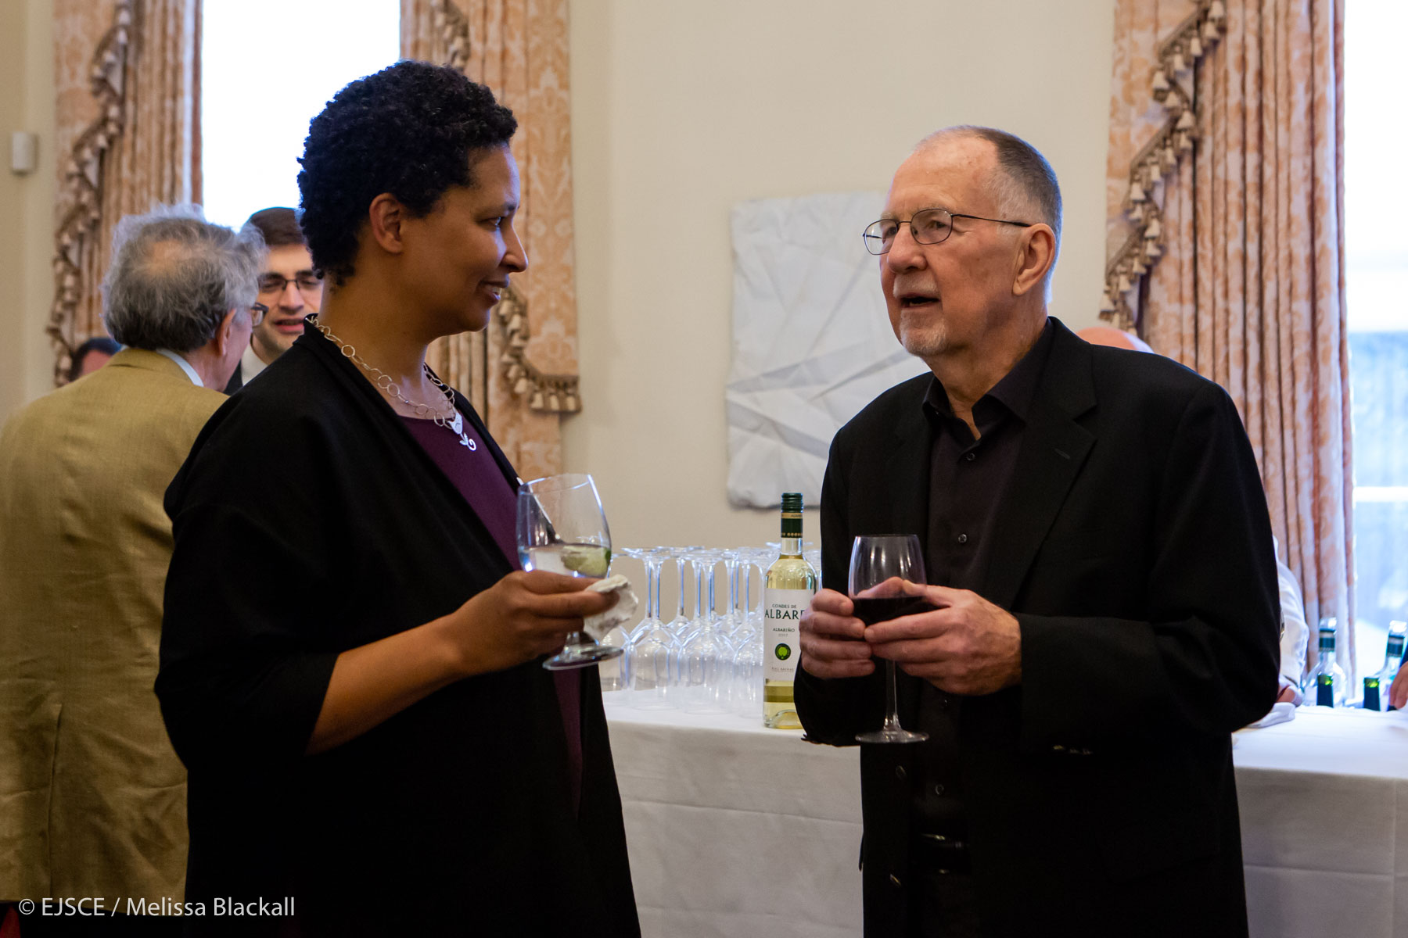
Stipends
Fellow-in-Residence stipends are either paid to you directly or sent to your home institution. A member of the Finance Team will be in touch with you directly if we need any additional information in order to process your stipend.
Graduate Fellow stipends are paid at the end of each month

Slide 31
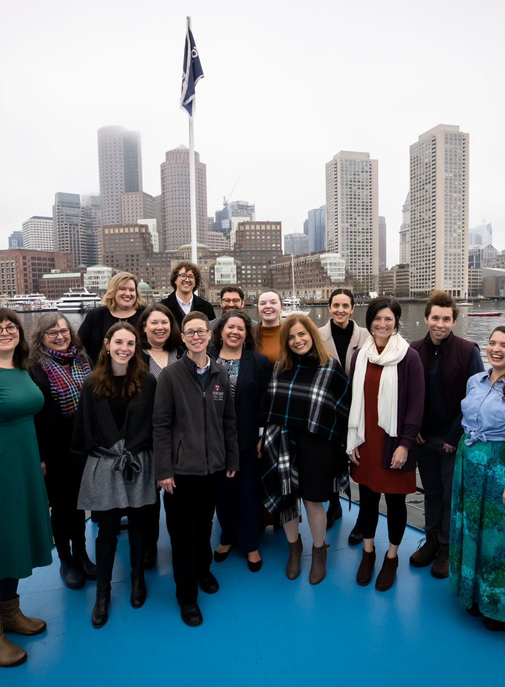
Directing Your Questions

Slide 32
Directing
Your
Questions
Seminars and Events for Fellows:
Emily Bromley, ebromley@fas.harvard.edu
Events:
Alex Ostrowski Schilling, aostrowskischilling@fas.harvard.edu
HR Issues + Financial Matters: Stephanie Dant, stephanie@ethics.harvard.edu
Danielle Allen’s Calendar:
Susan Orr, susanorr@fas.harvard.edu
Communications, Promoting Your Work:
Maggie Gates, mgates@fas.harvard.edu
Fellows Happy Hour and Social Activities:
Social Chairs
All Other Issues:
Emily Bromley

Slide 33
BREAK

Slide 34
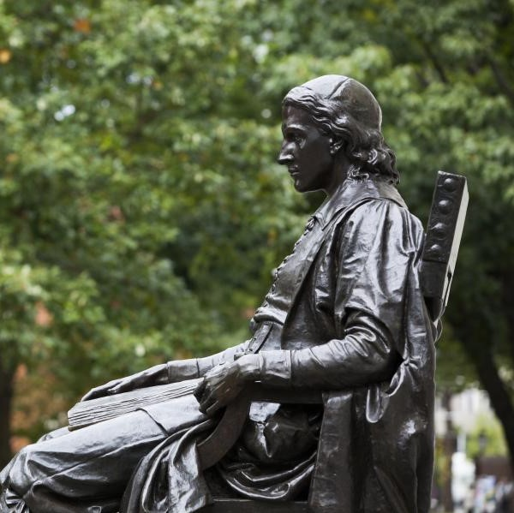
Harvard Resources

Slide 35
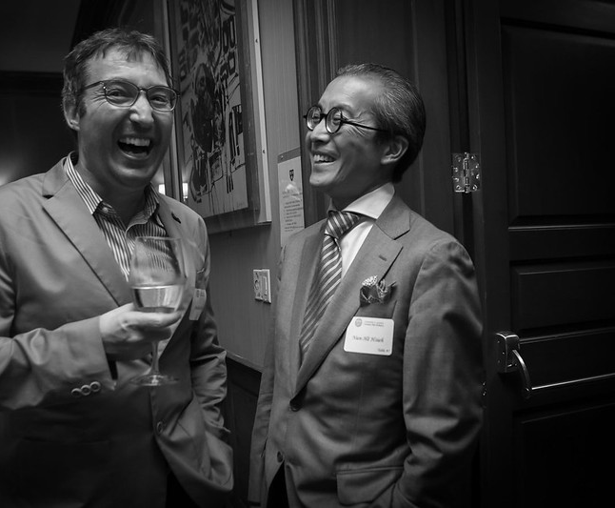
Harvard Credentials
HUID:
A Harvard ID number (HUID) has been assigned to you. Ask Emily if you don’t have it. You can obtain an ID Card at the ID Office/Campus Service Center in the Smith Campus Center .
Harvard Key:
Obtain your Harvard Key at https://key.harvard.edu/. This connects you electronically to resources at Harvard. Your “onboard e-mail” is the e-mail account we have used to correspond with you.

Slide 36
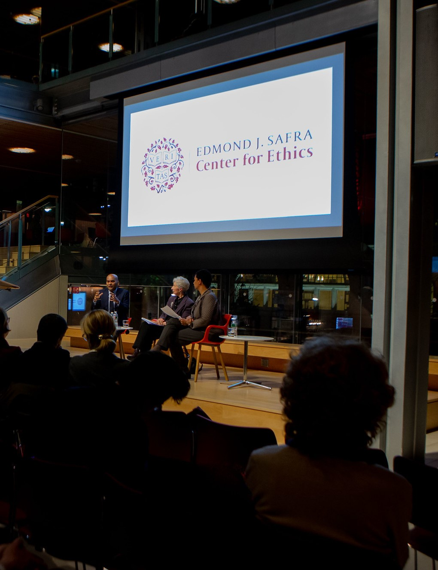
Harvard Credentials, cont.
Harvard Email:
Sign up at https://key.harvard.edu.
Harvard email address is necessary to access many University resources and receive announcements.
It is fine to forward that address to your primary email address.
MessageMe:
Activate the "MessageMe“ phone app for emergency university notices. You can also sign up for Message Me notifications at https://messageme.harvard.edu

Slide 37
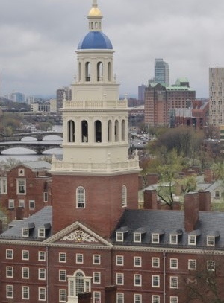
Tech Support
To Contact the Harvard University IT Group (HUIT): email ithelp@harvard.edu or call (617) 495-7777
Resources for Working Remotely can be found at: https://huit.harvard.edu/remote

Slide 38
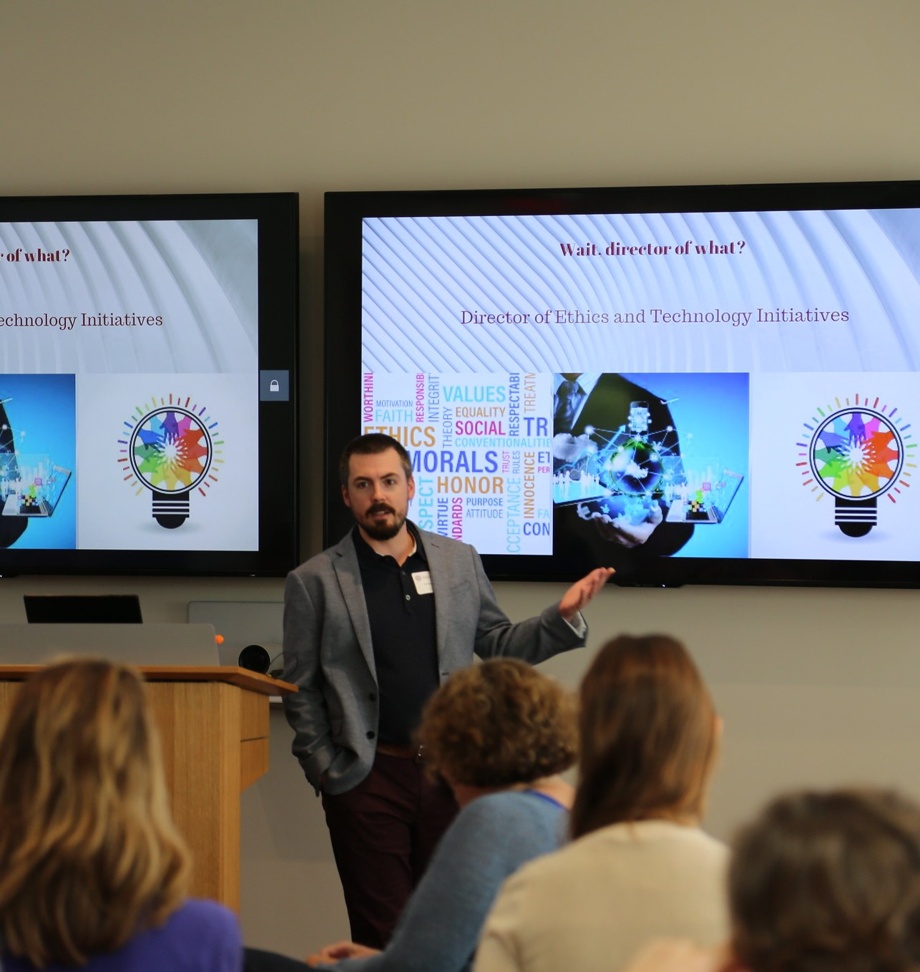
Tech Resources
Slack: harvard-ethics.slack.com
Office: https://mso.harvard.edu/
GSuite: http://g.harvard.edu/
Zoom: https://harvard.zoom.us/
VPN using Cisco Any Connect Secure Mobility Client (required for some applications):
      Install
      Connect

Slide 39

Perks
Athletic Facilities
Harvard Museums
Outings & Innings for discounts (check out the "Hidden Gems" page)
Center for Wellness classes and virtual resources

Slide 40

COVID-19 Precautions

Slide 41

Coronavirus Information
Information about Harvard’s response to COVID-19
Testing Dashboard
General Information about being on campus

Slide 42

Vaccinations
All Harvard community members who will have any on-campus presence must be vaccinated (or receive an exemption). More information here
Submit proof of vaccination or learn about exemptions here
Still need a vaccination? Find out how you can get one here

Slide 43
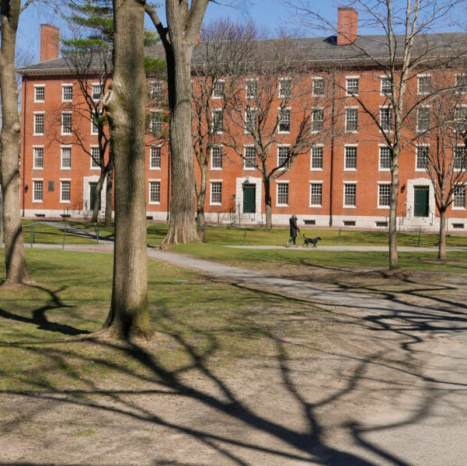
Spending Time on Campus
Masks are optional in most places, but you should have one handy at all times.
Optional Testing Program: ENDS 9/16 self-administered PCR tests are available but not required
Please stay home if you don’t feel well
Be ready to have to work remotely if necessary
More information available here

Slide 44

Using Center Office Space
Masks are optional in our office, but please be respectful of other's comfort
Masks and tests (through 9/16) available at the front desk
Please do stay home if you don’t feel well
Thanks in advance for helping us maximize the use of our space by regularly using Officely.

Slide 45

Testing
Optional testing program requires you to create a color.com account
Self-test and drop off the same day
Tests available at the front desk
If you test positive, follow University guidelines about when you can return to campus.
Find out more here

Slide 46
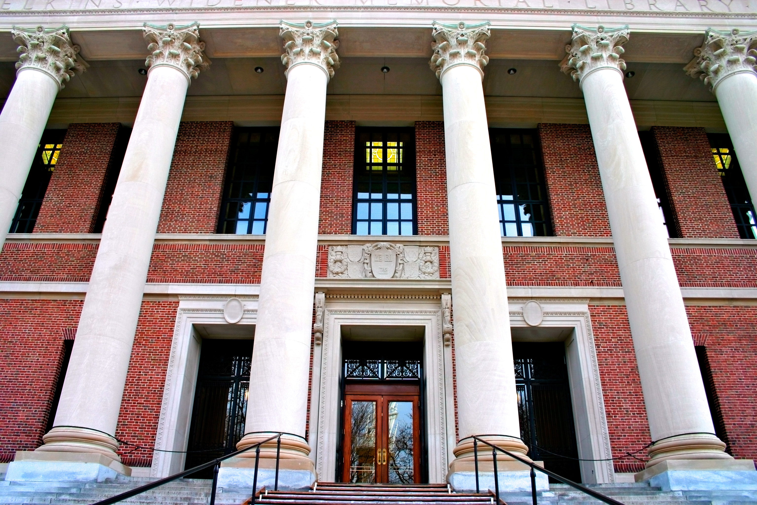
Library Orientation: Tuesday 9/6 at 3 pm
(Widener Library, 240)
Library services and tools info here
Widener Virtual Tour available here

Slide 47
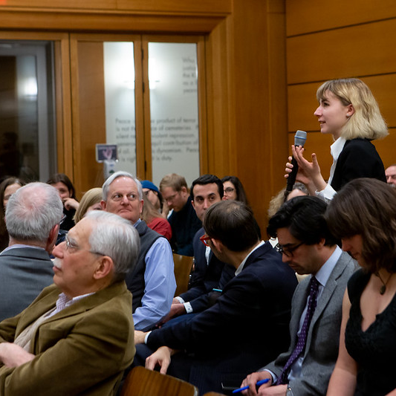
Questions?

Slide 48
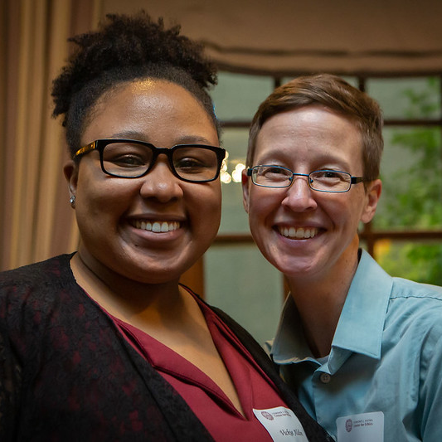
THANK YOU

