Slide 1


Welcome
New Fellows!
2021-2022

Slide 2
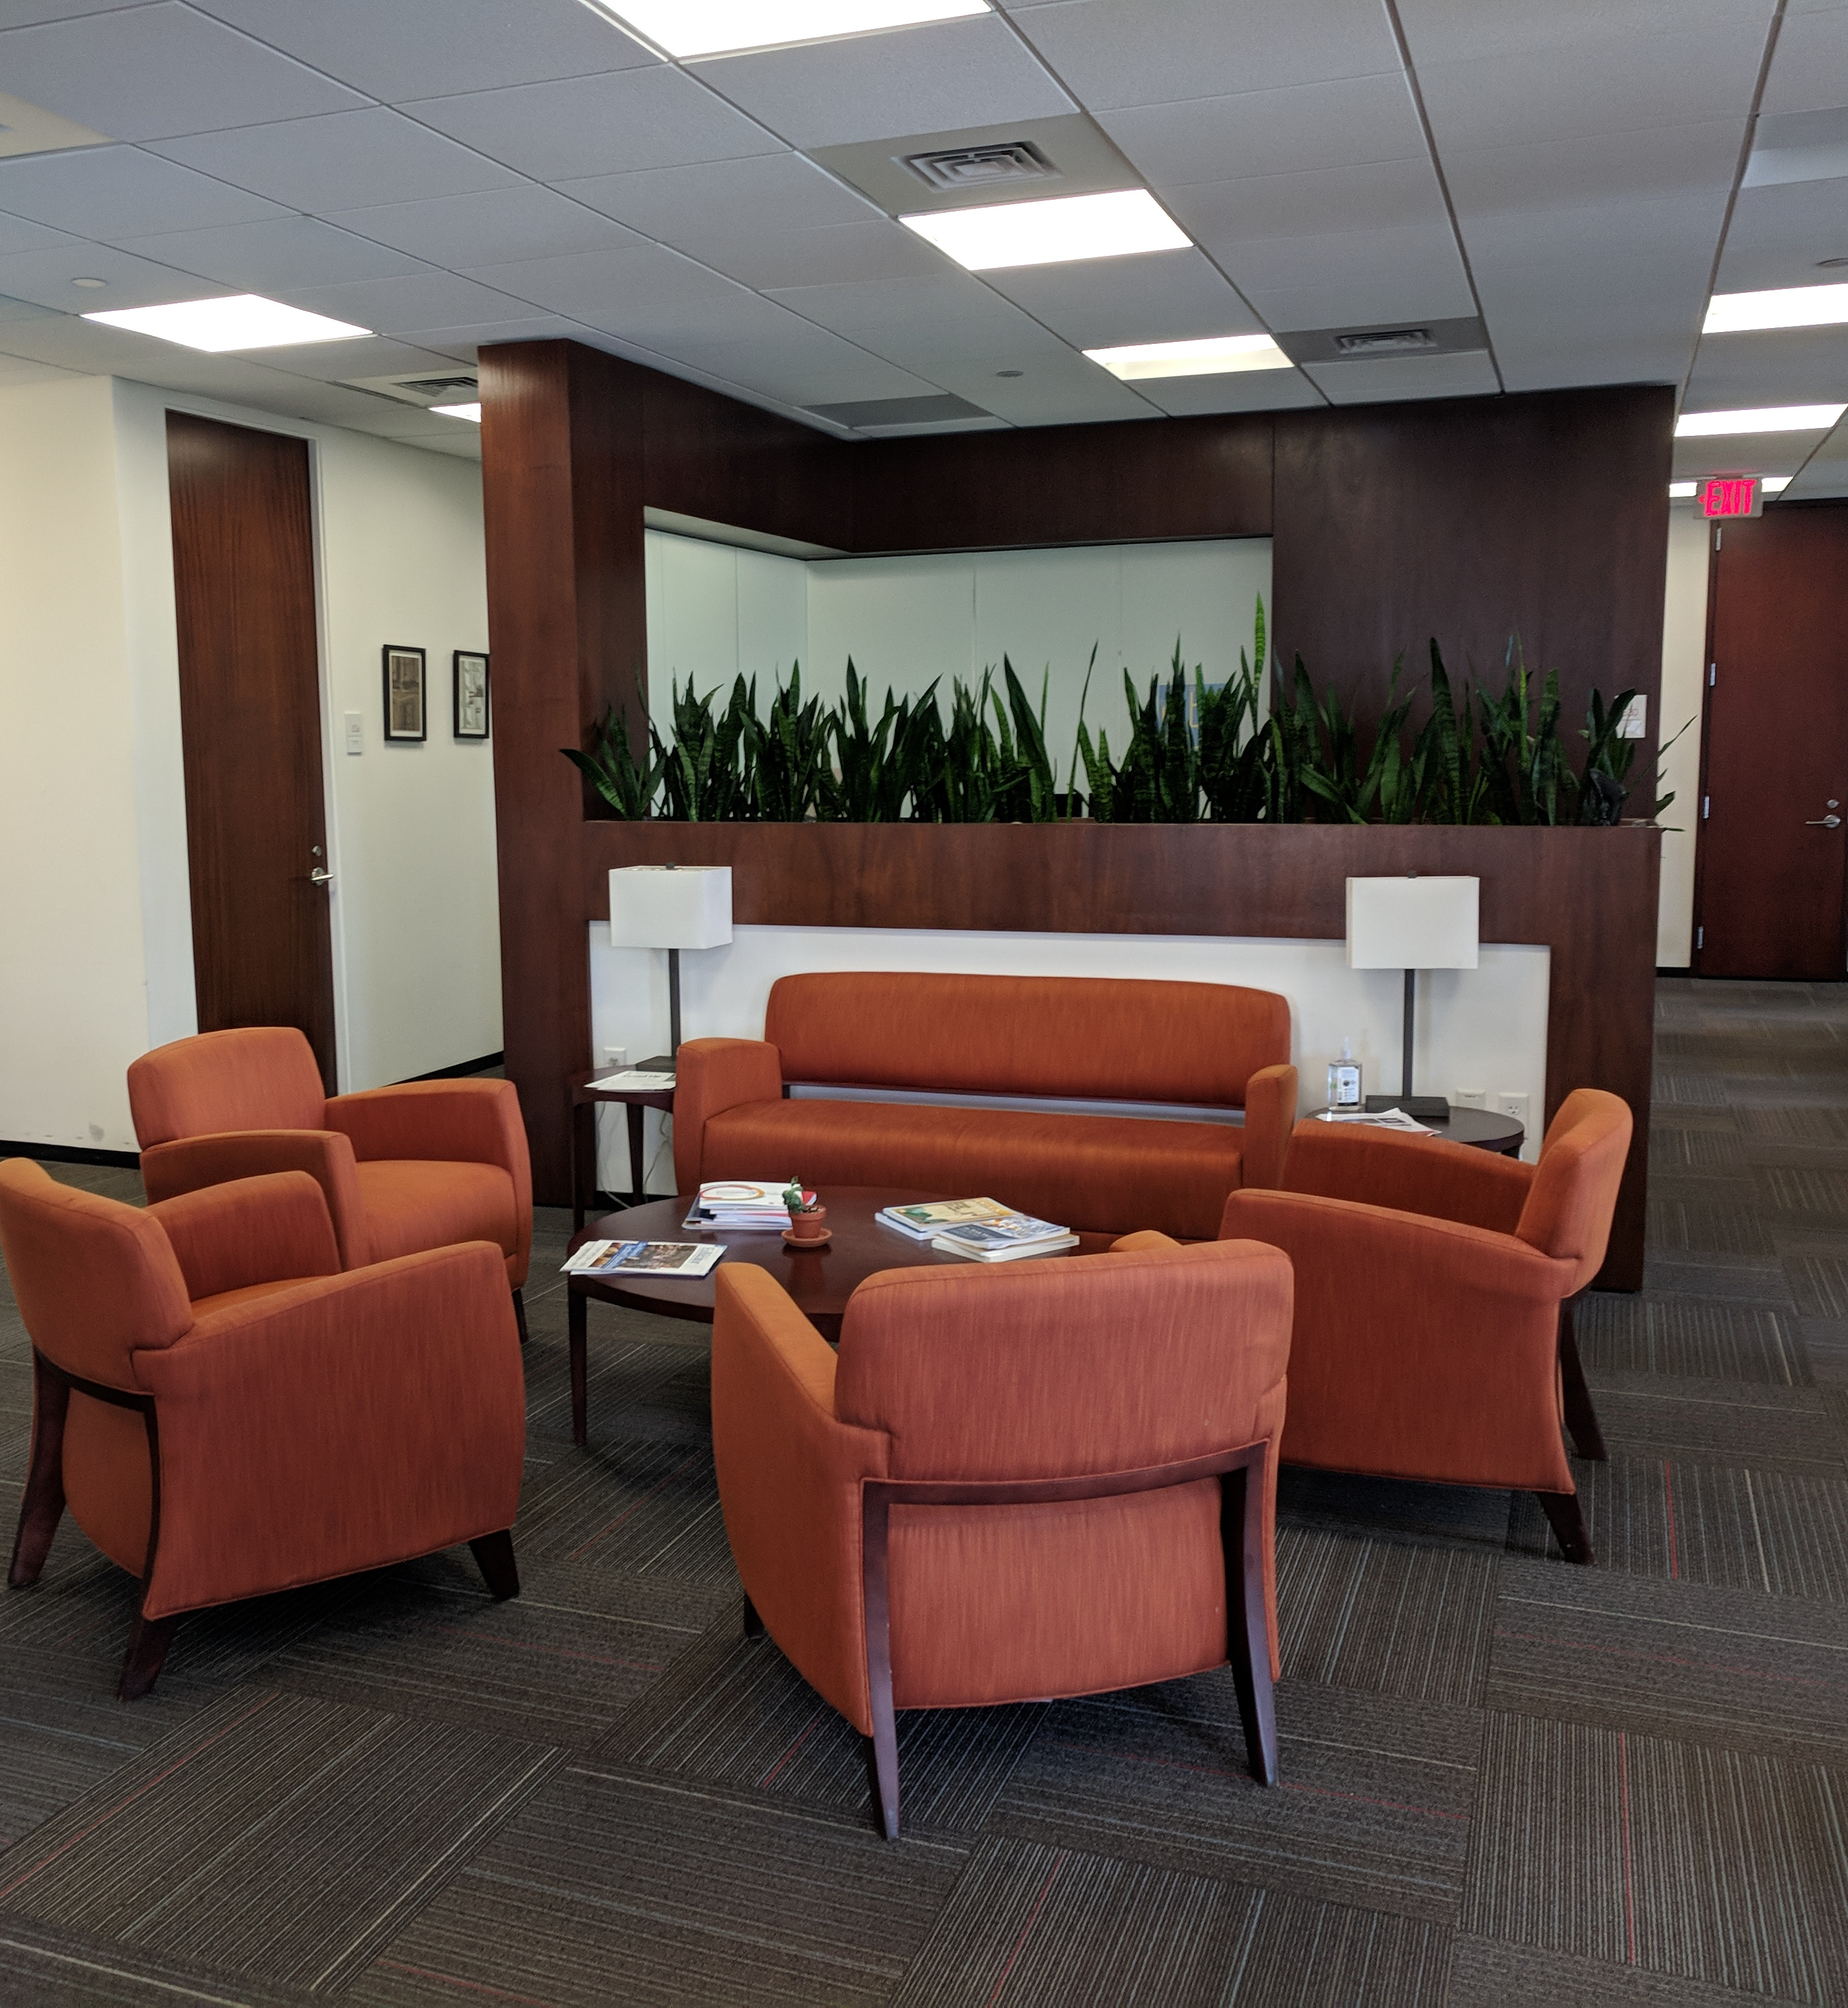
Contents
  Connecting with Each Other
  Orientation to the Center
  Information on Harvard Resources

Slide 3

Connecting with Each Other

Slide 4

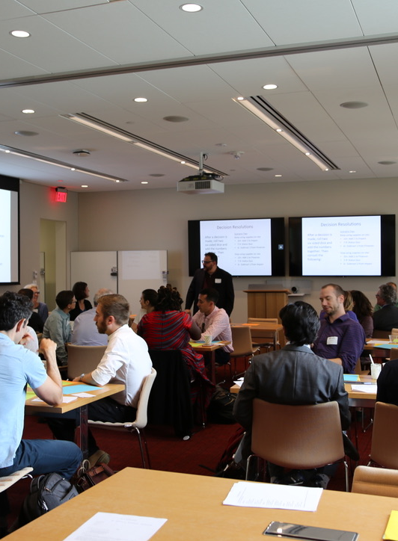
Seminars
Creating a Cohort Experience in a Semi-Virtual World:
Events Planned by Social Chairs
Casual talk around the office
"Walk and talk" events with random match
Fellow-driven Reading Groups
Fellow-driven Discussion Groups
Office hours?

Slide 5
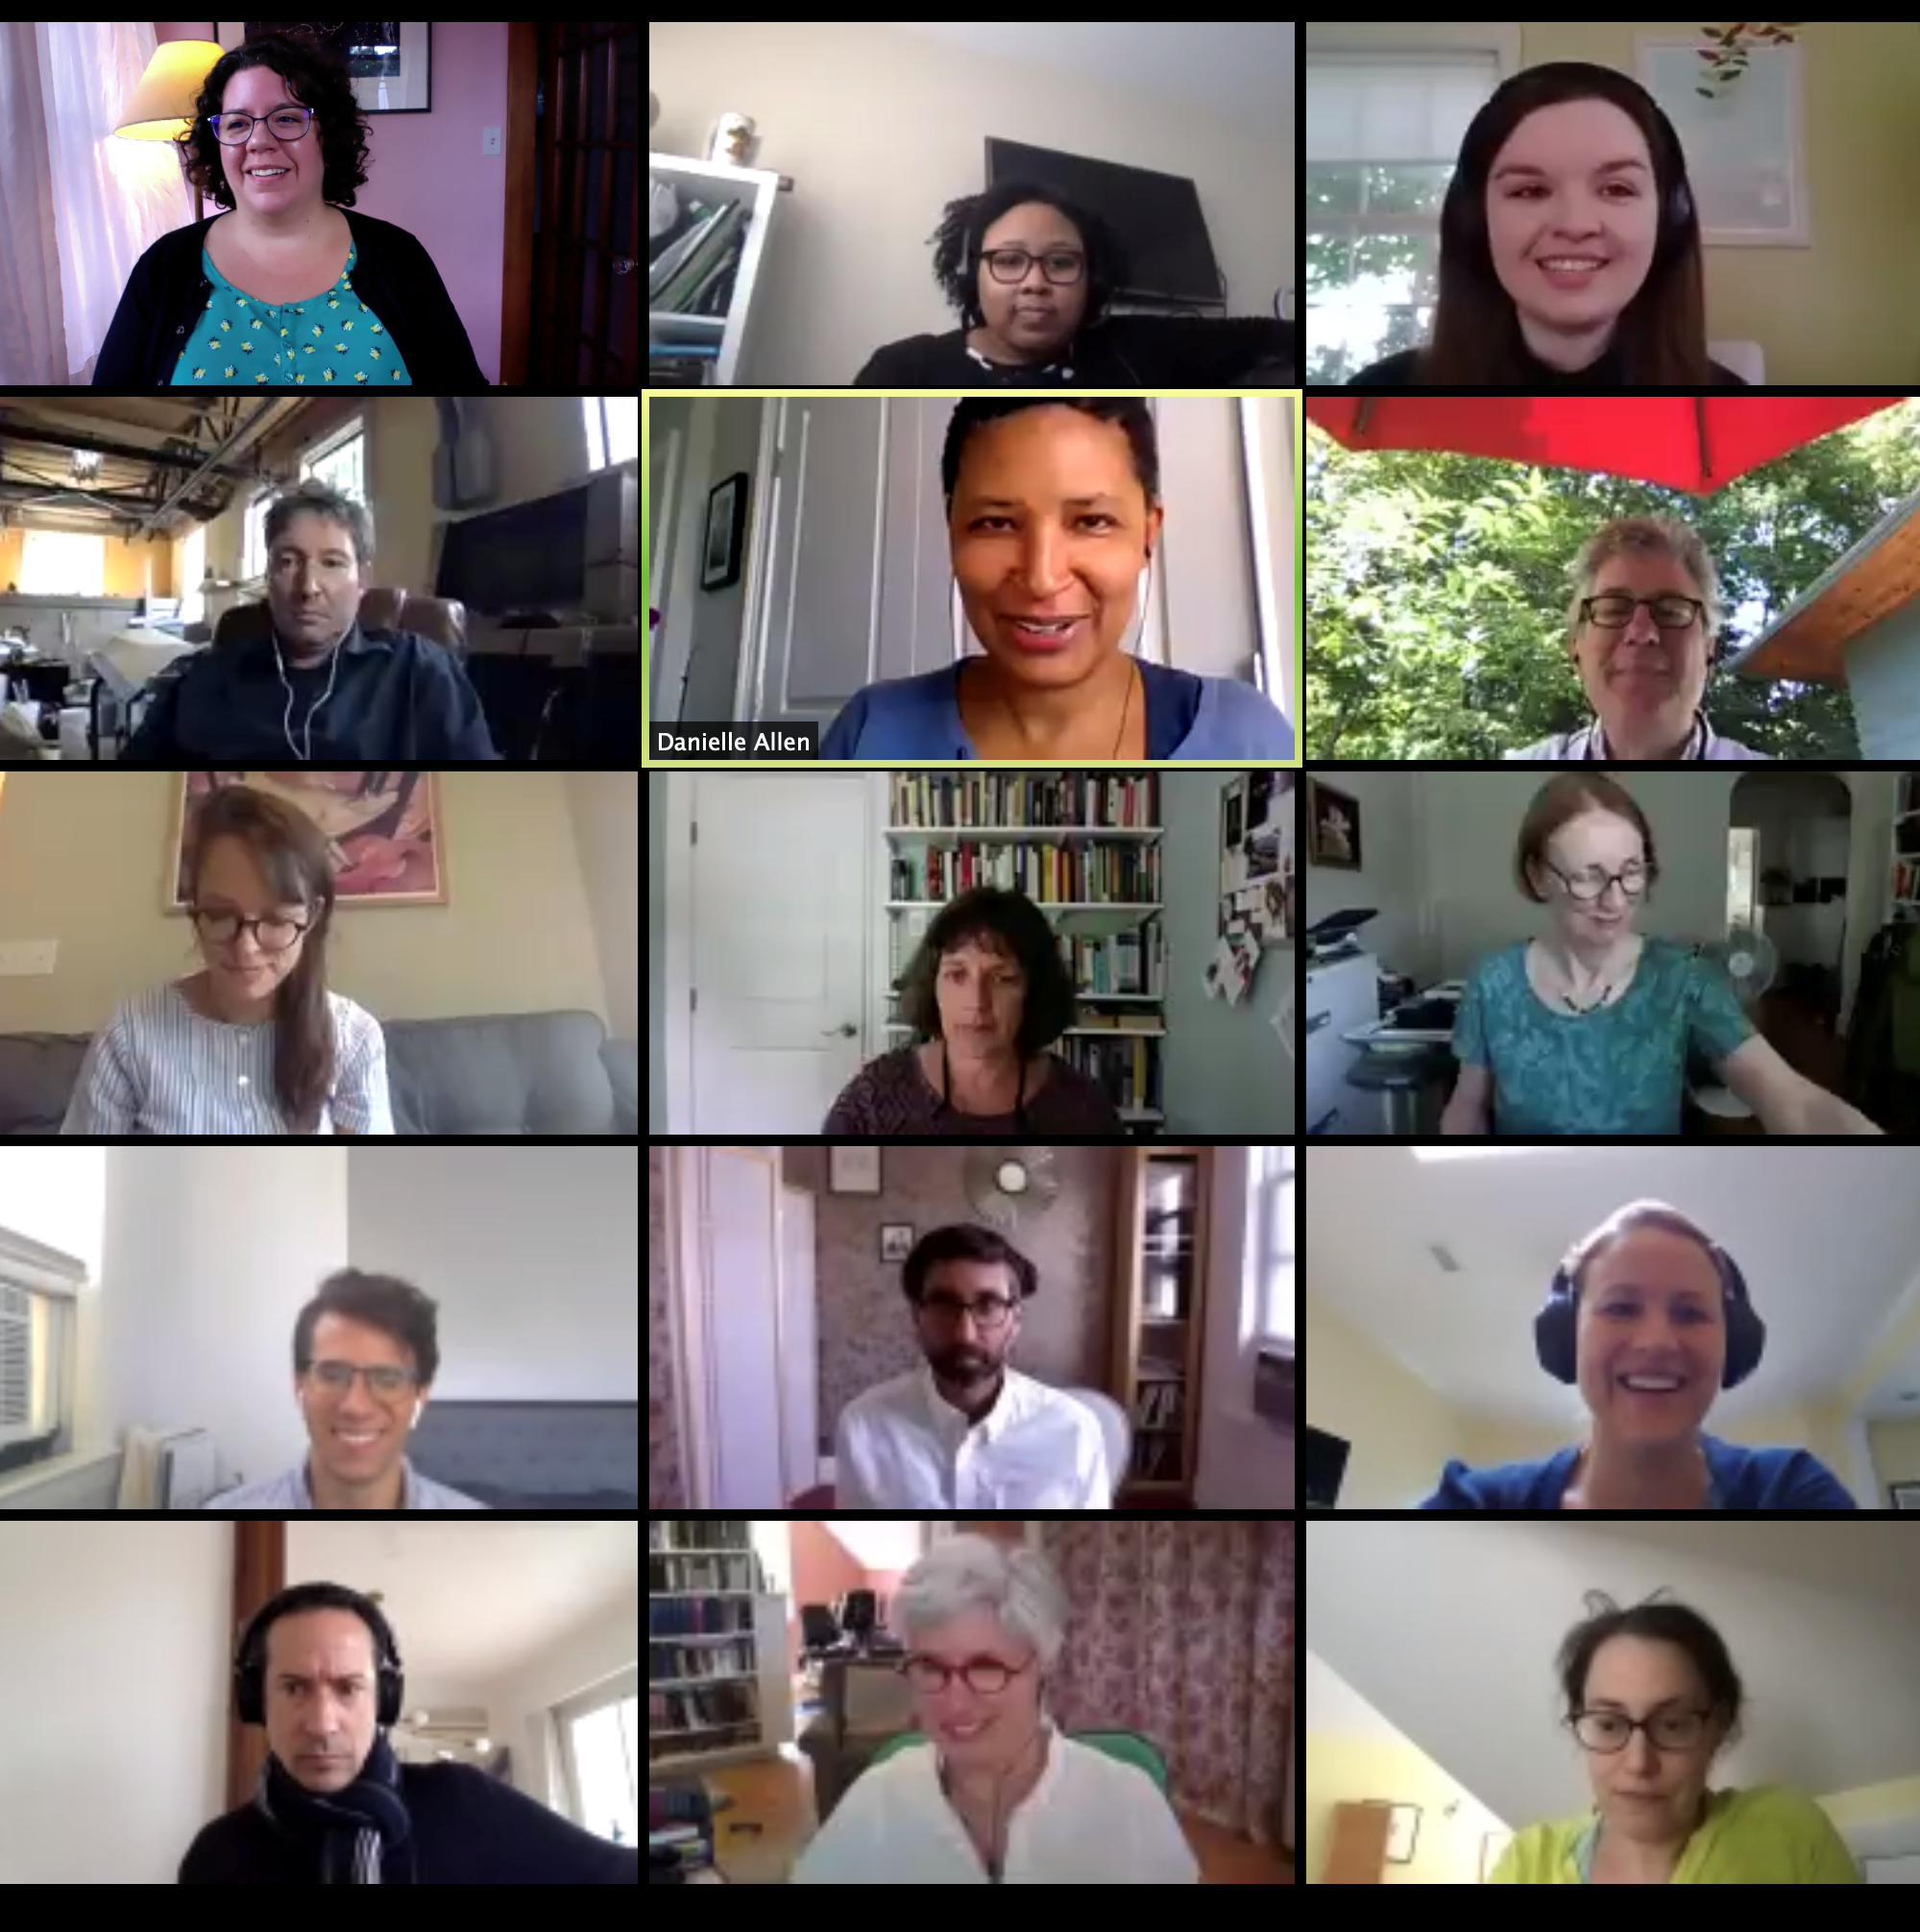
Fellows Zoom Lounge
You will all have a Zoom account through Harvard and can use it anytime.
We have also created a Zoom “Lounge” for fellows:
  https://harvard.zoom.us/my/ejsafrafellows
  Passcode = 221423
  Host Key = 788334
Use this when you’d like to be available to chat with other fellows, for reading groups, or meetings, but keep in mind it’s not private.

Slide 6
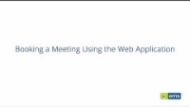

Making Good Use of Office Space
Once you have a sense of when you will be working from the office, please book your office space using the RoomBook system, roombook.harvard.edu.
We are currently scheduling through the end of 2021.
If you will NOT be using your space at a time when you normally would be, please relinquish the space in the system as well.
PLEASE HELP US KEEP TRACK OF OFFICE SPACE USE BY USING ROOMBOOK!
This will help us track people in case of a Covid outbreak and help you plan if you want to connect with a specific person.

Slide 7
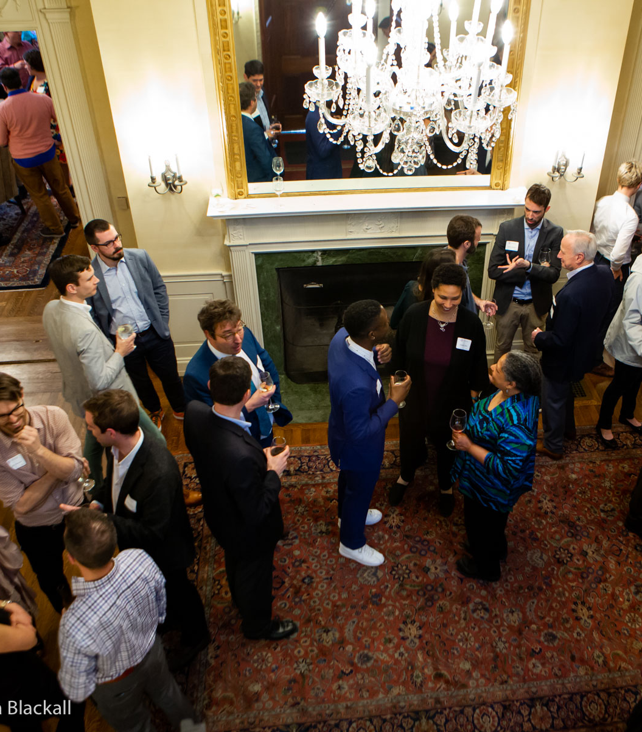
Orientation to the
Center

Slide 8
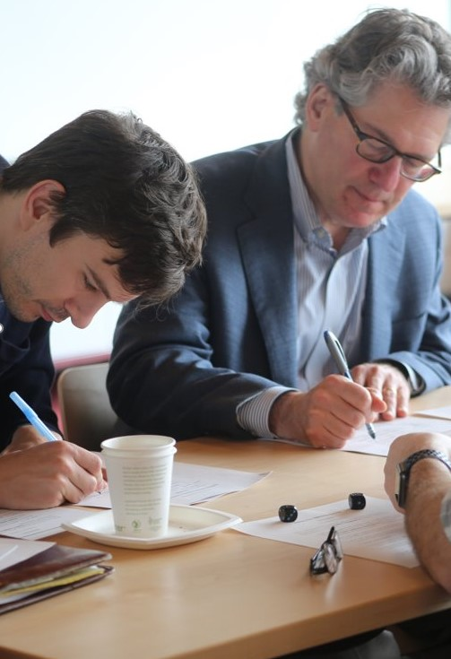
Mission
The Edmond J. Safra Center for Ethics seeks to strengthen teaching and research about pressing ethical issues; to foster sound norms of ethical reasoning and civic discussion; and to share the work of our community in the public interest.
https://ethics.harvard.edu/

Slide 9
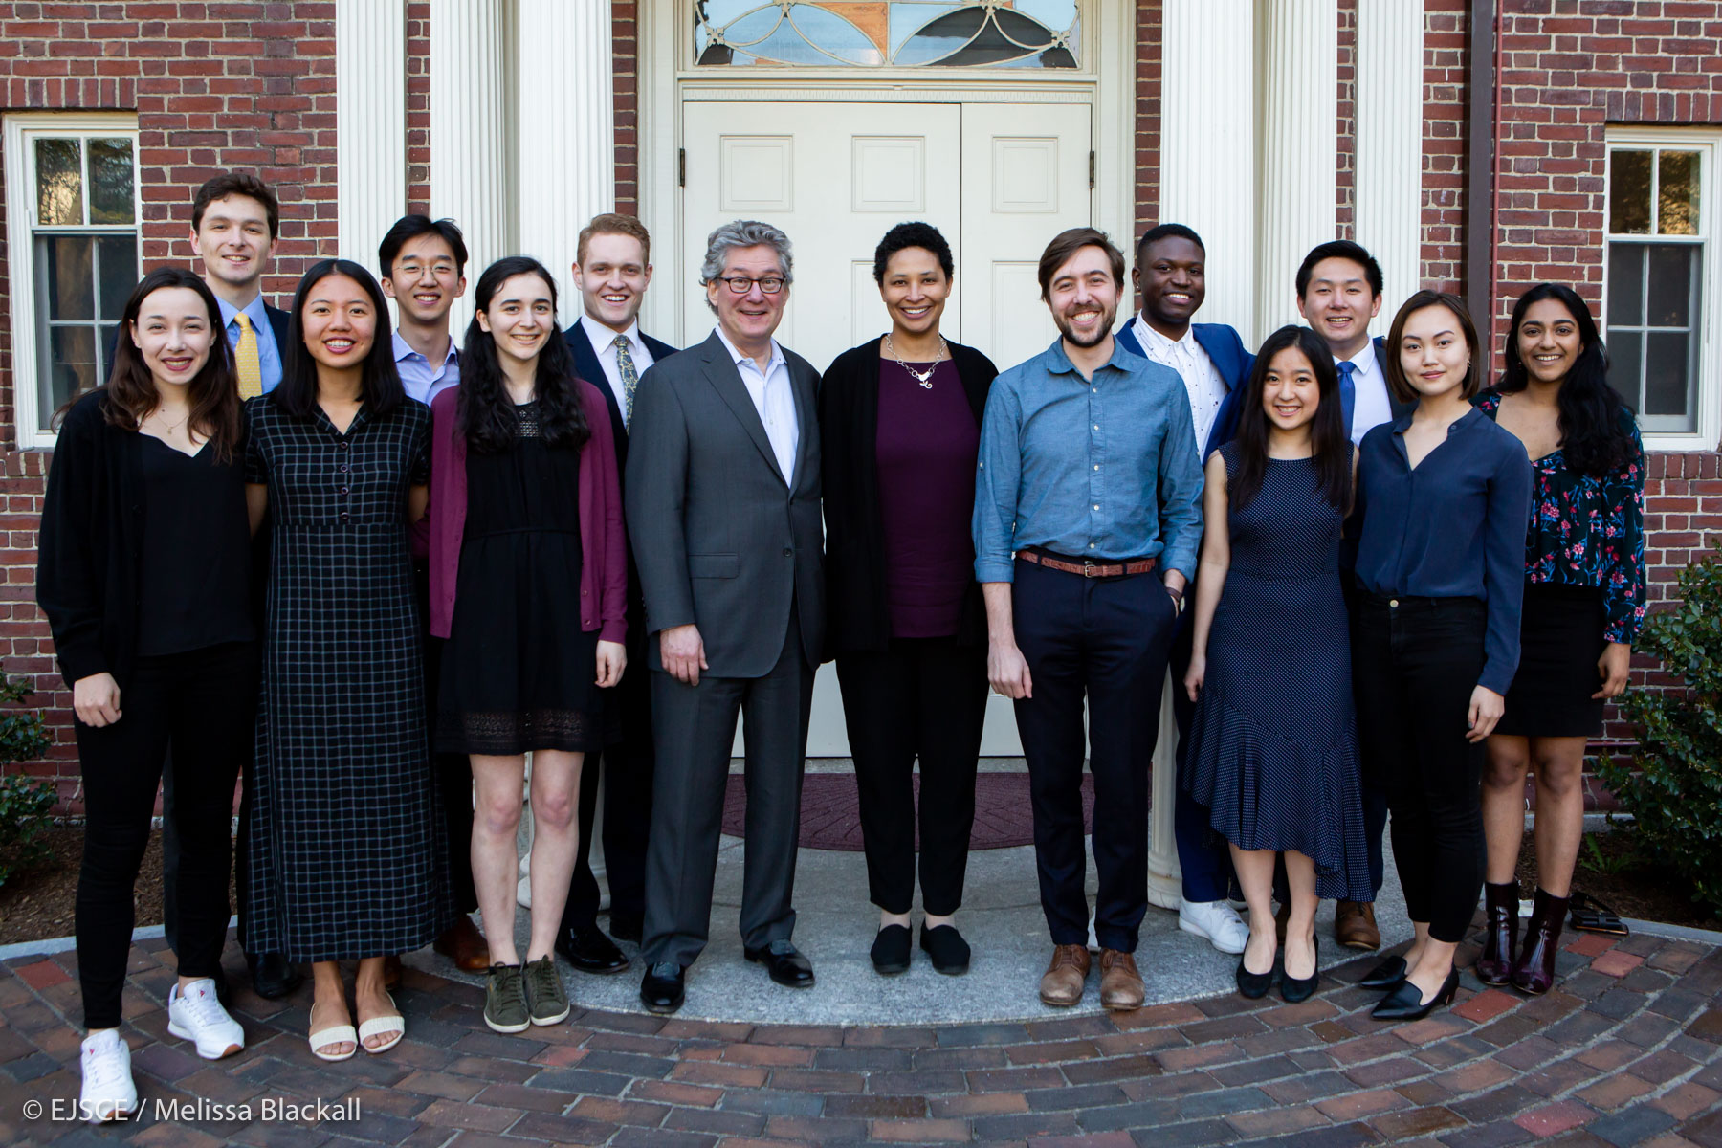
Fellowships Offered
Faculty / Fellows-in-Residence
Tel Aviv University Exchange Fellows
Visiting Fellows
Graduate Fellows
Ethics Pedagogy Fellows
Undergraduate Fellows
Intercollegiate Civil Disagreement Partnership Fellows
2019's graduating senior Undergraduate Fellows

Slide 10
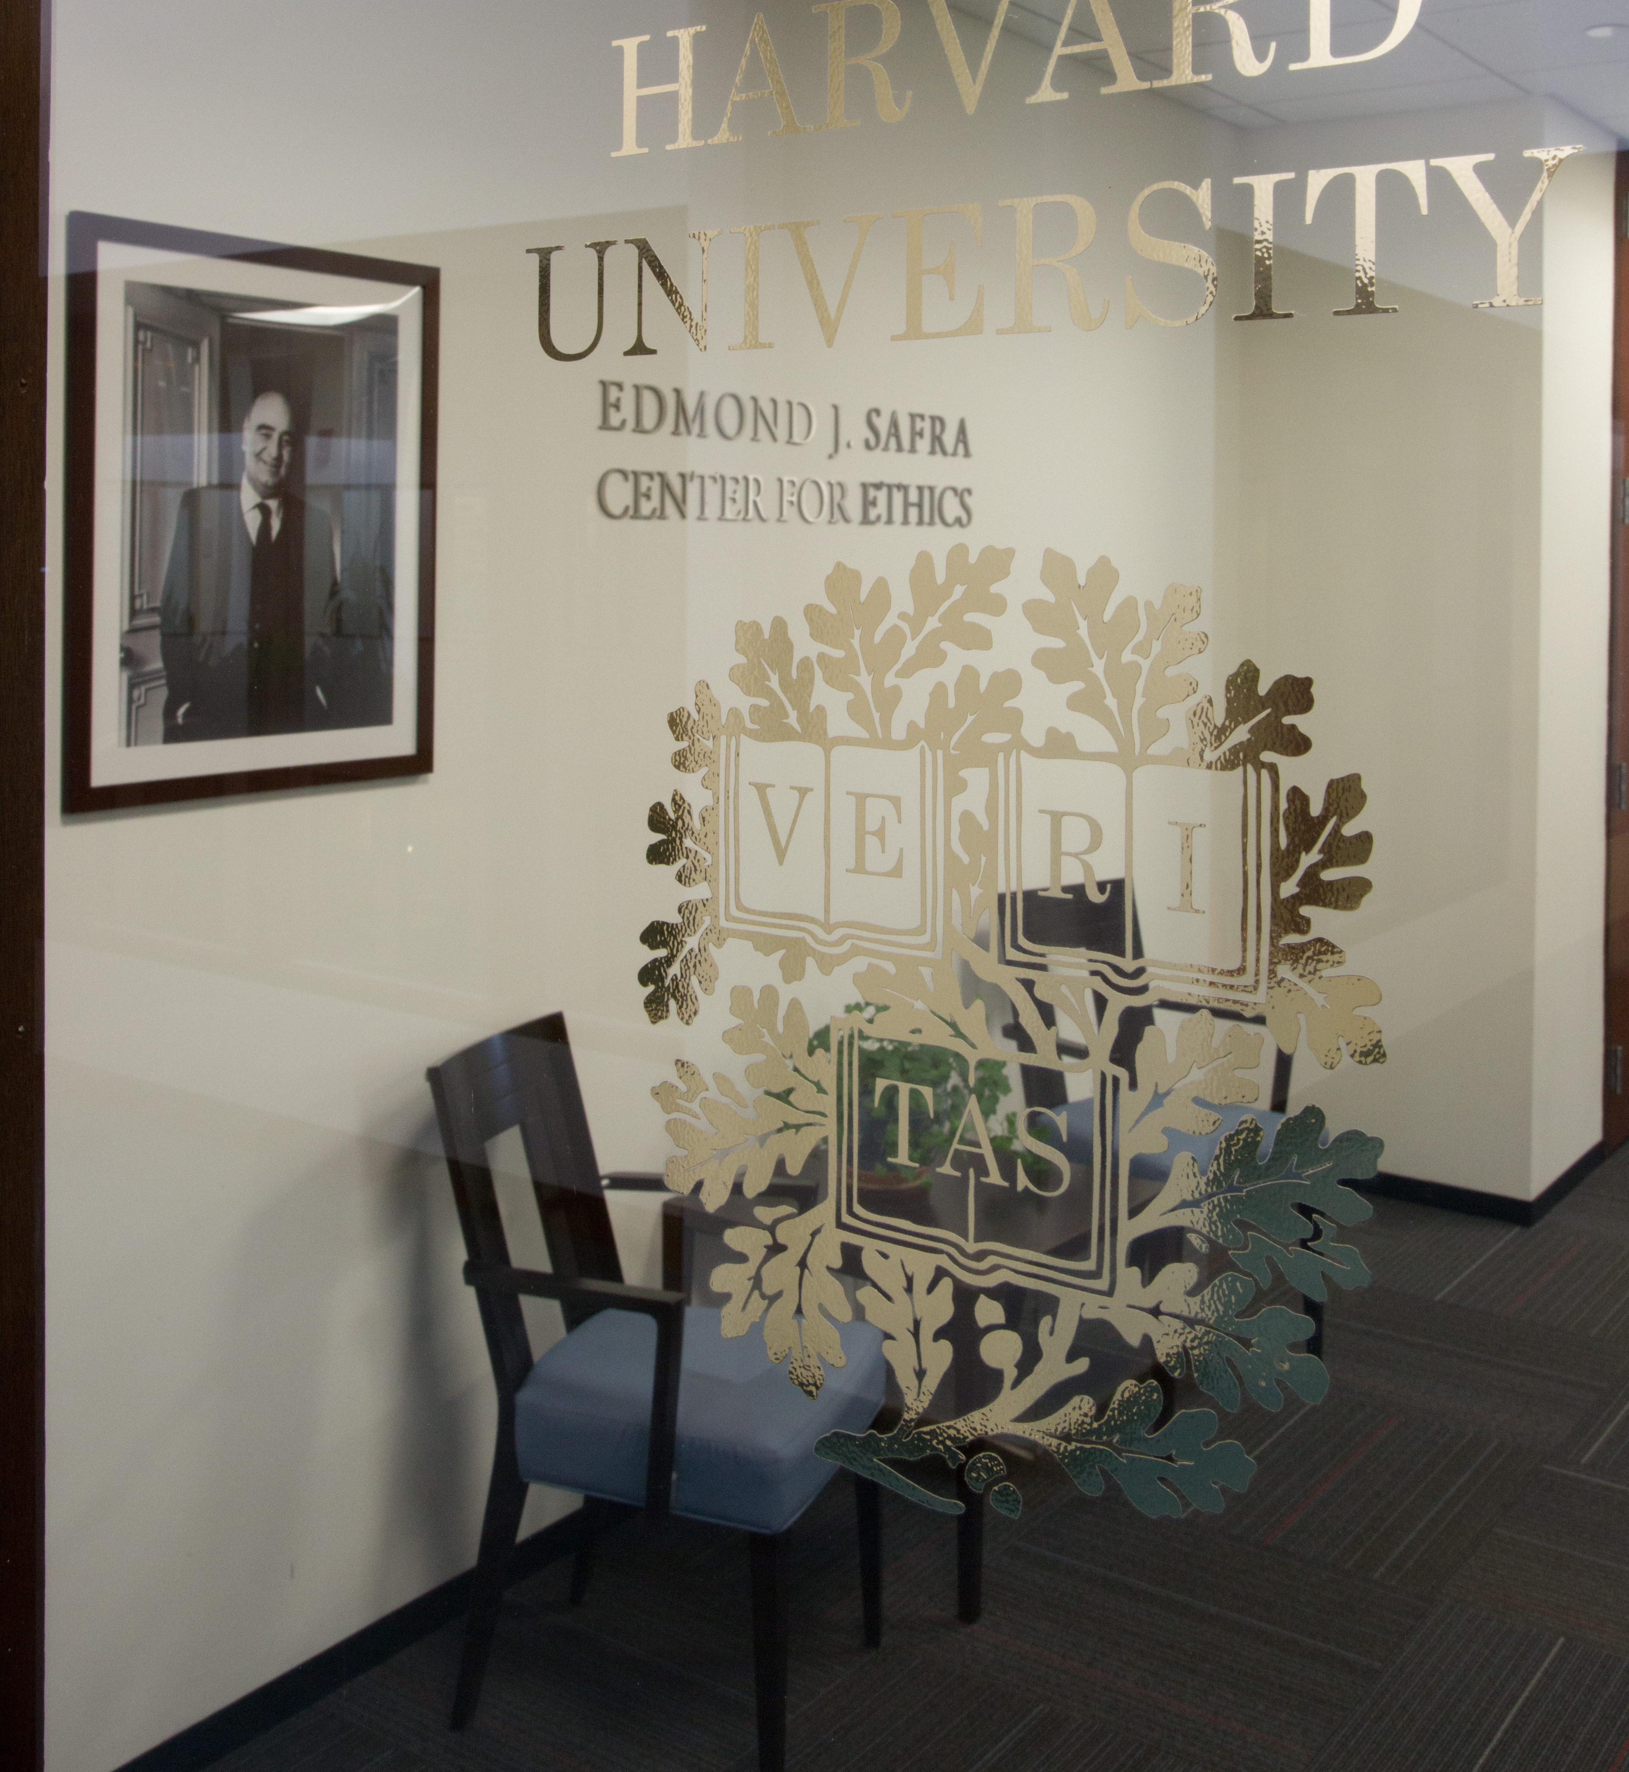
Naming Convention for Public Use
  Edmond J. Safra Center
  Center for Ethics
  EJ Safra Center
  EJS Center
  NEVER just "Safra Center"
  Fine to mention Center affiliation on publications but not required

Slide 11
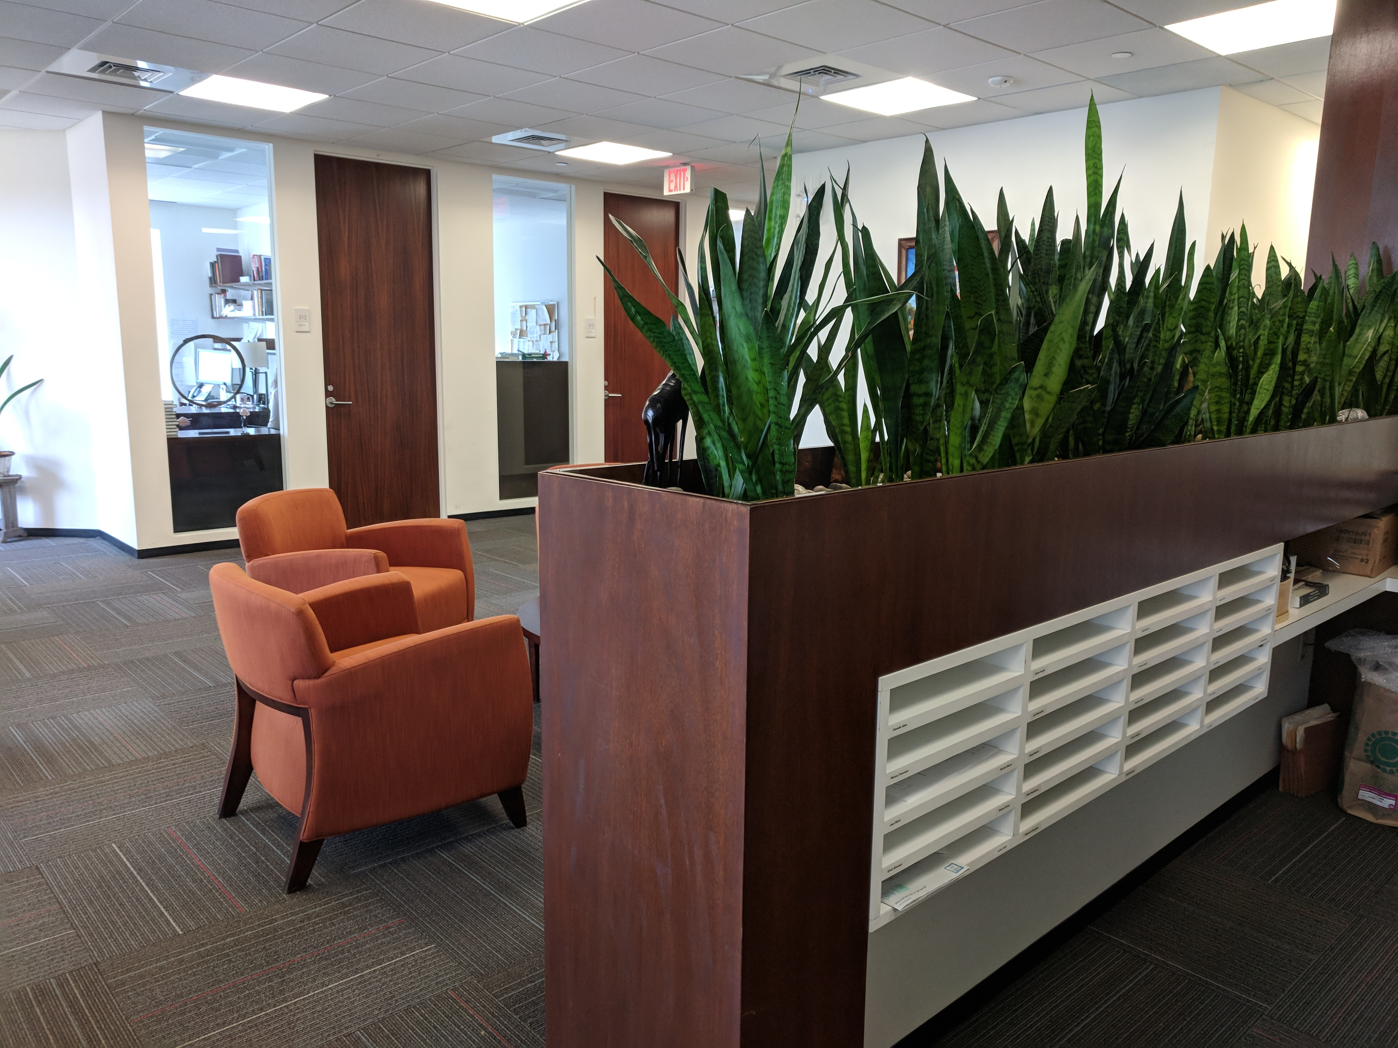
Finding Information
Our website: ethics.harvard.edu
Follow Us:
  Twitter: @harvardethics
  Facebook: @harvardethics
  Instagram: @harvardethics
Public Events: https://ethics.harvard.edu/calendar/upcoming

Slide 12
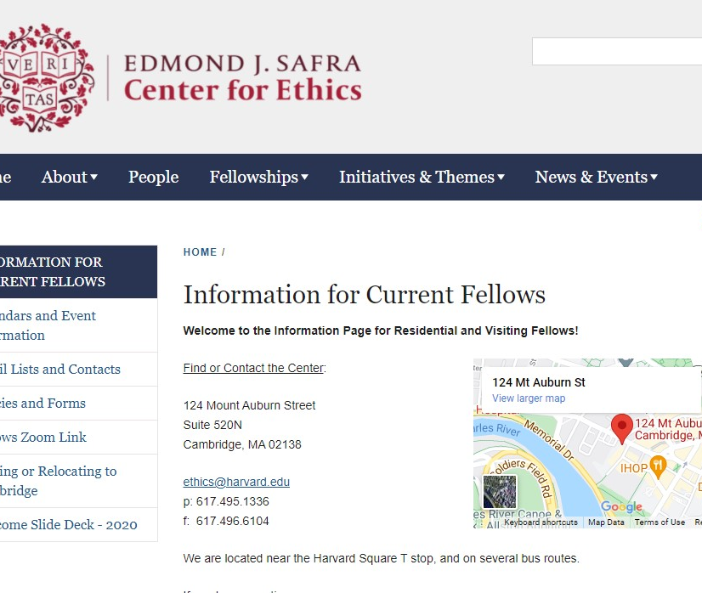
Online Information for Current Fellows
Visit the special section of the Center's website, just for Fellows, at
https://ethics.harvard.edu/information-fellows

Slide 13
BREAK

Slide 14
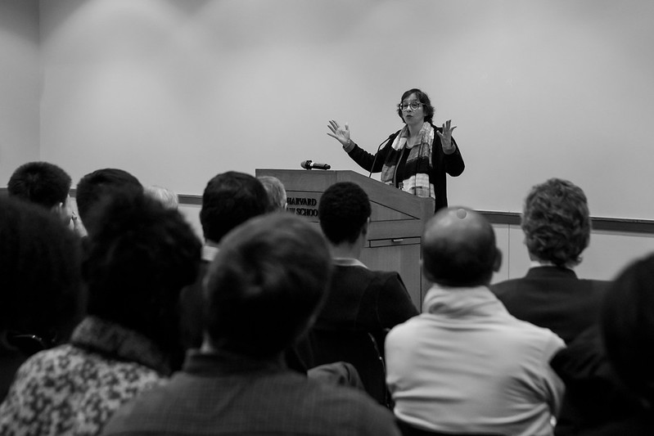
Upcoming Center-Sponsored Public Events
October 7 - "Reconsidering Reparations" with Olufemi Taiwo, 4 pm.
October 22 - Ethics in Your World Book Series with Myisha Cherry, 12 pm.
November 4 - Civil Disagreement Series on Gun Control, 4pm.
November 19 - Ethics in Your World Book Serie, speaker TBD, 12 pm.
More Added Regularly. Read the Newsletter!

Slide 15
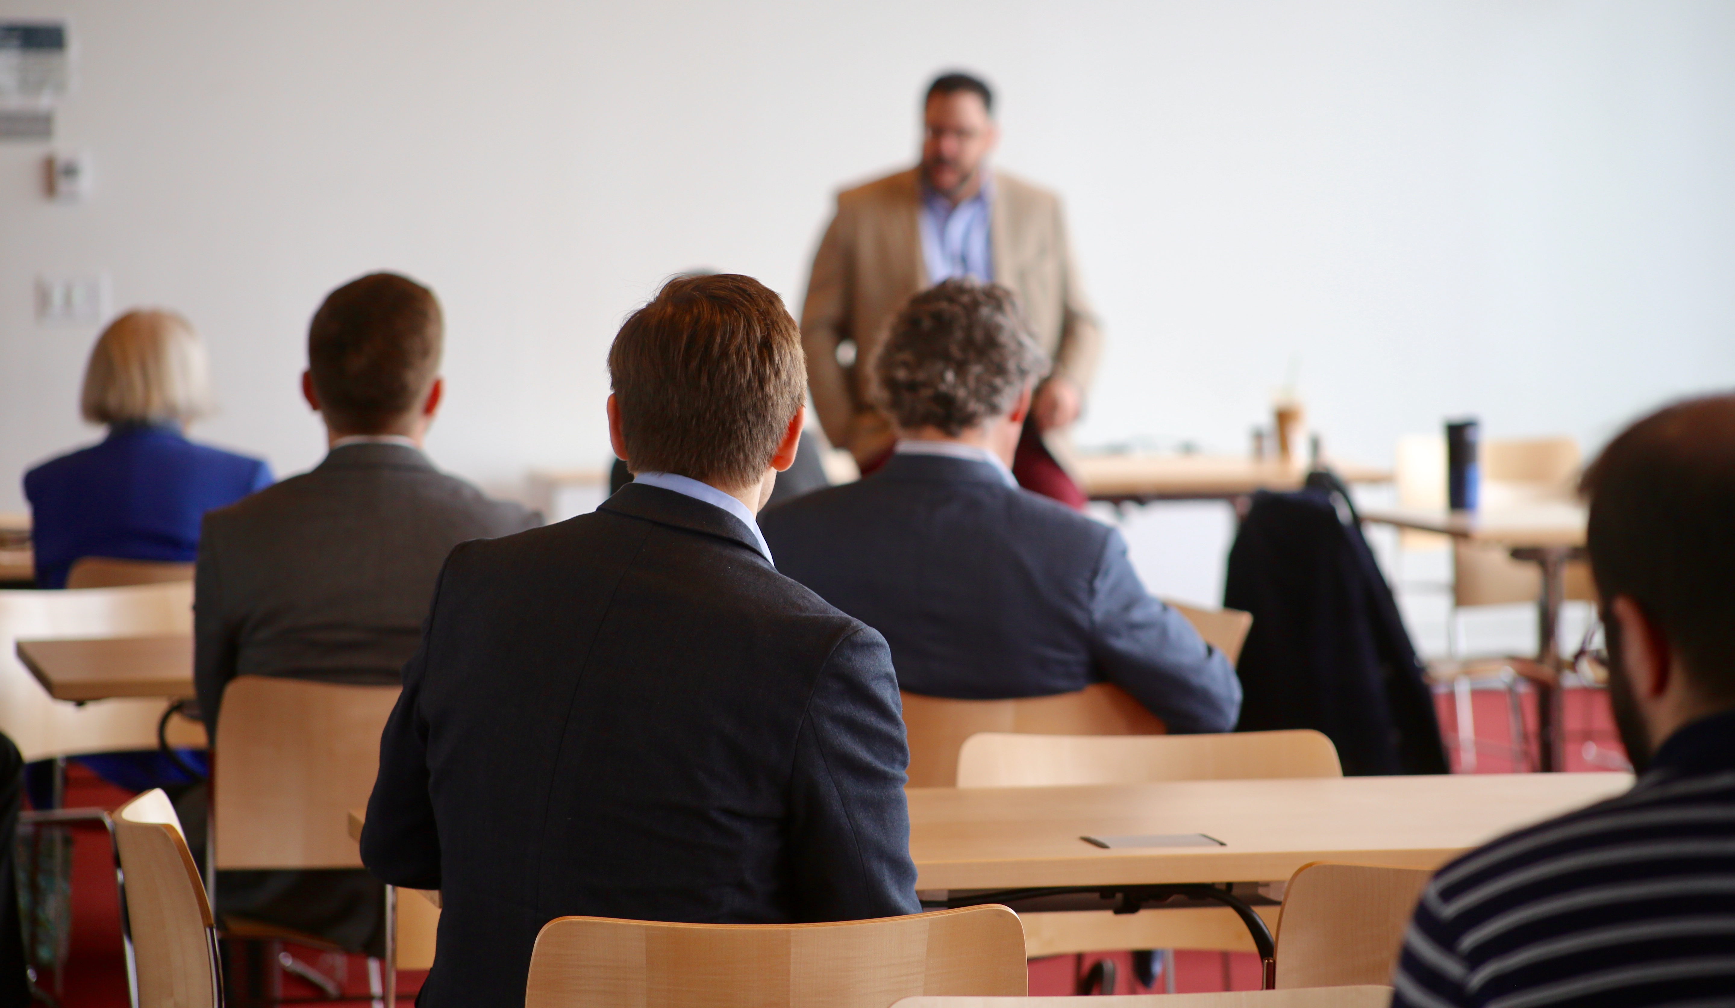
Upcoming Events around Harvard
Virtual Academic and Social Activities: https://www.harvard.edu/coronavirus/socialize-remotely
Harvard Gazette Events: https://news.harvard. edu/gazette/harvard-events/
Contact Departments of interest to you and ask to be added to mailing lists

Slide 16
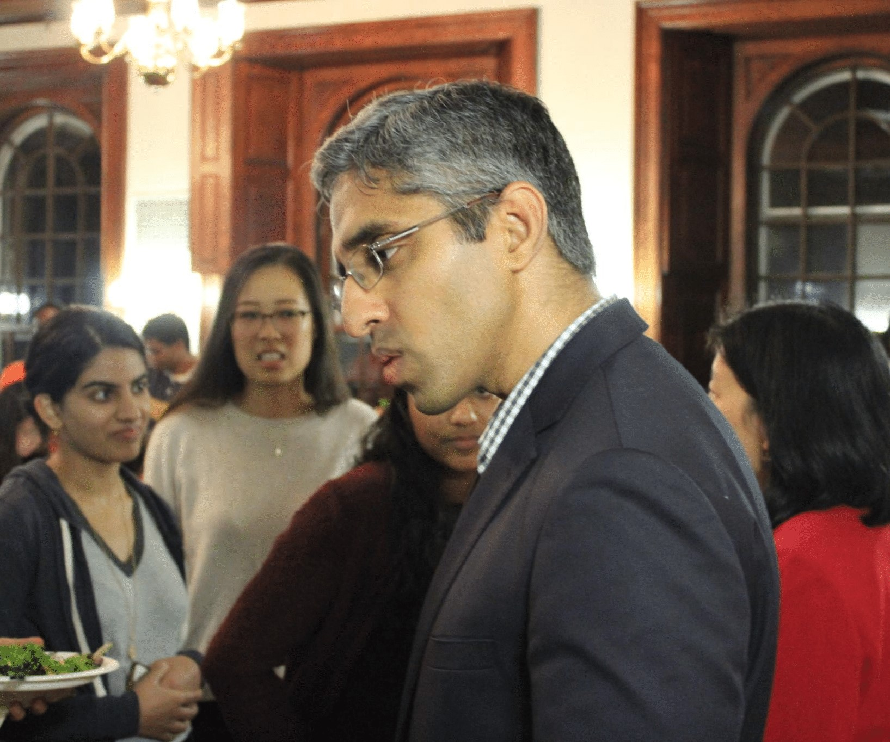
Ideas for Events During the Year?
Do you have a workshop, talk, or other event in mind for this academic year? Please let Emily know!
If you can share details with Emily and the Programming Team by mid-September, we will consider it as we decide what other events the Center will host this year.
Even if we cannot sponsor your event, you may be able to get some support in holding it. Fellowship research funds can be used to host an event.
Decisions and Desserts event with Vivek Murthy and Alice Chen, September 28, 2018

Slide 17

Sharing Your Accomplishments: We Want to Know!
Publications, talks, awards, etc? Let Maggie know.
Something else to share with the community? Ask Maggie to include in the Newsletter.
Have an idea or suggestion for an event or improvement? Talk to Emily.

Slide 18
Making the Most of Your Fellowship Year
Primary obligation: your own research and writing
Other obligations: seminars, lectures, dinners (when possible)
Most valuable opportunity: conversations and connections with others

Slide 19
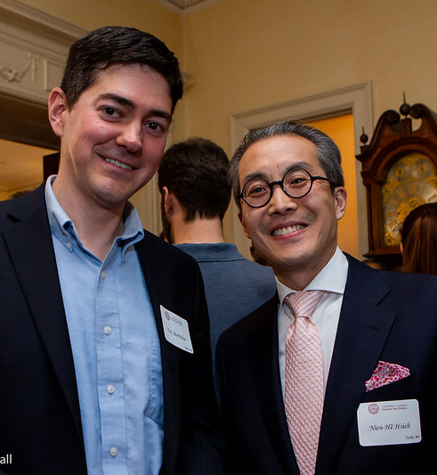
Center Faculty
Getting to know Faculty affiliated with the Center is a valuable opportunity.
Read up on the people on our website and tell us who you want to meet! We can help!
Fellows-in-Residence: Faculty Mentors

Slide 20
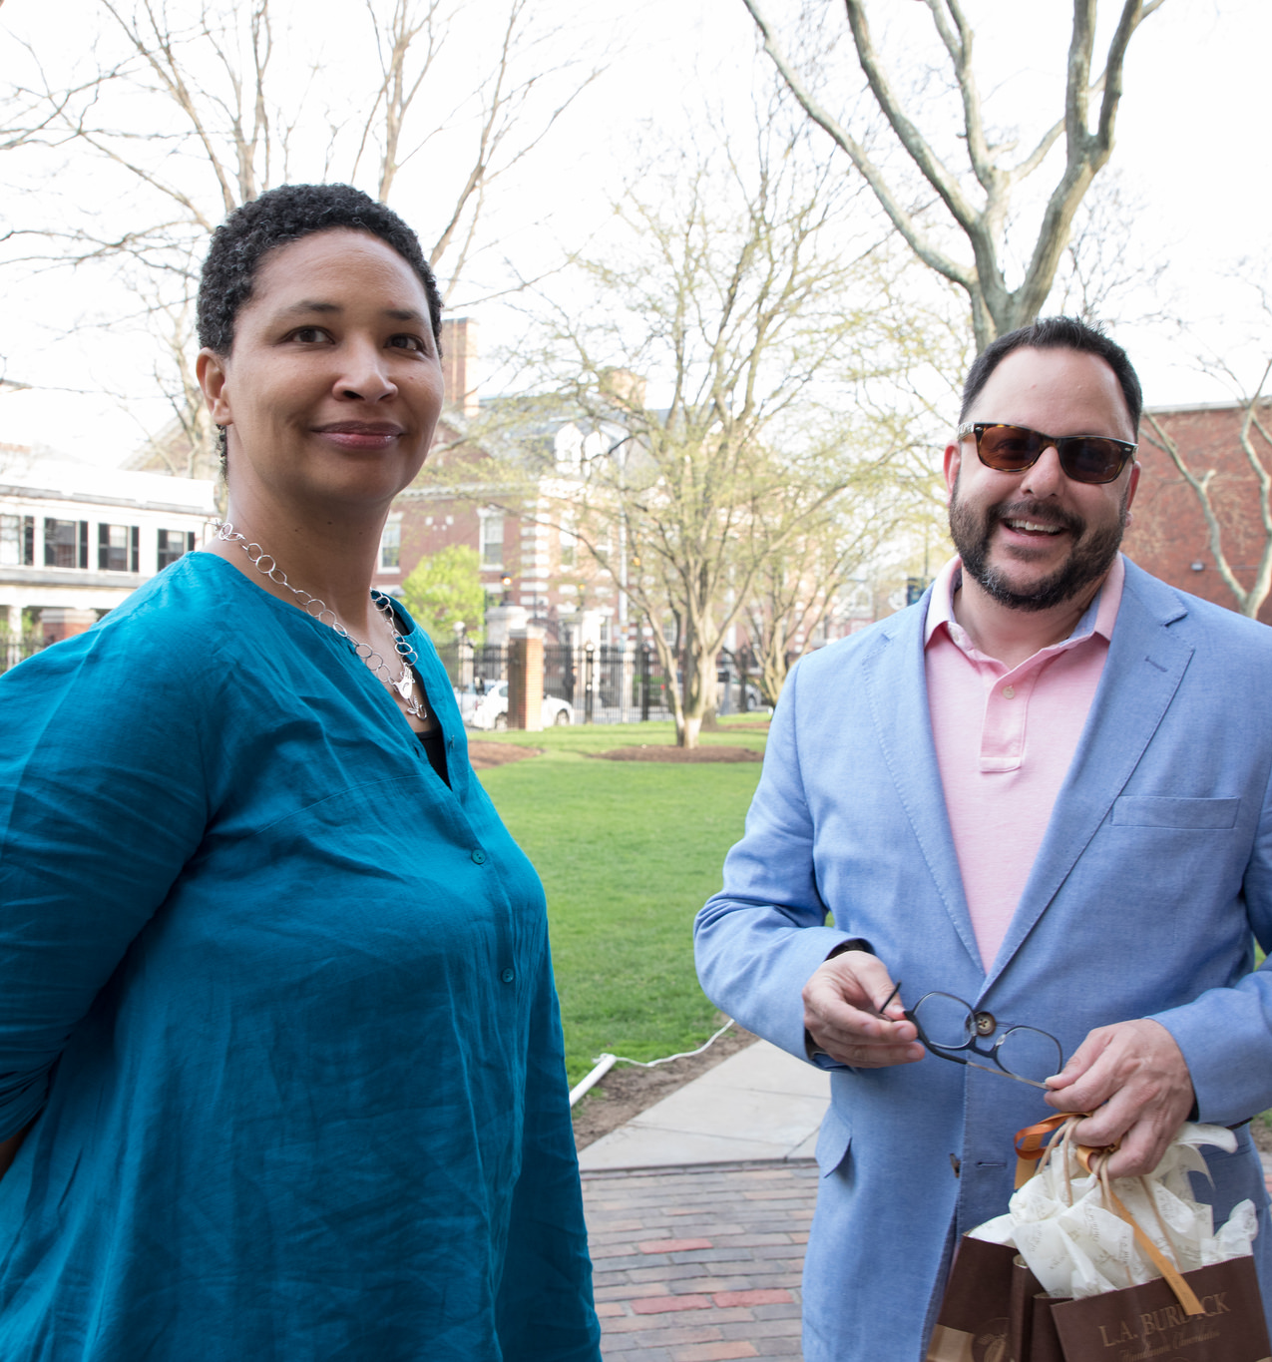
Seminars
FIR/Faculty Seminars: Tuesdays at Noon
Grad Fellow Seminars: Tuesdays at 9:45 am
Grad Fellows are expected to attend FIR seminars
Inviting others to your seminar is fine (unless program directors say otherwise), but please let us know who to expect

Slide 21
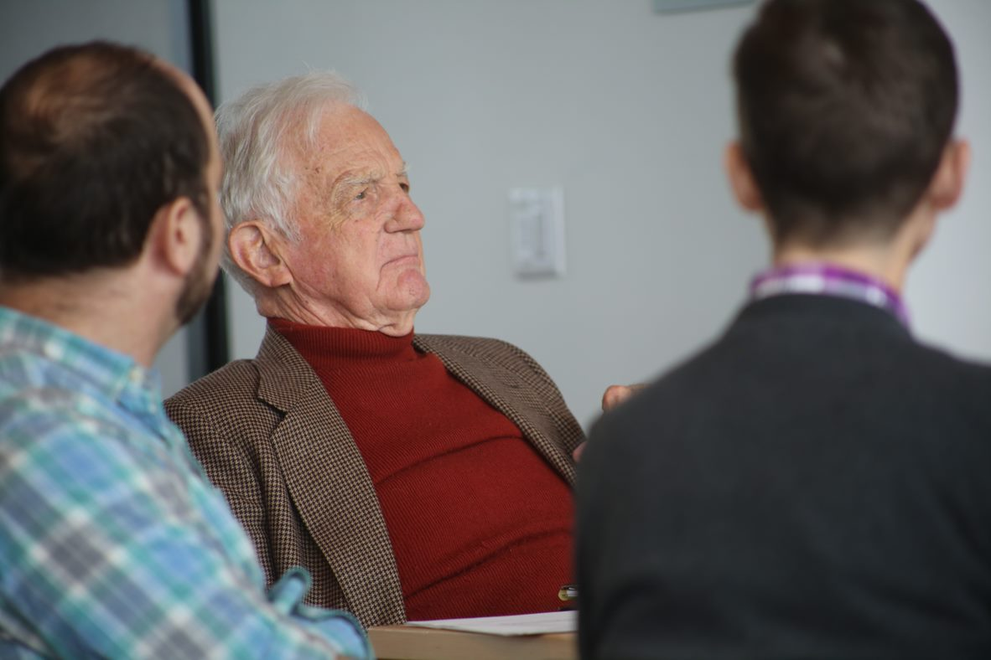
Keep an eye out for a seminar scheduling survey, and respond ASAP
First meeting of the Fellows-in-Residence seminar on Tuesday, September 14 at noon is a Planning Meeting
For this meeting we will need a 1-page summary of your work in general, or better yet, what you’re likely to present at a seminar in advance
We will ask you to speak about your work for 1-2 minutes max
Then you can all leave, and Faculty Committee members will brainstorm ideas for seminar respondents
Fellow-in-Residence Seminar Planning Meeting

Slide 22

Research Funds and Financial Matters

Slide 23
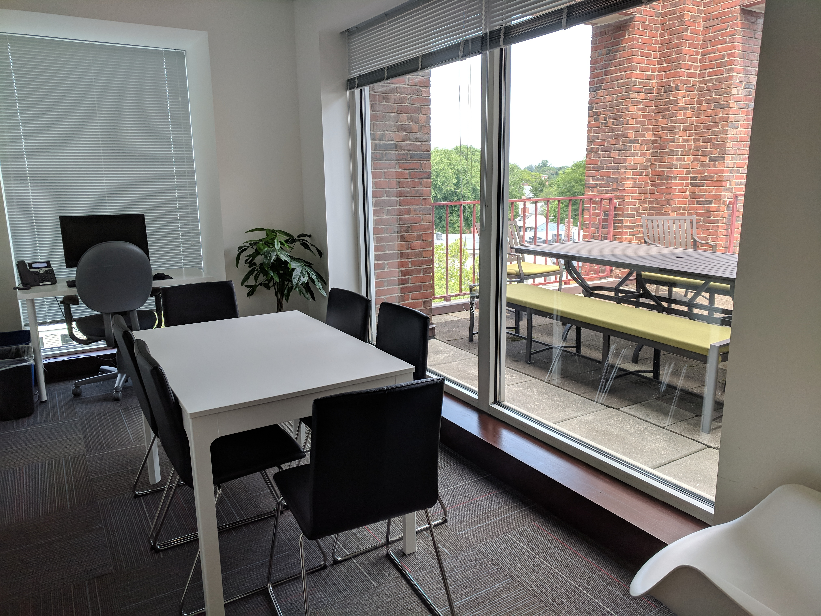
Research Funds
This year we are handling research funds differently due to our remote circumstances.
Fellow-in-Residence and Grad Fellow research funds will be paid in a lump sum directly to you in early fall
Research funds should be used for expenses related to your research such as books, professional memberships, conference fees, etc.

Slide 24
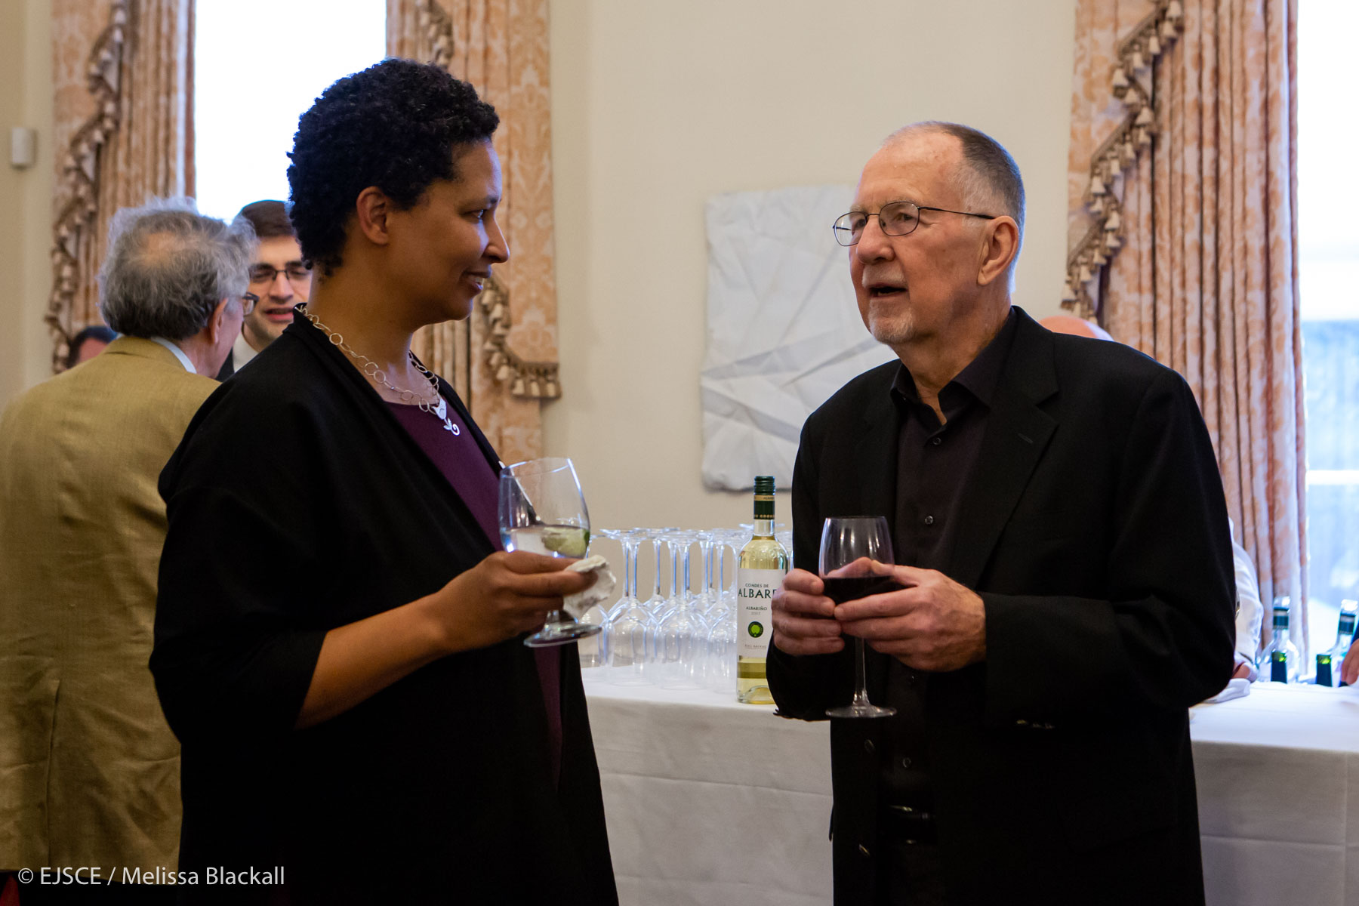
Stipends
Fellow-in-Residence stipends are either paid to you directly or sent to your home institution. A member of the Finance Team will be in touch with you directly if we need any additional information in order to process your stipend.
Graduate Fellow stipends are paid at the end of each month

Slide 25
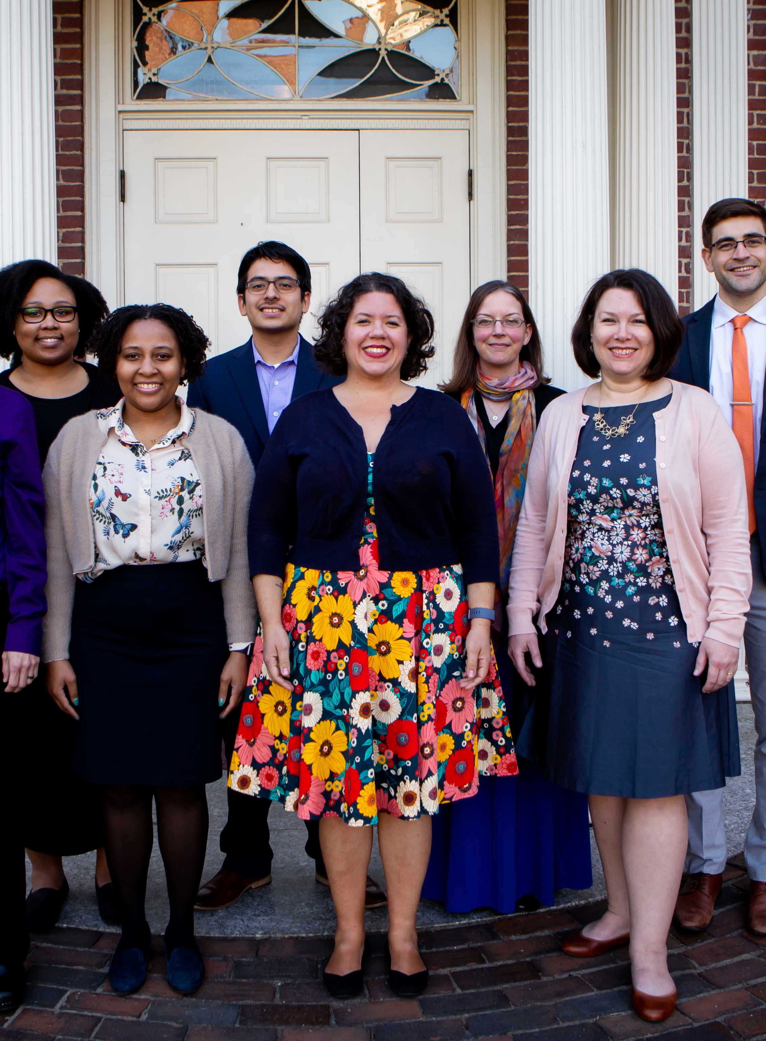
Directing Your Questions

Slide 26
Directing
Your
Questions
Seminars and Events for Fellows: Emily Bromley, ebromley@fas.harvard.edu
HR Issues + Financial Matters: Stephanie Dant, stephanie@ethics.harvard.edu
Nien-hê Hsieh’s Calendar: Susan Orr, susanorr@fas.harvard.edu
Communications, Promoting Your Work: Maggie Gates, mgates@fas.harvard.edu
Fellows Happy Hour and Social Activities: Social Chairs
All Other Issues: Emily Bromley

Slide 27
BREAK

Slide 28
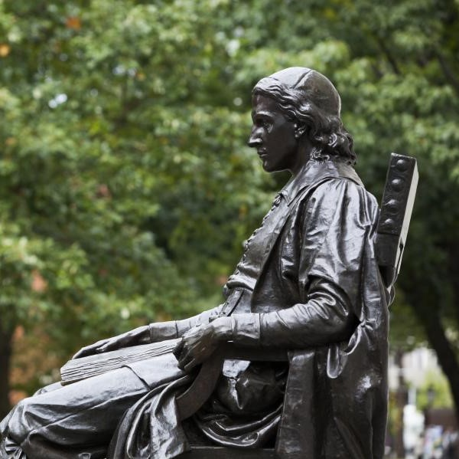
Harvard Resources

Slide 29
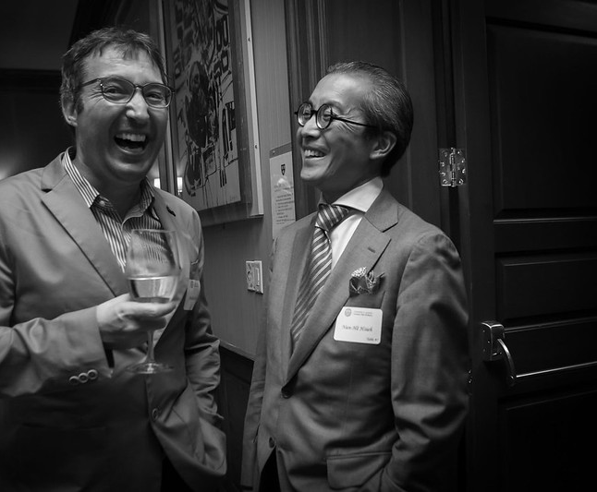
Harvard Credentials
HUID:
A Harvard ID number (HUID) has been assigned to you. Ask Emily if you don’t have it. You can obtain an ID Card at the ID Office/Campus Service Center in the Smith Campus Center .
Harvard Key:
Obtain your Harvard Key at https://key.harvard.edu/. This connects you electronically to resources at Harvard. Your “onboard e-mail” is the e-mail account we have used to correspond with you.

Slide 30

Harvard Credentials, cont.
Harvard Email:
Sign up at https://key.harvard.edu.
Harvard email address is necessary to access many University resources and receive announcements.
It is fine to forward that address to your primary email address.
MessageMe:
Activate the "MessageMe“ phone app for emergency university notices. You can also sign up for Message Me notifications at https://messageme.harvard.edu

Slide 31
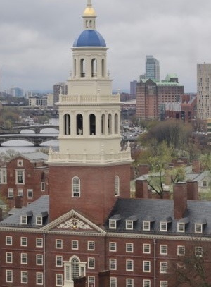
Tech Support
To Contact the Harvard University IT Group (HUIT): email ithelp@harvard.edu or call (617) 495-7777
Resources for Working Remotely can be found at: https://huit.harvard.edu/remote

Slide 32
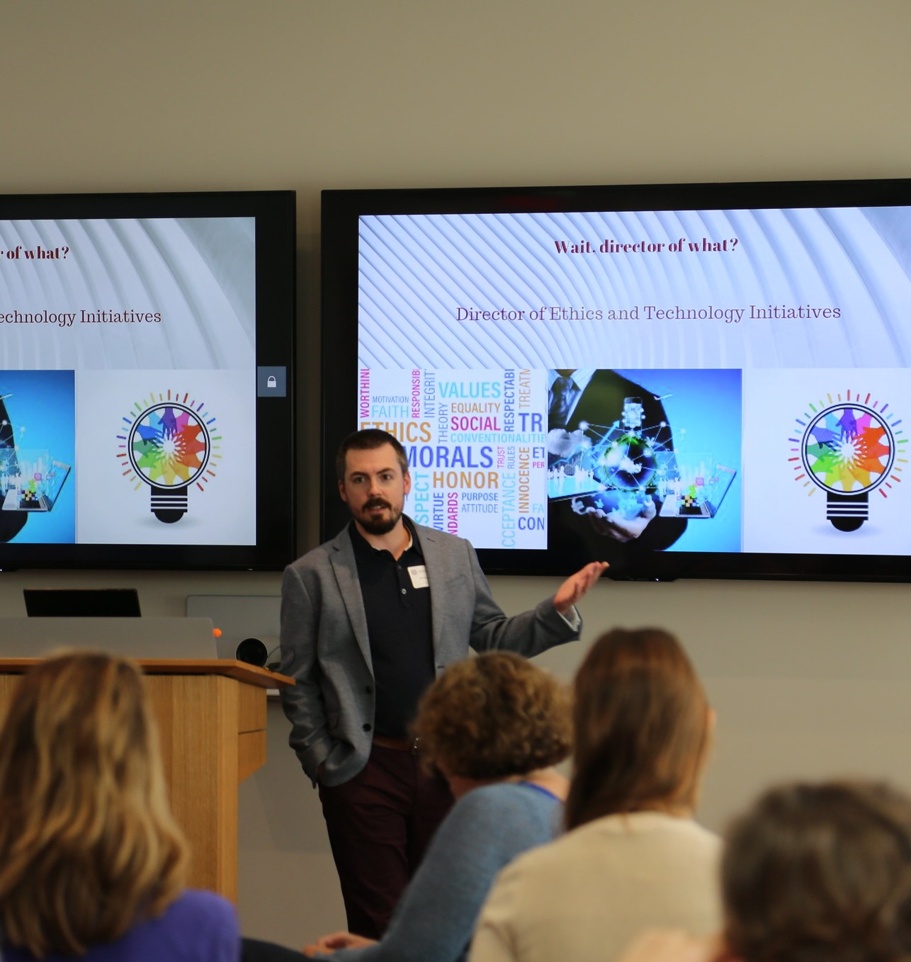
Tech Resources
Slack: harvard-ethics.slack.com
Office: https://mso.harvard.edu/
GSuite: http://g.harvard.edu/
Zoom: https://harvard.zoom.us/
VPN using Cisco AnyConnect Secure Mobility Client (required for some applications):
  Install
  Connect

Slide 33

Perks
Athletic Facilities
Harvard Museums
Outings & Innings for discounts (check out the "Hidden Gems" page)
Center for Wellness classes and virtual resources

Slide 34

COVID-19 Precautions

Slide 35

Coronavirus Information
Information about Harvard’s response to COVID-19
Testing Dashboard
General Information about being on campus

Slide 36

Vaccinations
All Harvard community members who will have any on-campus presence must be vaccinated (or receive an exemption). More information here
Submit proof of vaccination or learn about exemptions here
Still need a vaccination? Find out how you can get one here
As of September 1, 94% of employees and 92% of students have been vaccinated (The Harvard Crimson)

Slide 37
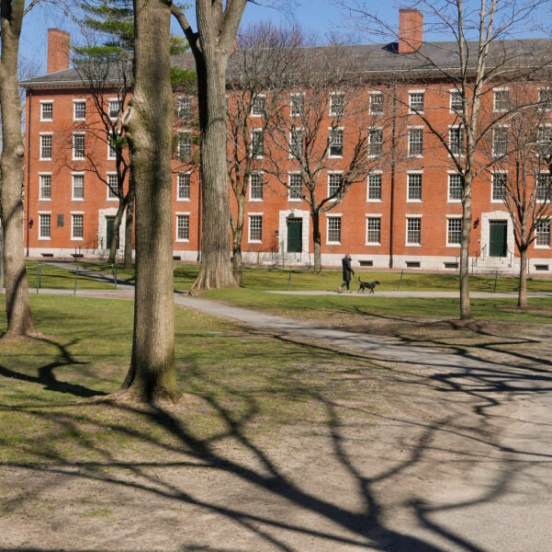
Spending Time on Campus
Masks are required when indoors, except when alone behind a closed door or when actively eating.
Physical distancing is generally not necessary
Stay home if you don’t feel well
Be ready to have to work remotely
More information available here

Slide 38

Using Center Office Space
You are required to wear a masks in our office, except when alone behind a closed door or when actively eating.
Please do stay home if you don’t feel well
Thanks in advance for helping us maximize the use of our space by regularly using www.roombook.harvard.edu

Slide 39

Testing
Get tested weekly if you will be on campus regularly
Create a Color Account
Self-test and drop off the same day
Pick up new tests (Science Center or Northwest Labs only)
Quarantine if necessary
Find out more here

Slide 40
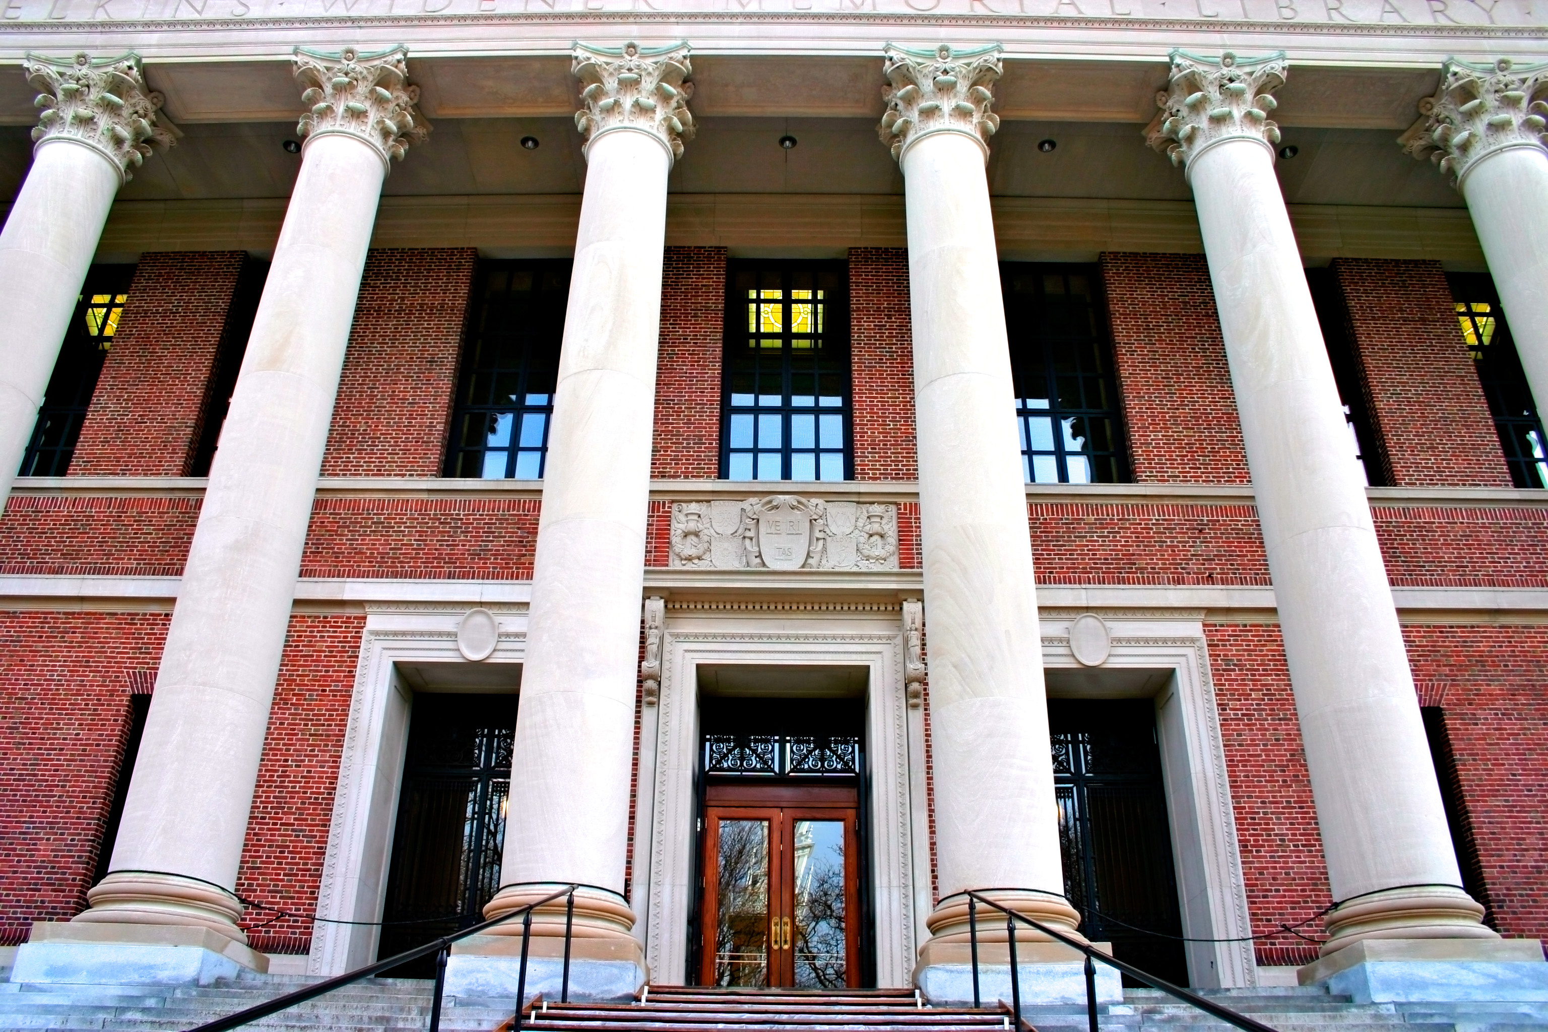
Library Orientation: Friday 9/9 at 1 pm
(Widener Library, 240)
Library services and tools info here
Widener Virtual Tour available here

Slide 41
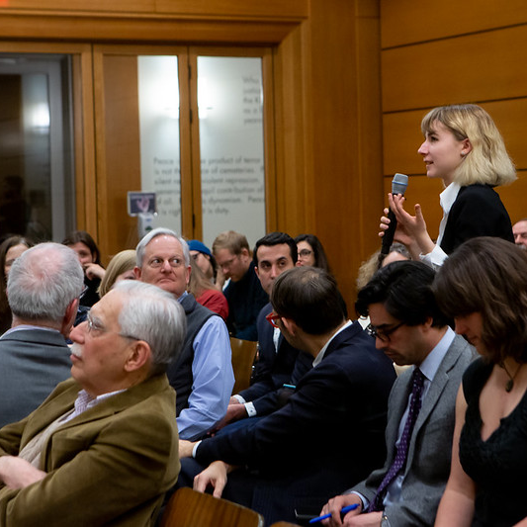
Questions?

Slide 42
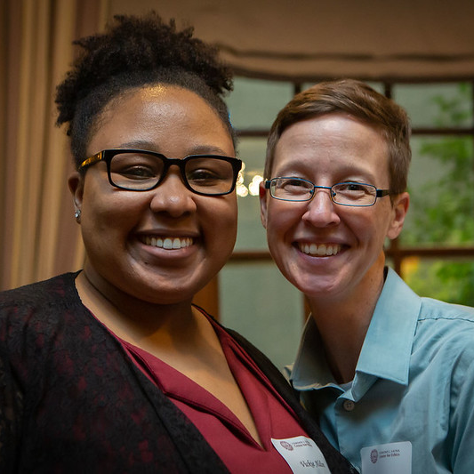
THANK YOU

