Slide 1


Fellows Orientation
2019-2020
September 6, 2019

Slide 2

Welcome! We’re glad you’re here

Slide 3
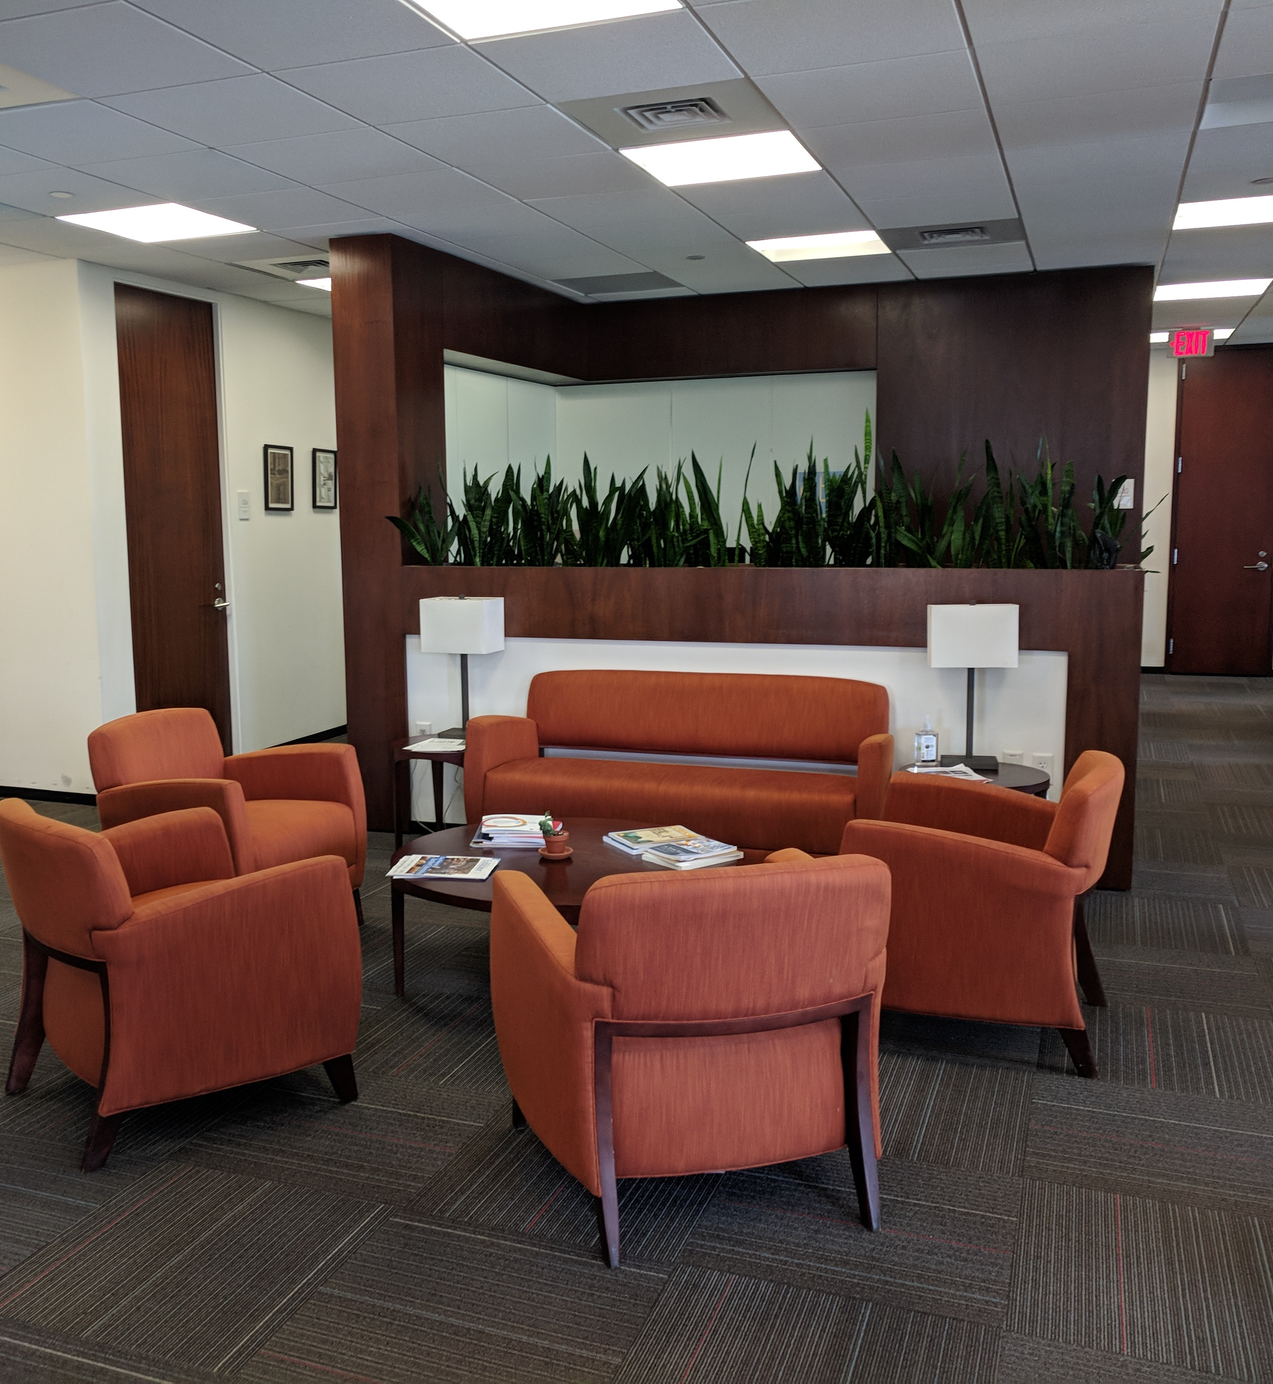
Agenda
Welcome & Brief Introductions
Overview of the Center
Opportunities
Office Logistics
Financial Matters
Questions

Slide 4
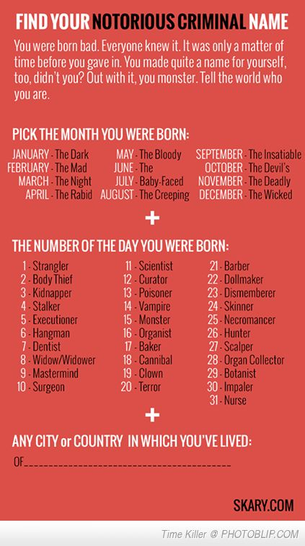
Brief Introductions
Tell us who you are, in real life and as a notorious criminal!

Slide 5
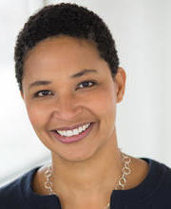
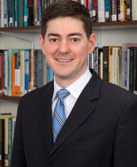
EJSCE Faculty Directors
Danielle Allen
Director, EJ Safra Center
&
James Bryant Conant University Professor
Eric Beerbohm
Co-Director, Fellows-in-Residence Faculty Seminar
&
Professor of Government

Slide 6
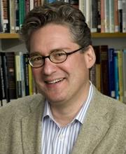
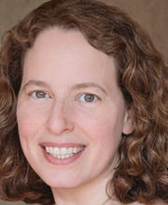
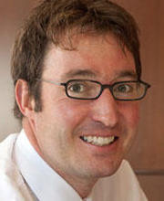
Arthur Applbaum​
Director, Undergrad Fellowship Program​
&
HKS Professor
Meira Levinson​
Co-Director, Graduate Fellows Program​,
HGSE Professor, &
2019-20 EJSCE Fellow
Mathias Risse​
Co-Director, Graduate Fellows Program, Carr Center Director, &
HKS Professor

Slide 7
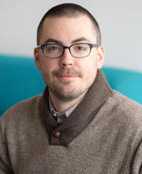
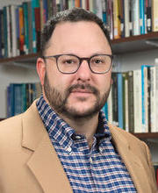
Jeff Behrends
Director of Ethics and Technology Initiatives​
&
FAS Lecturer in Philosophy
Chris Robichaud
Director of Pedagogical Innovation
&
HKS Senior Lecturer

Slide 8
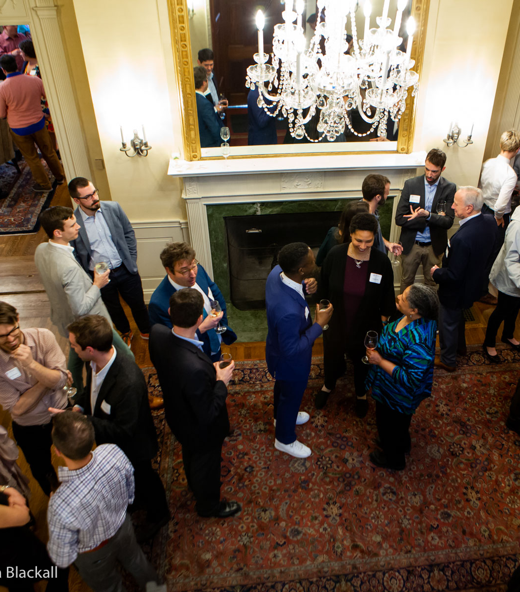
Overview of the
Center

Slide 9
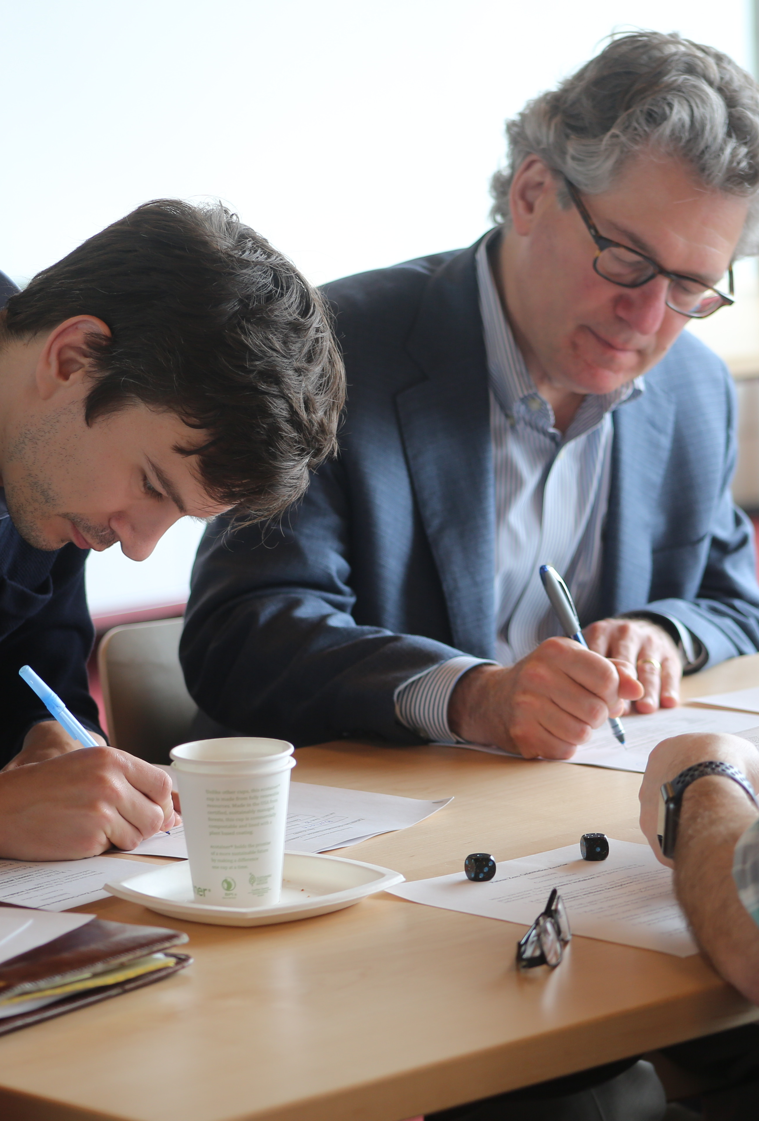
Mission
The Edmond J. Safra Center for Ethics seeks to strengthen teaching and research about pressing ethical issues; to foster sound norms of ethical reasoning and civic discussion; and to share the work of our community in the public interest.
https://ethics.harvard.edu/

Slide 10
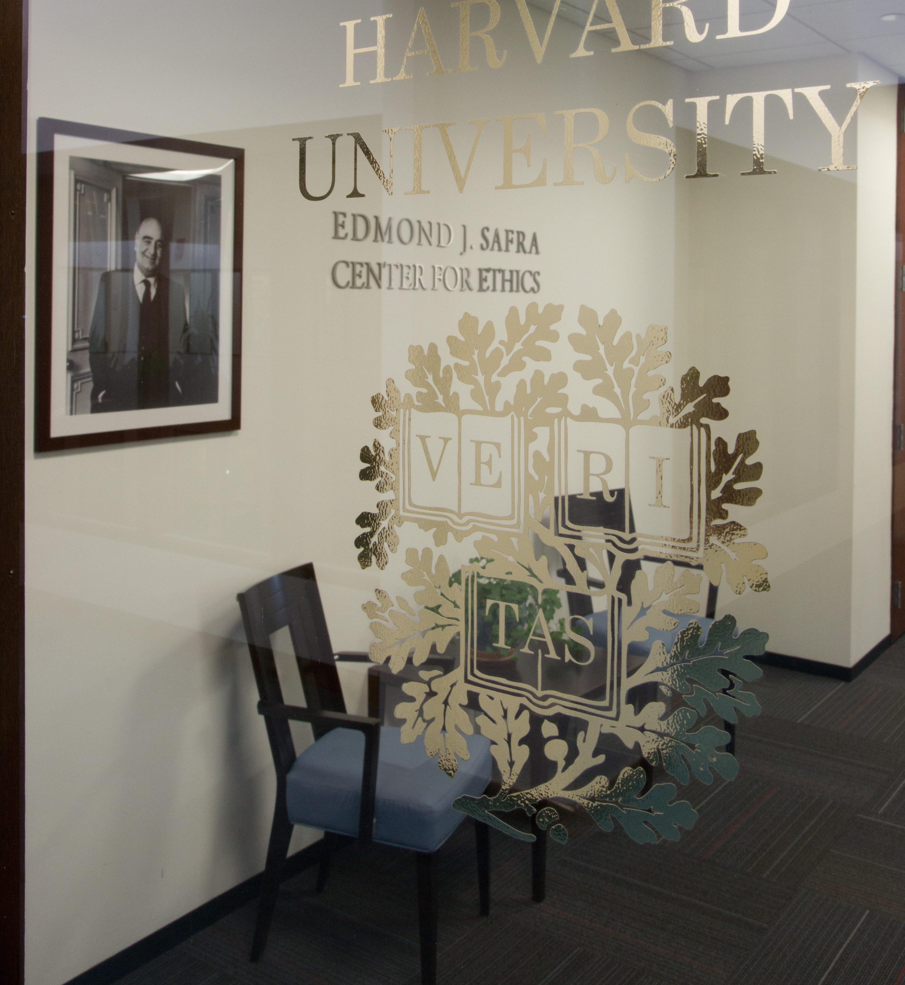
Quick Facts
Founded by Dennis Thompson in 1986
First Interfaculty Initiative at Harvard
Naming Convention for Public Use:
  Edmond J. Safra Center for Ethics
  EJ Safra Center
  EJS Center
  NEVER just "Safra Center"

Slide 11
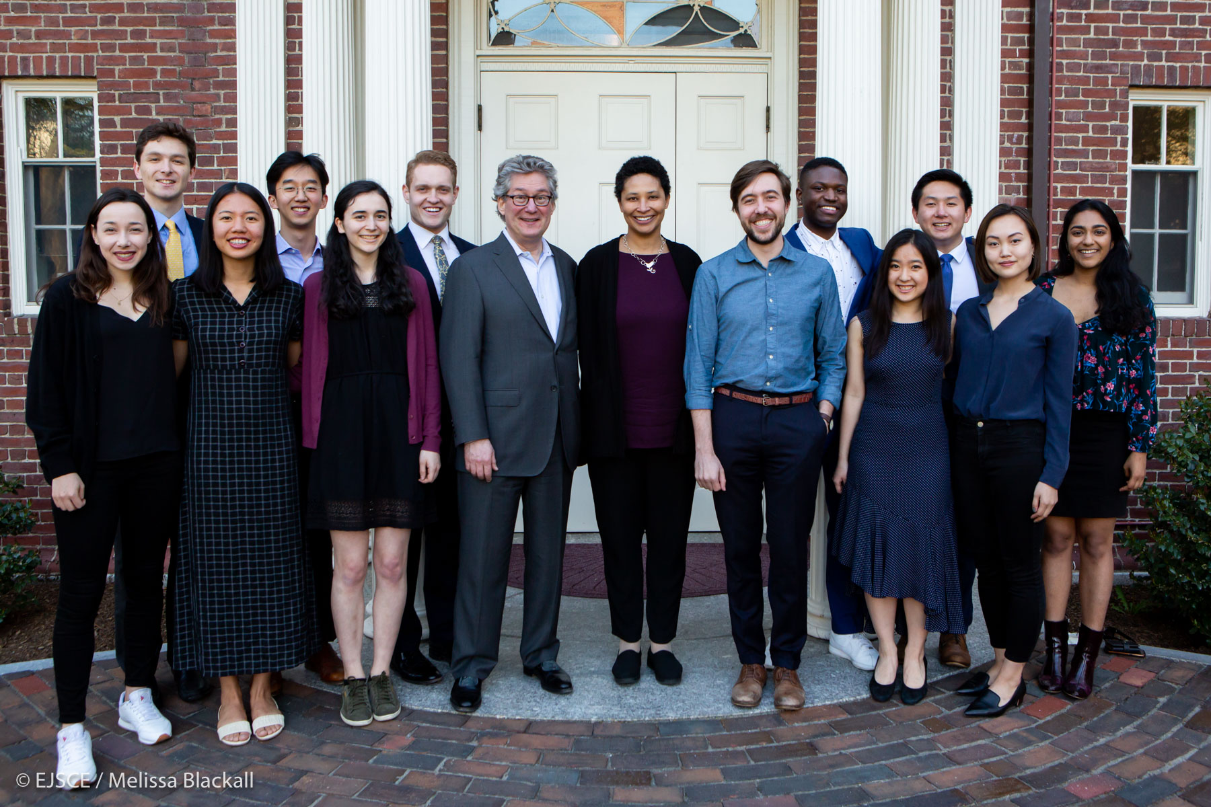
Fellowships Offered
Faculty / Fellows-in-Residence
Tel Aviv University Exchange Fellows
Graduate Fellows
Ethics Pedagogy Fellows
Undergraduate Fellows
Visiting Fellows
Last year's graduating senior Undergraduate Fellows

Slide 12
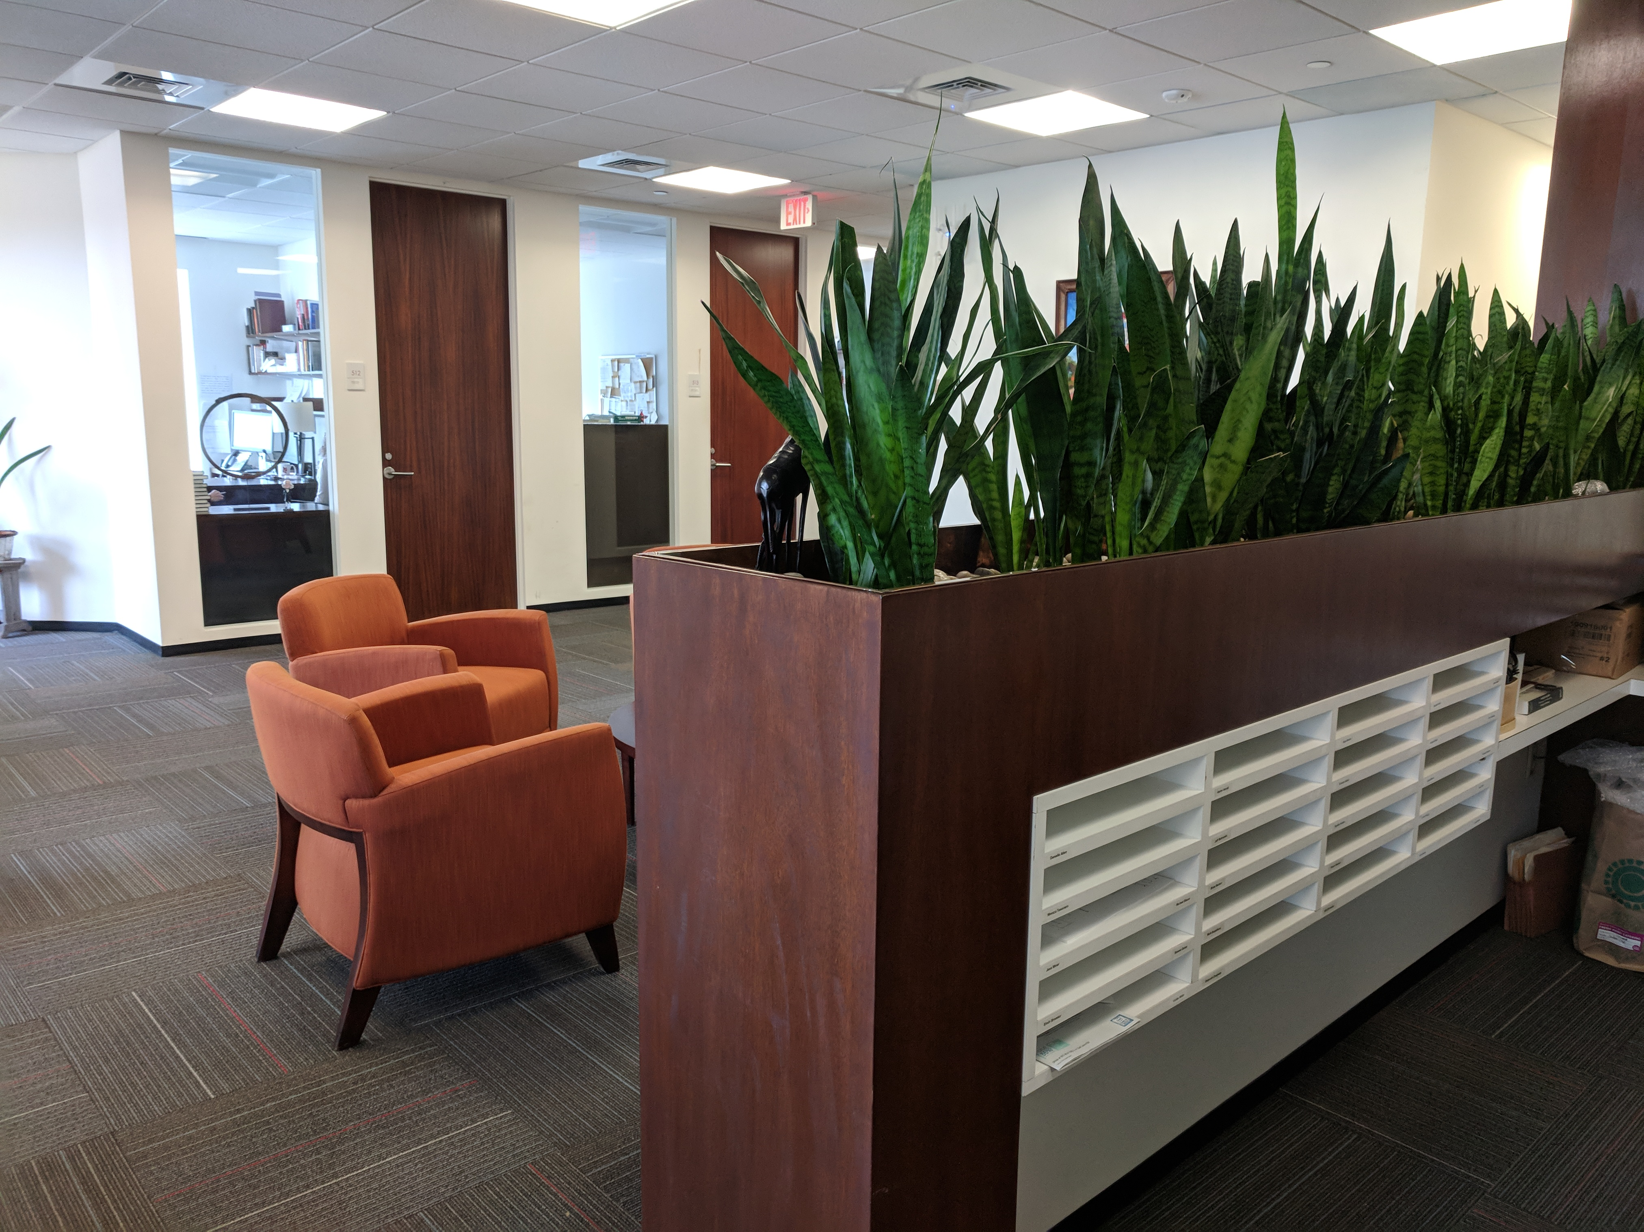
Your Time at the Center
September 1, 2019 to June 30, 2020
IT Support
Social Chairs!
Headshots 9/24 and 10/1
Follow Us:
  ethics.harvard.edu
  Twitter: @harvardethics
  Facebook: @harvardethics

Slide 13
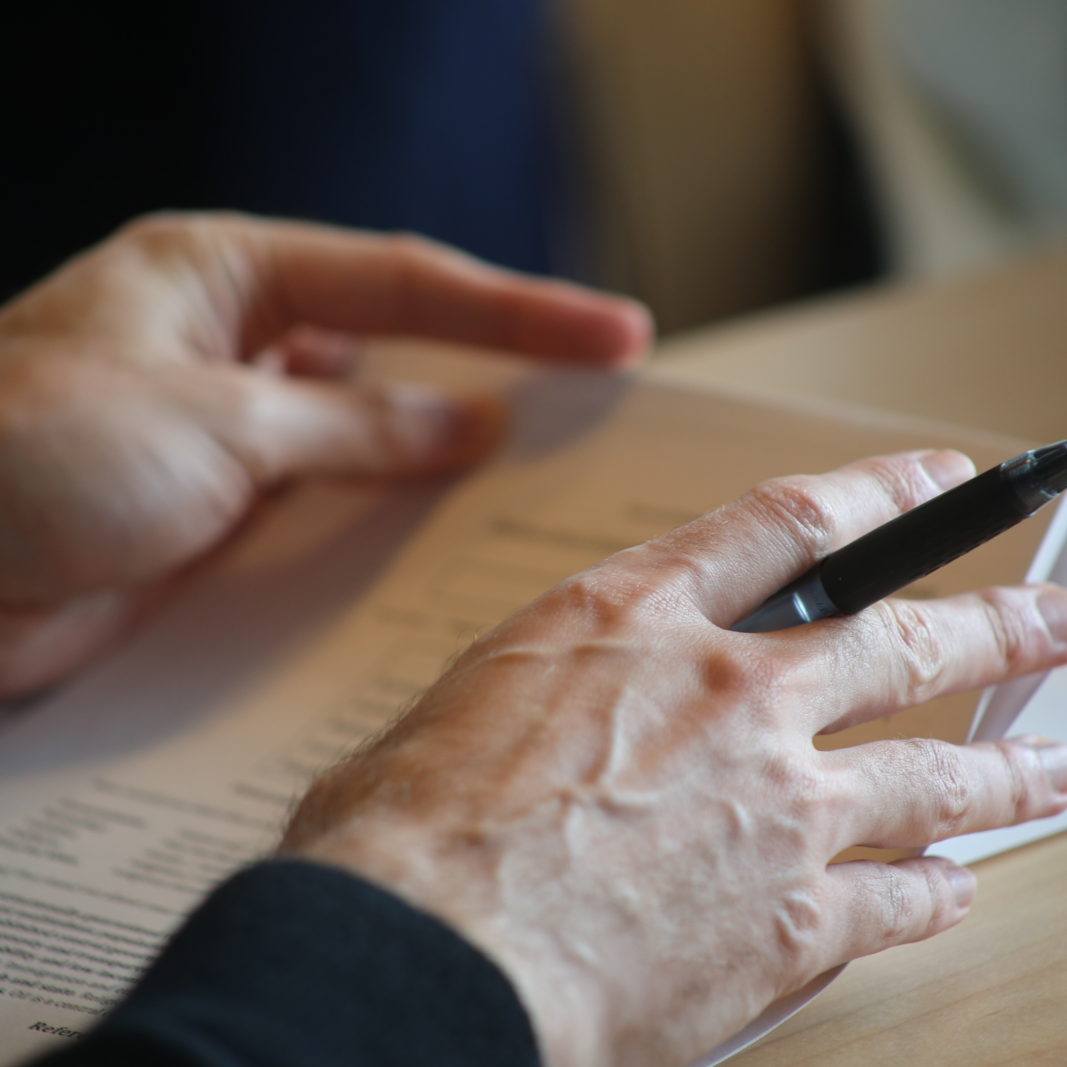
We Want to Know!
Publications, talks, awards, etc? Let Maggie know.
Have an idea or suggestion for an event or improvement? Talk to Emily.

Slide 14
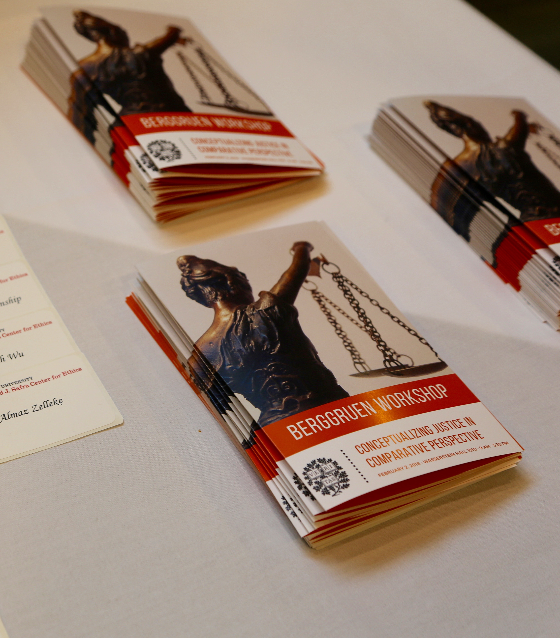
Opportunities
&
Obligations

Slide 15
Making the Most of Your Time Here
Primary obligation: your own research and writing
Other obligations: seminars, lectures, dinners
Most valuable opportunity: conversations with others

Slide 16

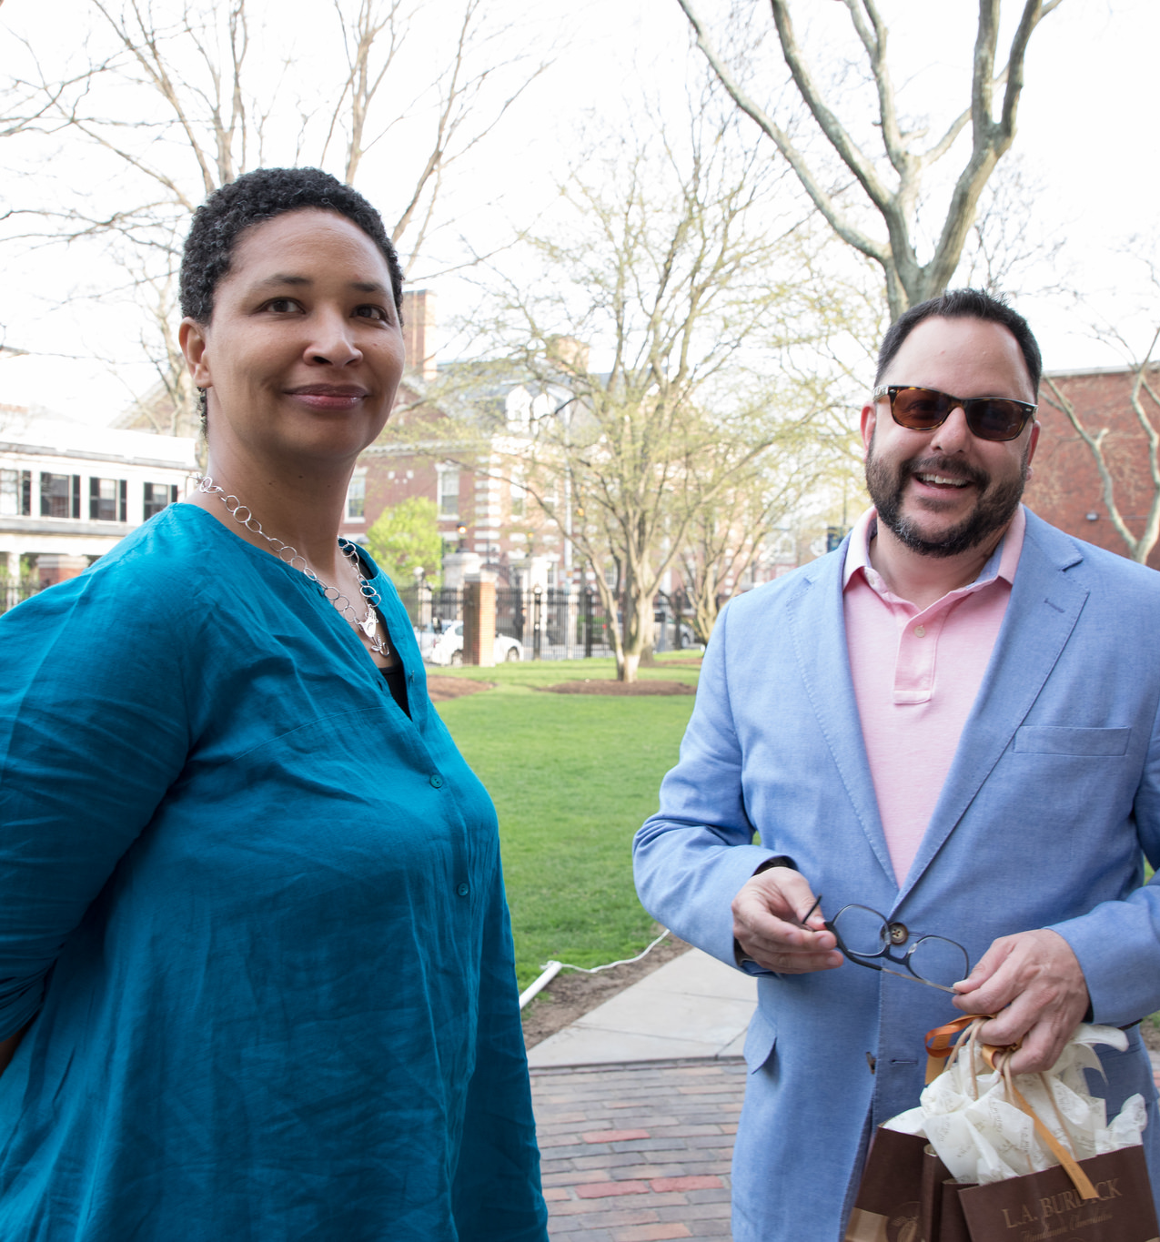
Seminars
FIR/Faculty Seminars: Tuesdays at Noon, lunch provided
Sharing your title/abstract
Grad Fellow Seminars: Tuesdays at Noon, lunch provided
Grad Fellows are expected to attend FIR seminars
Inviting others to your seminar

Slide 17
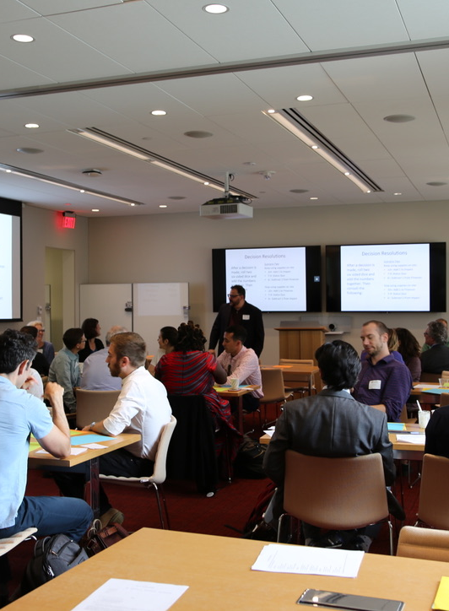
Seminars
September 10 – Fellow-in-Residence Seminar Planning Meeting (grad fellows need not attend)
September 17 – First Meeting of the Graduate Fellowship Seminar
September 24 – Guest Seminar Presenter James Mickens, Professor of Computer Science
October 8 – First Traditional Fellows-in-Residence Seminar

Slide 18
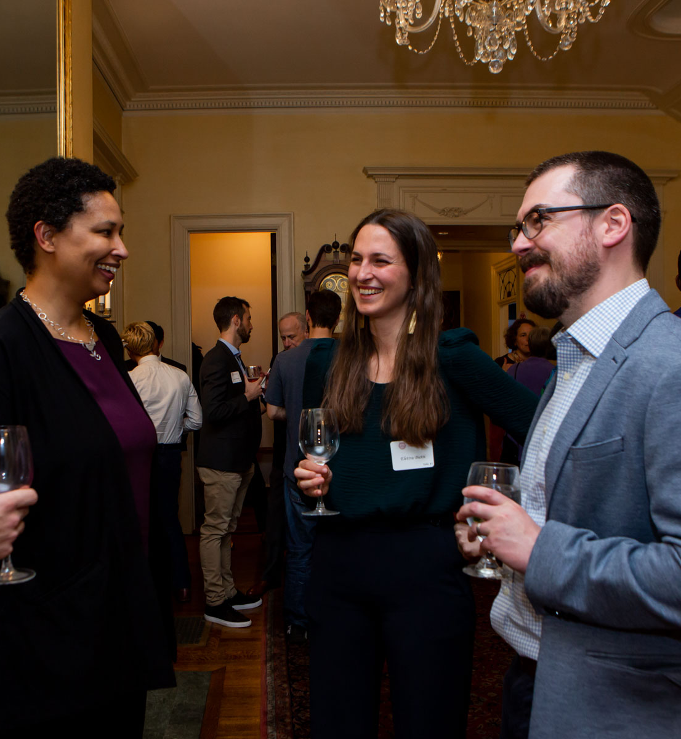
Other
Obligations
Opening and Closing dinners
WARNING: Fellows provide entertainment at the Closing Dinner!
Public Lectures and dinners – attend as many as possible
Presence in the office

Slide 19
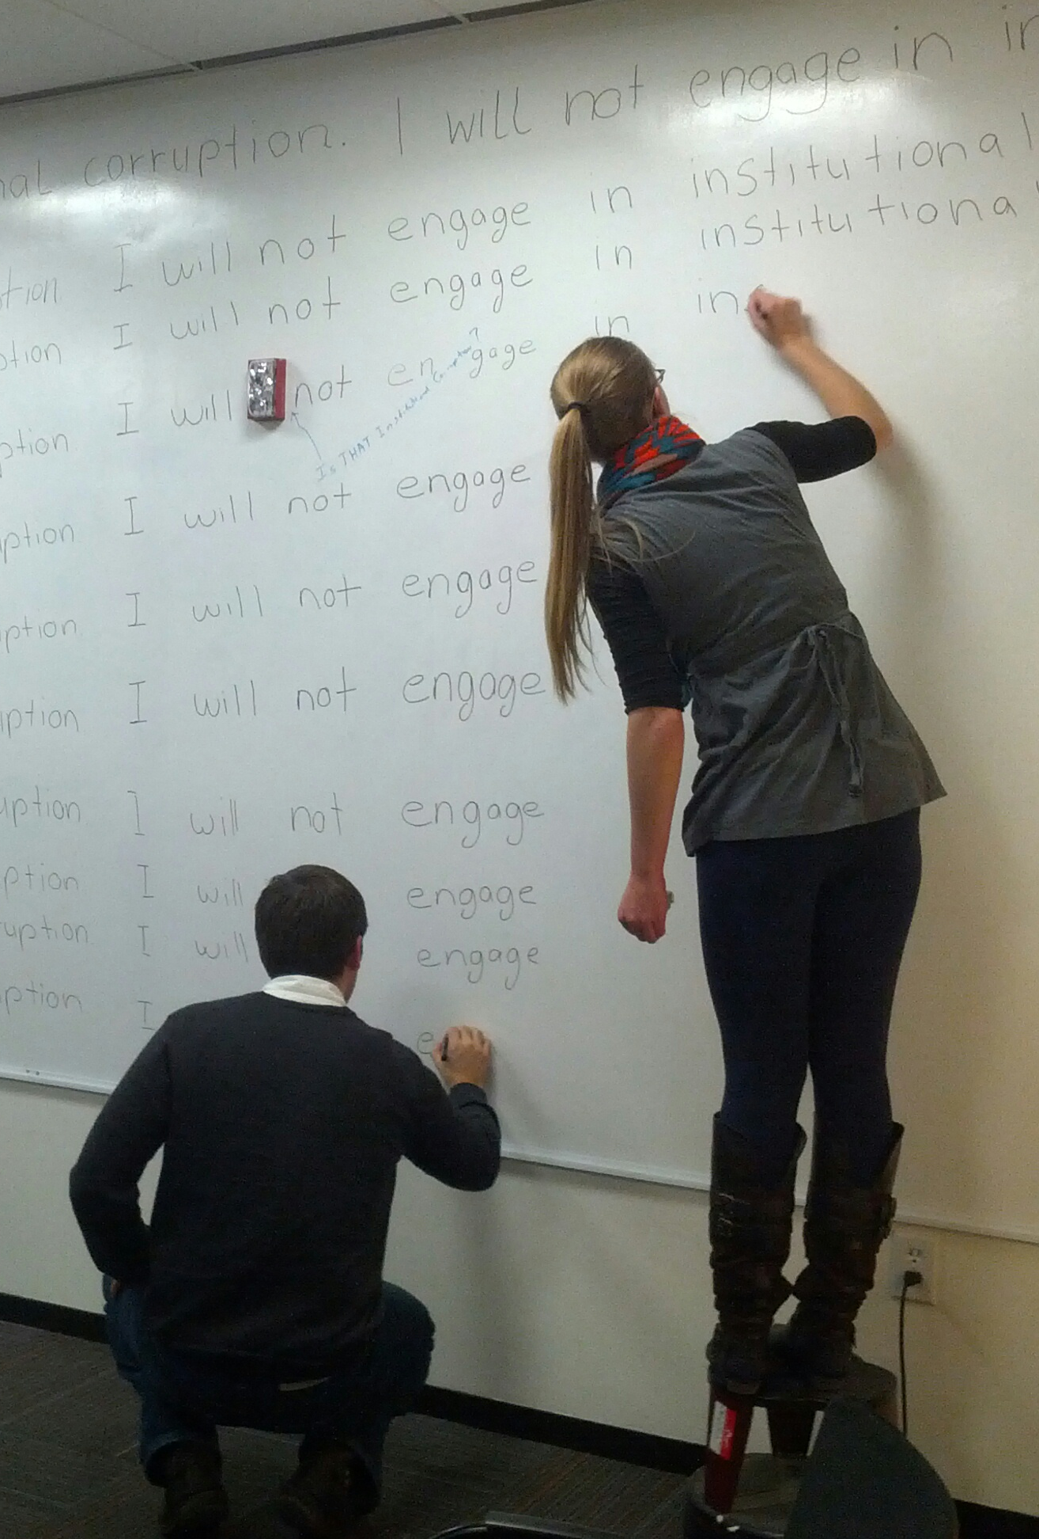
More Opportunities
Ethics Mondays – proposing topics and attending
Media requests
For the Record blog series
Organize a reading group, workshop, or social outing
New: Breakfast Club
New: Brown Bag Lunches
TIP: read up on the people on our website and tell us who you want to meet!

Slide 20
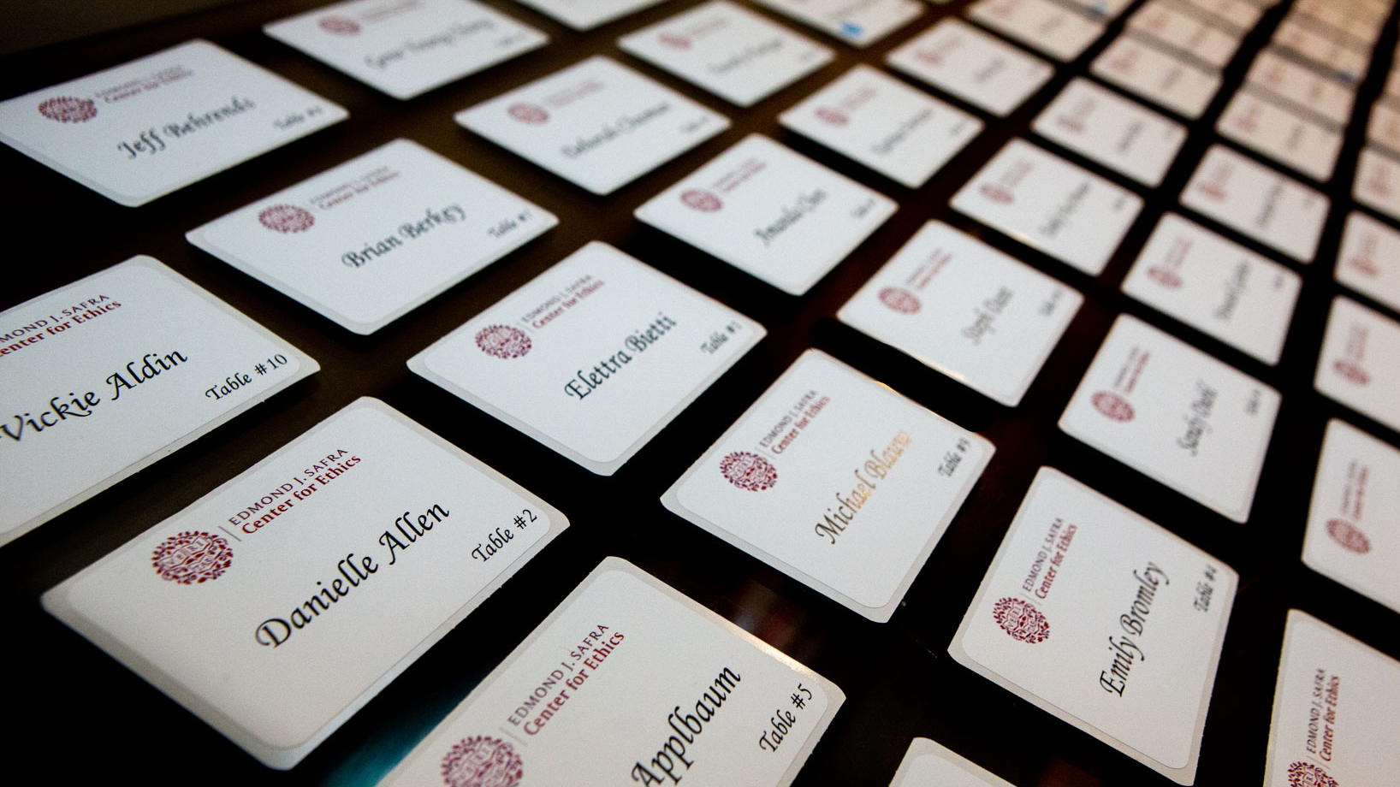
Center Events
Organized by Vickie
Catering for seminars/ inviting others
RSVPs
Changes of plan
Guests – only invited to opening and closing dinners

Slide 21
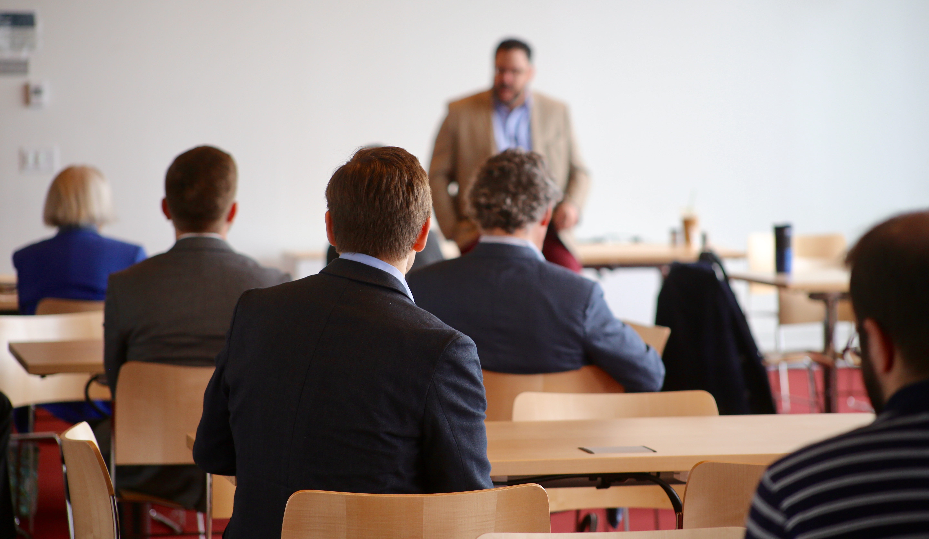
Upcoming Events ethics.harvard.edu/information-fellows
September 11 – Algorithms, Justice, and Democracy reading group
September 12 – Brown Bag Lunch with CRCS
September 18 - Breakfast Club
September 26 - George Daley Public Lecture & Dinner
September 27 - EIYW: Katrina Forrester in conversation with Brandon Terry
October 3 – Brown Bag Lunch at Wyss Institute

Slide 22
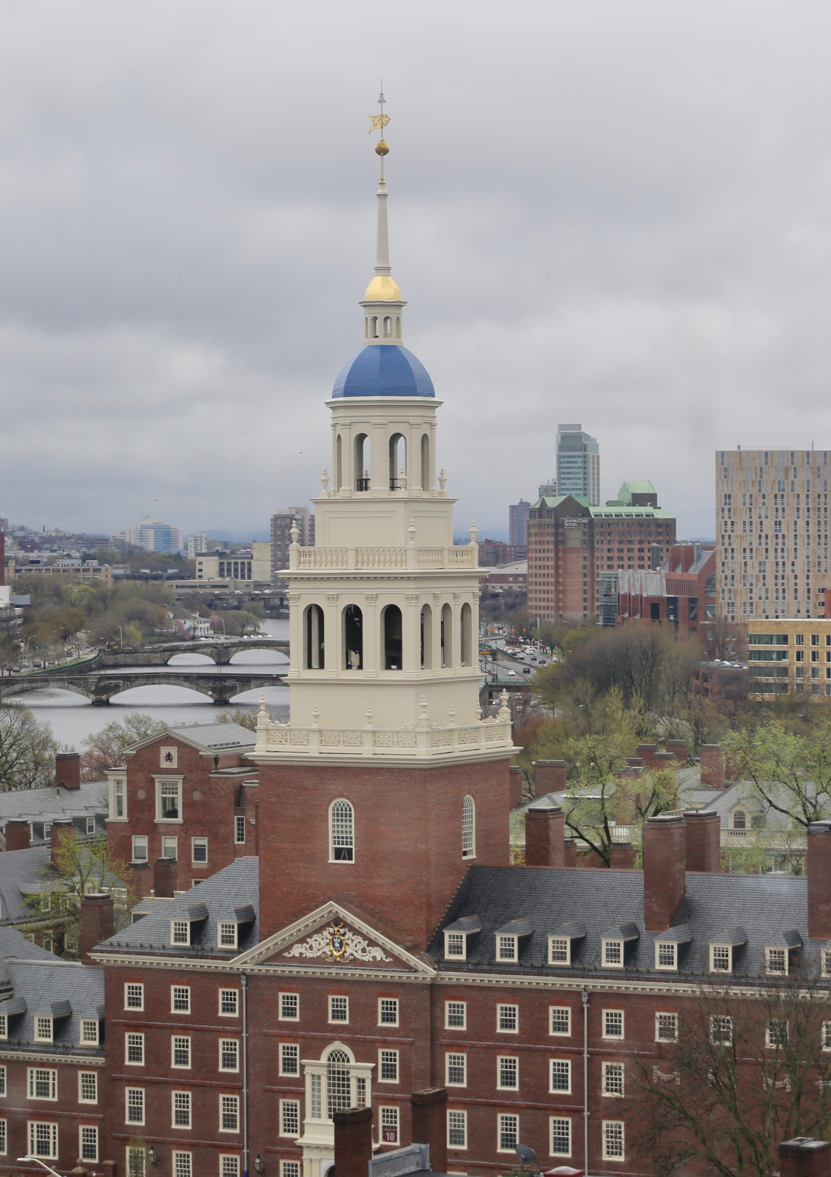
Outside the Center
Other Centers and Departments – get on mailing lists!
Gazette Events https://news.harvard. edu/gazette/harvard-events/
Athletic Facilities
Harvard Museums
Outings & Innings for Discounts

Slide 23
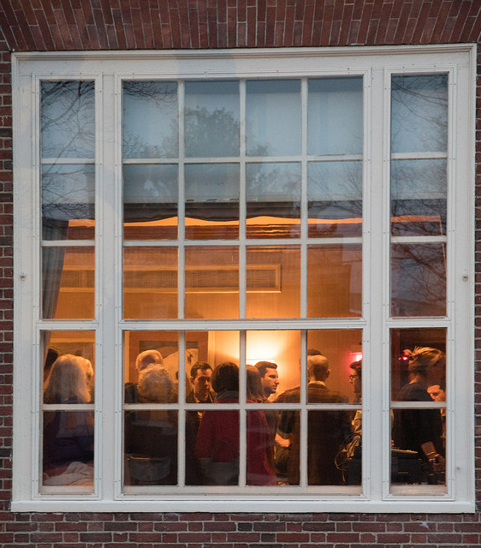
Office Logistics

Slide 24
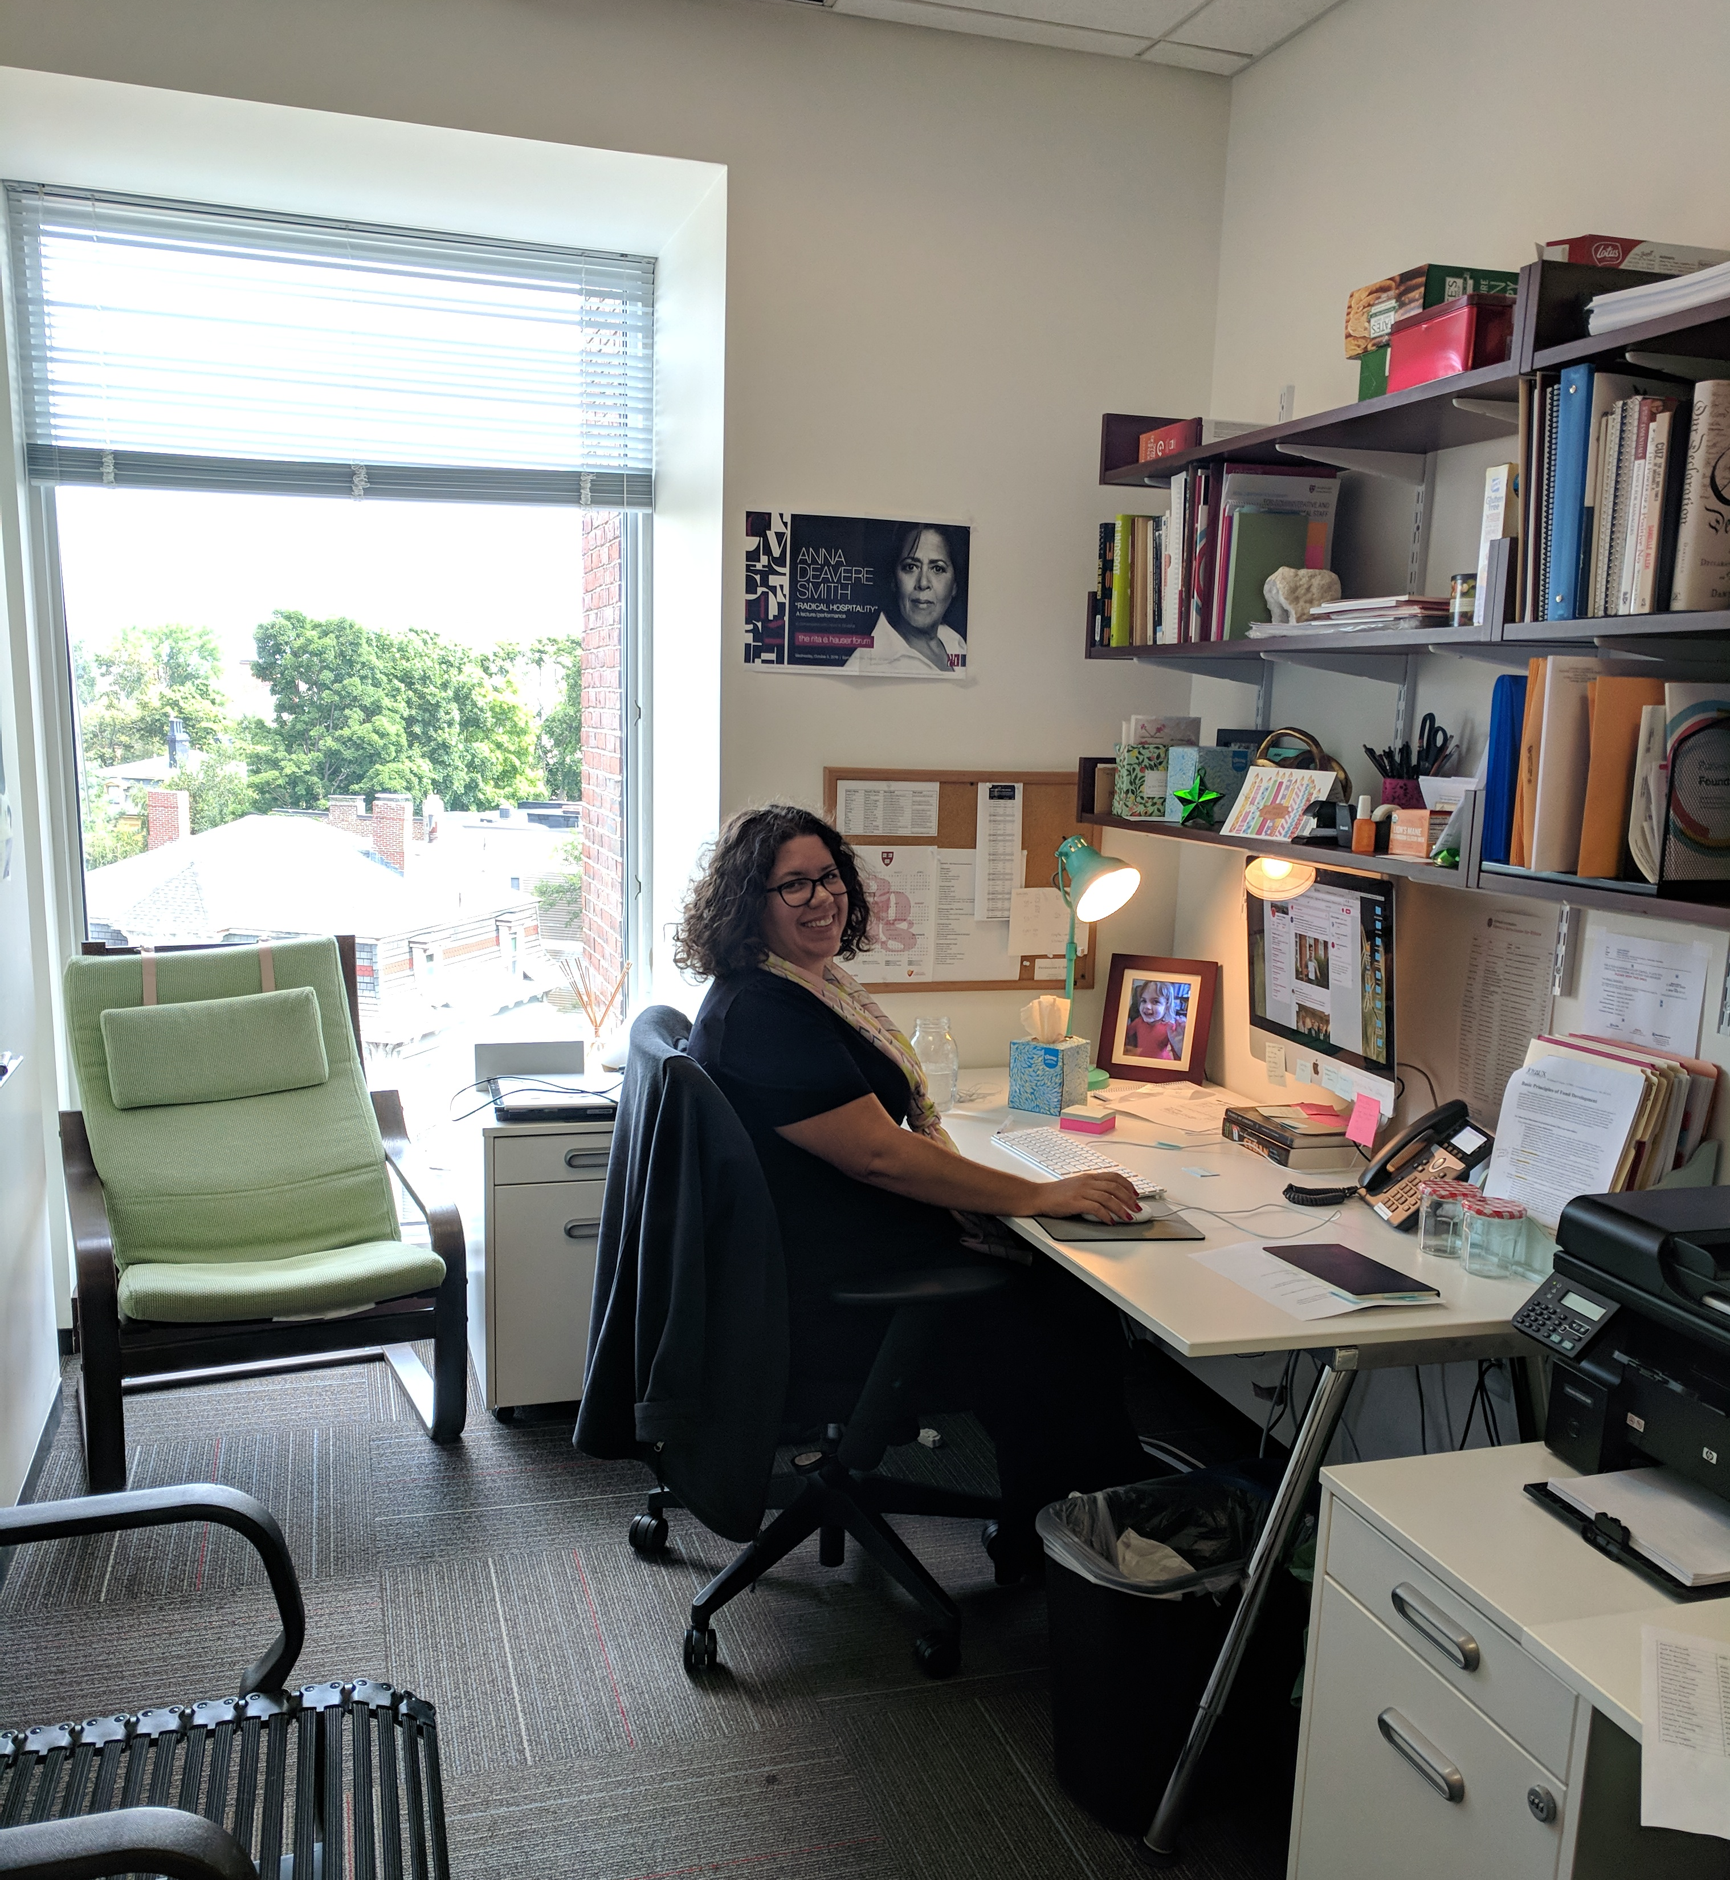
Around the Office
Suite access and locking office doors
Climate control
Common spaces
Supplies
Staff Flexwork schedule starts September 9

Slide 25
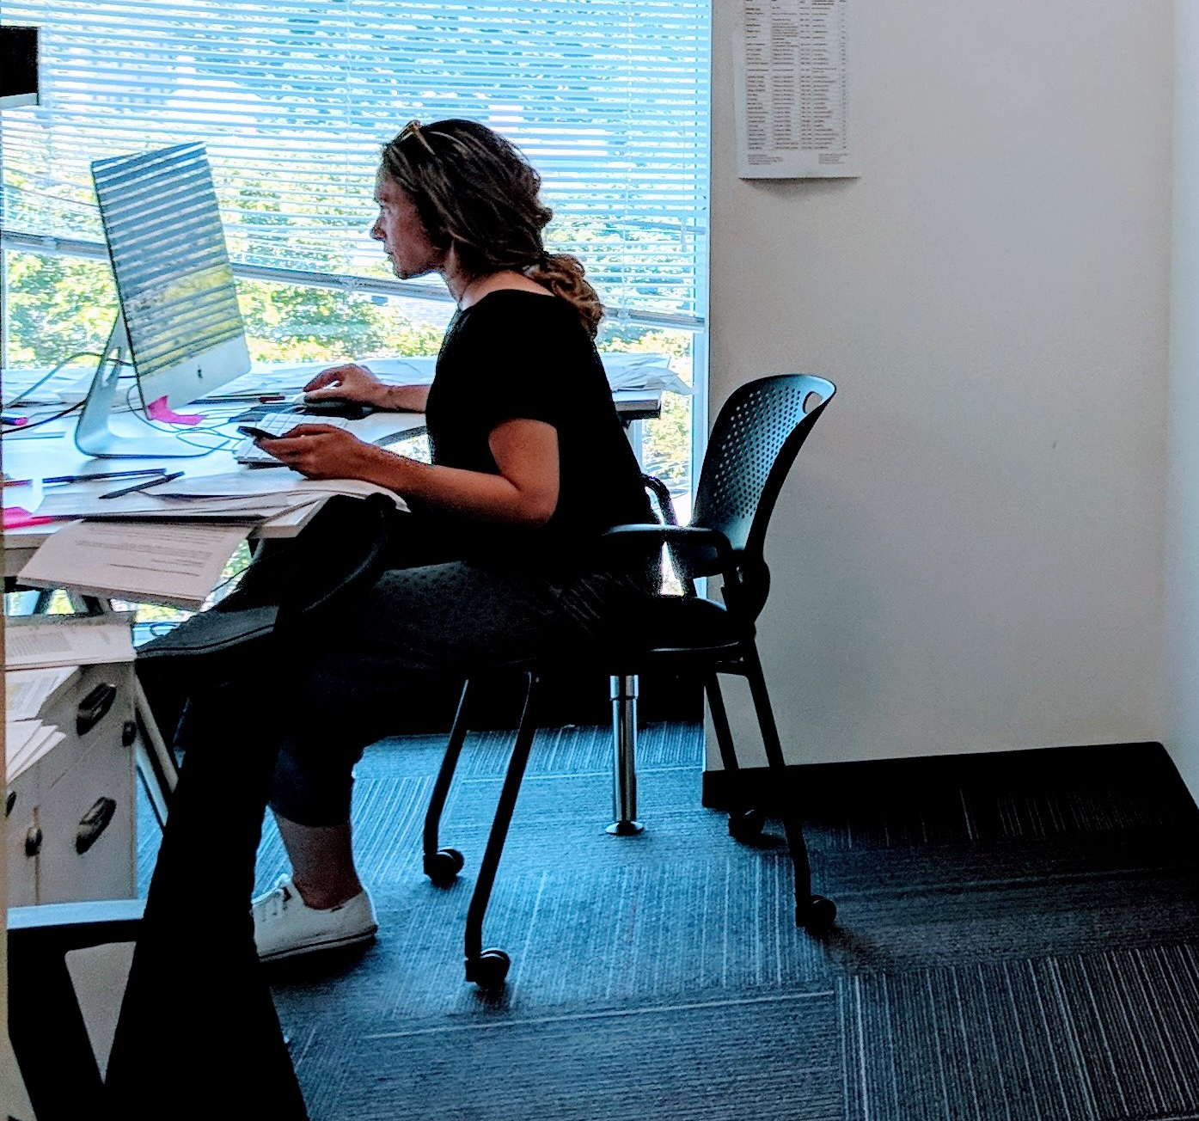
Copying, Printing and Faxing
Evacuation plan in offices
Maintenance Issues – report to Sam
Mail slots
Center library and books by community members

Slide 26
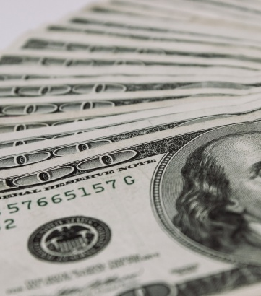
Research Funds and Financial Matters

Slide 27
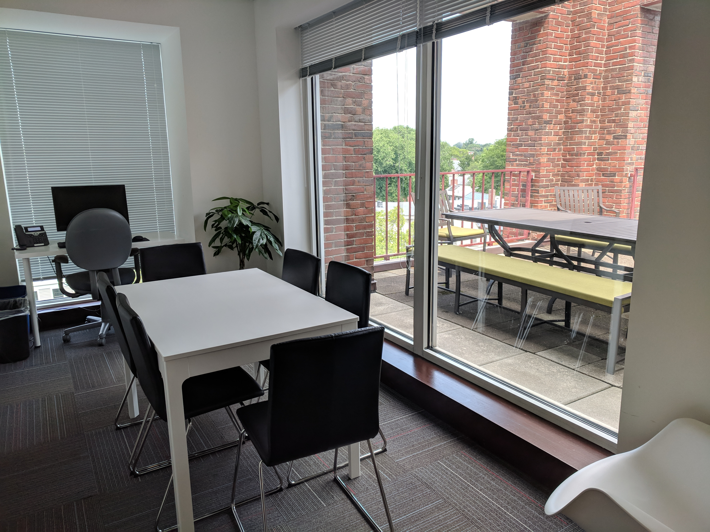
Money Matters
How do reimbursements work? Typically, you spend your own money, and then apply for reimbursement.
RECEIPTS ARE REQUIRED for reimbursement.
Research funds cover expenses incurred between September 1, 2019 and May 30, 2020.

Slide 28
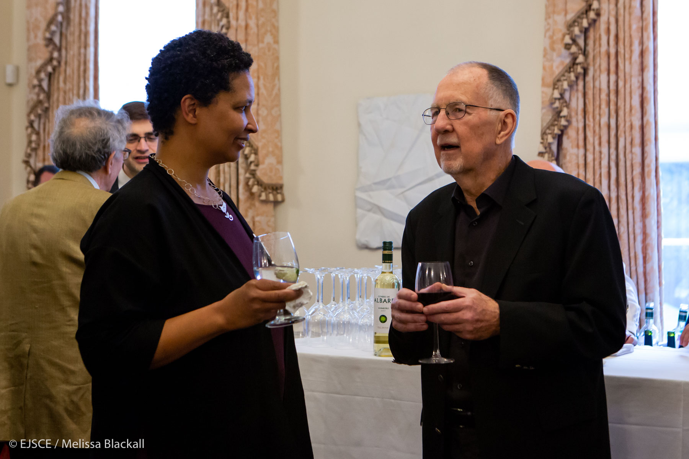
Reimbursement materials must be submitted 60 DAYS from the date of purchase, except in the case of travel expenses.
Year-end “spend down” of funds and bulk purchases are not permitted.

Slide 29
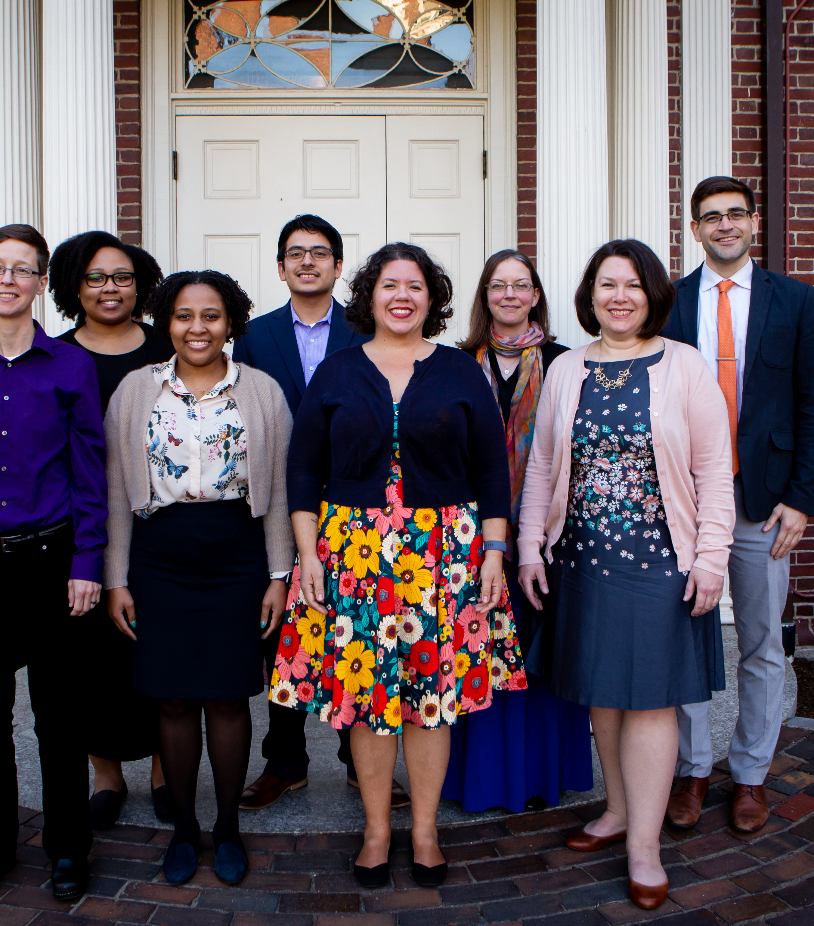
Directing Your Questions

Slide 30
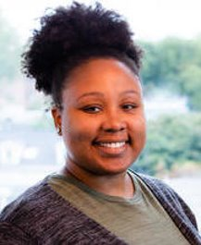
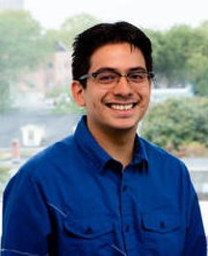
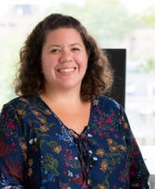
Directing
Your
Questions
If you need to know about...
Events
Finance
Communications
Ask...
Vickie
Emiliano
Maggie

Slide 31
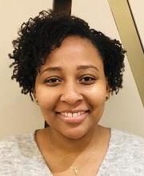
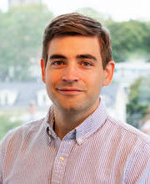
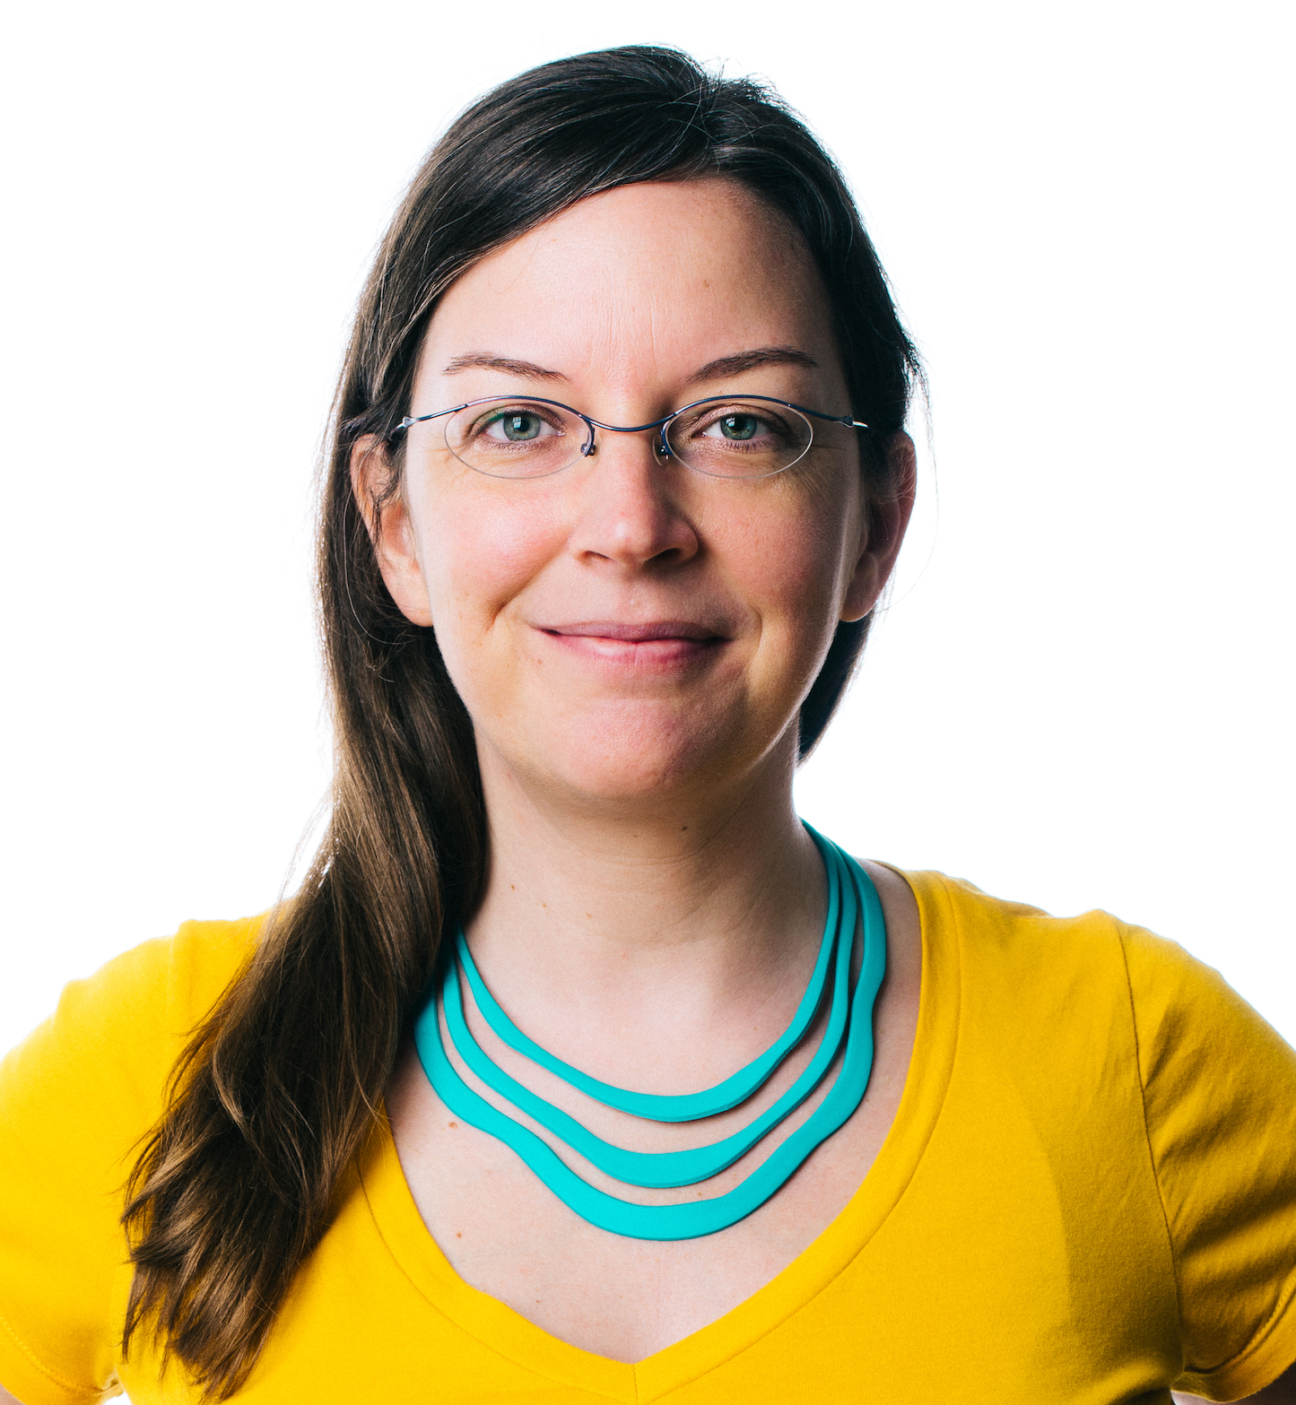
Directing
Your
Questions
If you need to know about...
Danielle's Time
Appointments & HR issues
Civics/DKP
Ask...
Cherise
Stephanie
Michael

Slide 32
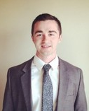
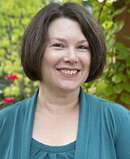
Directing
Your
Questions
If you need to know about...
Mail and Front Desk, Printer Issues, Building Maintenance
Everything Else
Ask...
Sam
Emily

Slide 33
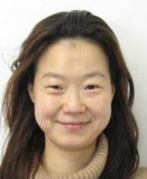
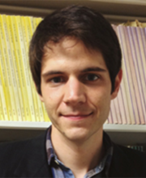
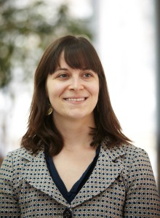
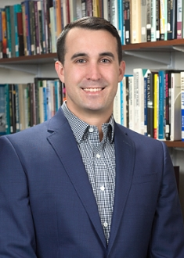
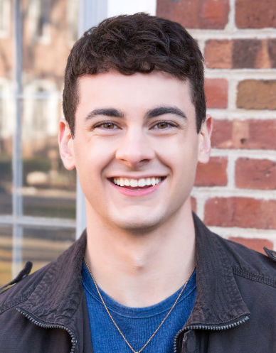
Other Friendly Faces
Some of the Initiative Staff You Will See Around the Office
Chaebong
David
Katie
Jake
Brian

Slide 34

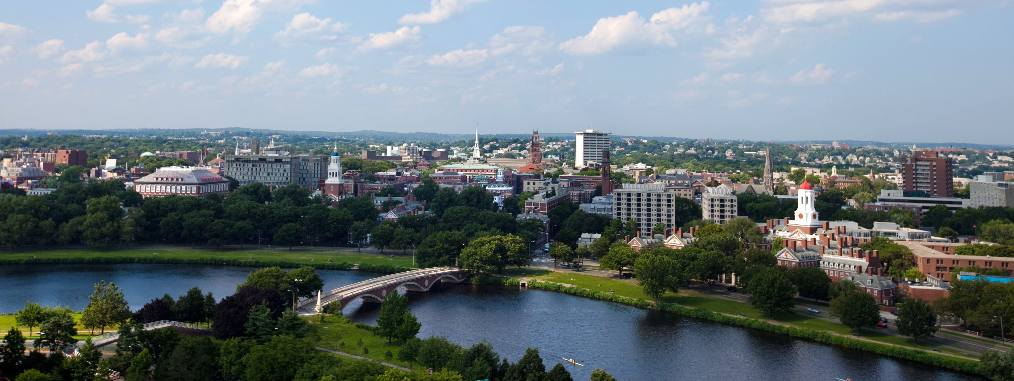
Questions?

Slide 35
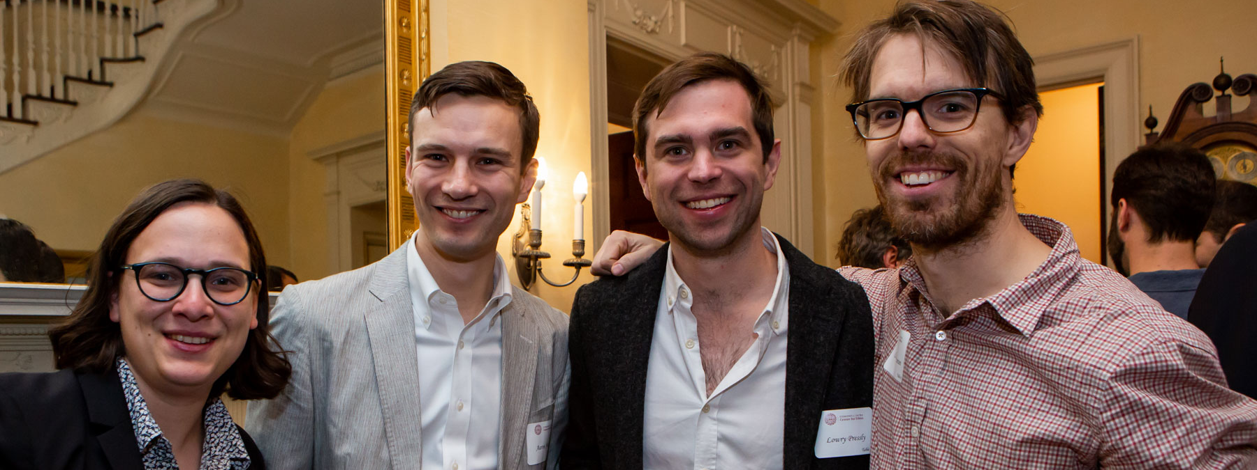
THANK YOU

Slide 36
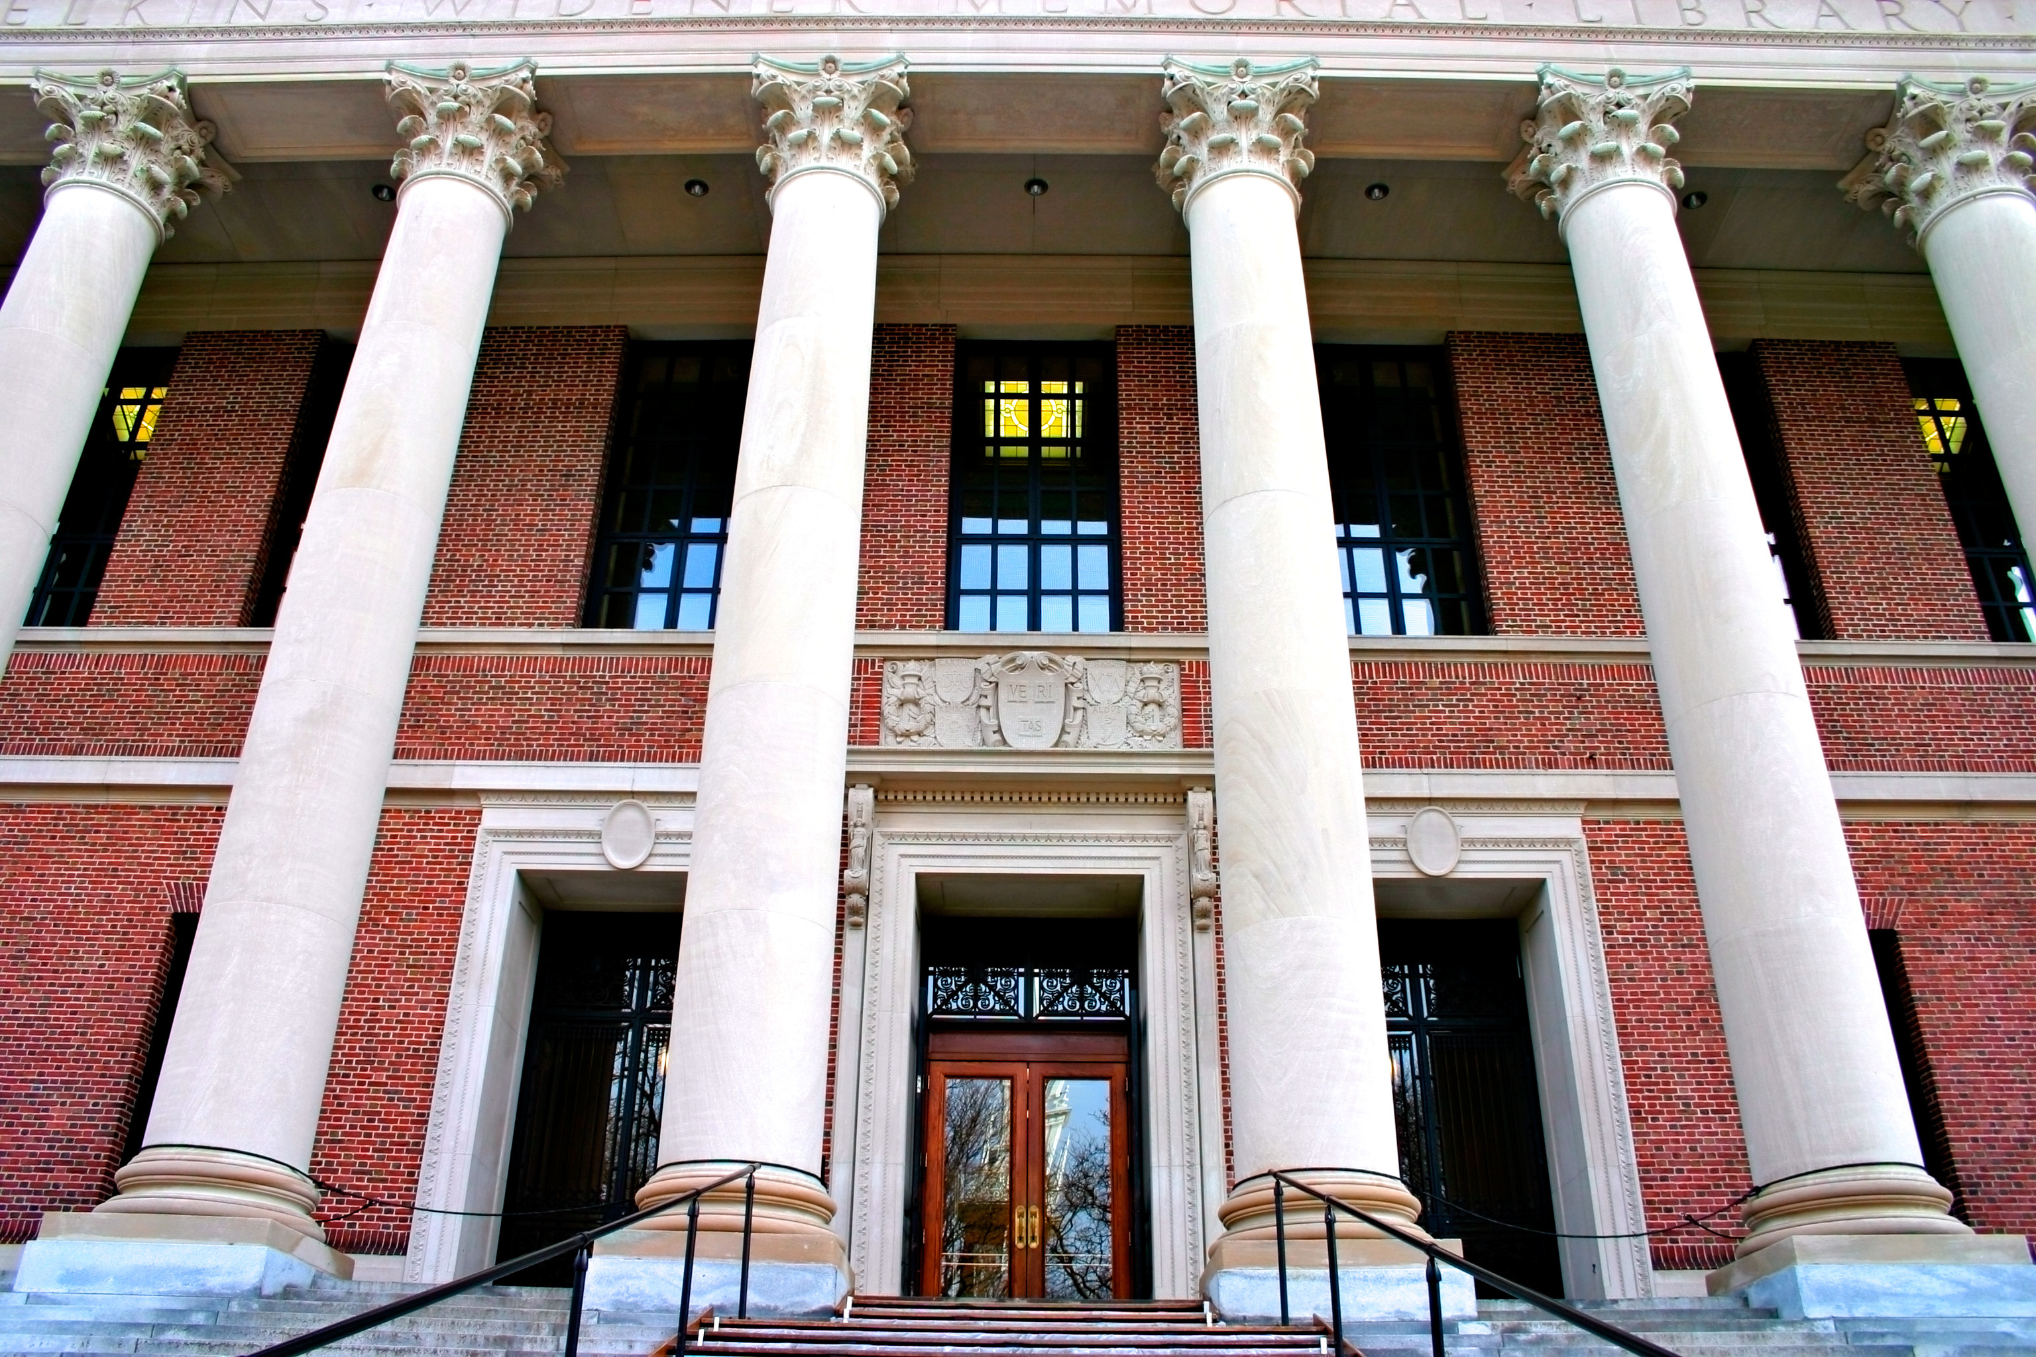
Library Orientation https://library.harvard.edu/services-tools
Meet in Widener room 240 at 3:15 pm or walk over with Emily

